Slide 1
Library consortia: a power in the land
Dr Hazel Woodward
University Librarian
& Director of Cranfield Press
Cranfield University
Presentation to the EKUAL Conference, Turkey, May 2011

Slide 2
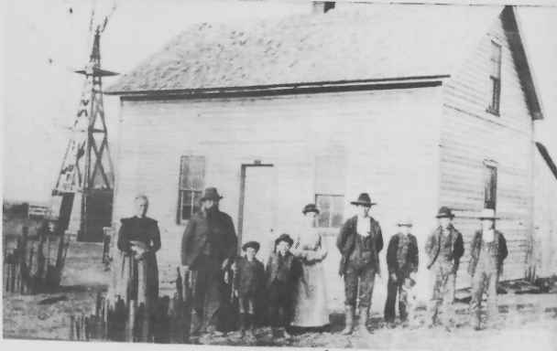
There is nothing new about library co-operation
Interlibrary loan: In 1898, the University of California Librarian announced he was willing to lend to other libraries who were willing to reciprocate
Catalogues: In 1901 the first regional union catalogue was developed at California State Library

Slide 3

The first ‘real’ library consortium?
In the later 1980s the first US state-wide consortium – OhioLink – was established
Received widespread attention as they were able to obtain additional state funding for their cooperative work

Slide 4

The role of consortia
“Consortia are like snowflakes, each one is unique” (Merryll Penson, Galileo)
What do they do?
  Licensing & negotiation
  Union catalogues
  Interlibrary loan
  Cooperative collection development
  Shared storage
  Research projects
  Digital initiatives
  Training

Slide 5

CBUC, Spain
Consortium of Academic Libraries of Catalonia
10 full members, 8 associate members, mainly universities
Set up in 1996
Regional consortium but very active in Southern Europe
Digital Library of Catalonia: 11,200 e-journals; 8,000 e-books; 51 e-databases

Slide 6

UGC INFONET, India
Up to 172 HE institutions
Deals negotiated centrally, members then opt in and pay individually
A flat fee per member, overall discount by sliding scale dependent on number of members participating in a deal

Slide 7

JISC Collections, UK
Established as a mutual trading company in 2001
Members include all UK higher & further education institutions (over 180)
120 e-resources agreements and over 5.500 subscriptions. Including:
  36 agreements for e-journals
  Over 80 agreements for databases, e-books & multi-media resources
  20 archives licensed in perpetuity and available freely to all members

Slide 8
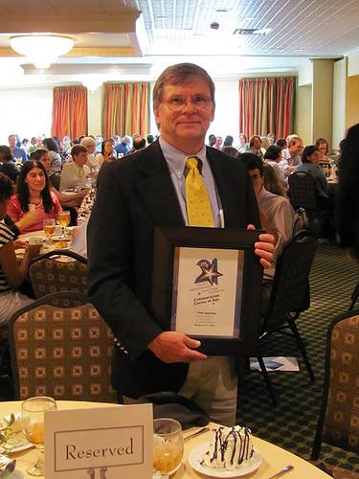
The consortium of consortia!
1996 the International Coalition of Library Consortia (ICOLC) formed in the US
First meeting in 1997 in St. Louis, Missouri
Now holds a Spring meeting in the US and an Autumn meeting in Europe
211 consortia from around the globe (Perry, 2009)
In the current economic situation, consortia are even more important than ever – we need to stand strong

Slide 9


Slide 10

The ICOLC Statement
Statement on the global economic crisis and its impact in consortial licenses (2009)
“We expect significant and widespread cuts in budget levels for libraries and consortia”
“These cuts will be prolonged”
“Library consortia are uniquely positioned to be the most effective and efficient means to preserve the customer base for publishers and create solutions that provide the greatest good for the greatest number. By working together, publishers and consortia can create the most effective pricing and renewal options and maintain the broadest base of subscribing libraries and services”

Slide 11

The changing face of consortia licensing
Many consortia are finding the “big deals” for e-journals are becoming unaffordable
They are approaching publishers to request more flexibility
Flexible pricing that offers customers real options, including the ability to reduce expenditure without disproportionate loss of content:
  Real price reductions
  Trade features for price
  Multi-year deals – opt outs
  Flexible payment options

Slide 12

What is wrong with the big deal?
Journals and the “big deals”
  e-journal big deals are consuming an ever increasing proportion
  of the acquisition budget
  larger publishers are flourishing at the expense of smaller publishers
  impact of the ‘big deal’ with year-on-year price increases & difficulty of making cancellations

Slide 13

Are consortia cancelling big deals?
At March 2011 ICOLC meeting in Austin, Texas it was agreed to undertake a journal cancellation survey
  How many packages have you already cancelled/ reduced?
  % reduction in spend
  % reduction in number of titles
  Did you replace this with title-by-title purchasing from same publisher?
  How many packages do you plan to reduce of cancel at next renewal?
The results will be presented at the Autumn ICOLC meeting in Istanbul

Slide 14

Consortia and e-books
Library book purchasing has reduced over a number of years
Many librarians think it is time to reverse this trend
Is it time for a radical re-think? (Kent Study: 40% of printed books had never circulated during 6 year period)
Are e-books the future? CIBER study shows the outlook for e-books is strong
New opportunities - customer-driven e-book purchasing

Slide 15

Consortia and e-databases
Abstracting & indexing services
  Internet search engines are the first port of call for students & researchers (CIBER, 2008; BL 2009)
  Google Scholar – utilising metadata from publishers & libraries – impact on A&I databases

Slide 16

The power of consortia
Despite the gloomy economic outlook there is no doubt that library consortia are a powerful voice for libraries and librarians
Publishers take heed of consortia and the ICOLC voice is listened to
We are all much stronger standing together - than standing alone

Slide 17

Value added services from consortia – JISC Collections
In addition to licensing content, JISC Collections provide a range of other value added services
  Research projects & studies
  Content delivery services
  Services to libraries
  Collaborative project with publishers

Slide 18

Research projects & studies
“The value of UK HEIs contribution to the publishing process”, JISC Collections, 2011
Peer review is essential to scholarly journal publishing
The number of articles being published (and thus reviewed) is rising & therefore the cost to universities is rising
The cost to UK universities is between £110 and £165 million ($176 and $264 million) per year
Editors & editorial boards cost UK universities up to £30 million ($48 million) per year
For comparison, UK universities spend between £113 and £121 million ($181 and $194 million) annually on journal subscriptions

Slide 19
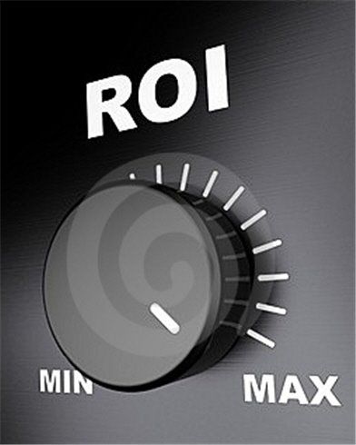
Research projects – Return on investment (ROI)
We need to better understand the value of libraries to research
“E-journals: their use value and impact”, RIN, 2009
  “There is a clear correlation between levels of use of e-journals and research outcomes, with more usage linked to the number of papers published, number of PhD awards and income from research grants and contracts”
We want to move on from simple ‘value for money’ to a study of ROI from libraries’ provision of access to scholarly journal articles
It is not enough just to know that articles are being downloaded, there is also a need for a better understanding of how articles are actually being used and their value to research
JISC Collections have commissioned Carol Tenopir to undertake a UK study

Slide 20

Projects -
Perpetual Access
  PEPRS - Piloting An E-Journals Preservation Registry Service
  EDINA Data Centre in Edinburgh is creating a working demonstrator for a registry of preservation locations for e-journals
  Working in partnership with the ISSN International Centre
  PECAN – Pilot for Ensuring Continuity of Access
  A project to scope the building of a registry of institutional entitlement to e-journals - post cancellation

Slide 21

Content delivery services
In addition to negotiating deals for current contents, JISC Collections also licenses large amount of ‘legacy’ content e.g. Early English Books Online, journal archives
This content is extremely valuable to UK researchers – but it is only accessible from lots of different places
Moreover, the range and diversity of interfaces makes for frustration and confusion particularly for the less experienced researcher

Slide 22
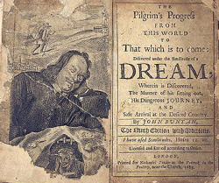
Historic Books Platform
The Historic Books Platform will comprise 3 separate collections:
    Early English Books Online (125,000 books)
    Eighteenth Century Collections Online (155,000 books)
    British Library books - digitised by Microsoft (65,000 books)
Work is currently underway to develop a proof of concept, cross-searchable interface

Slide 23
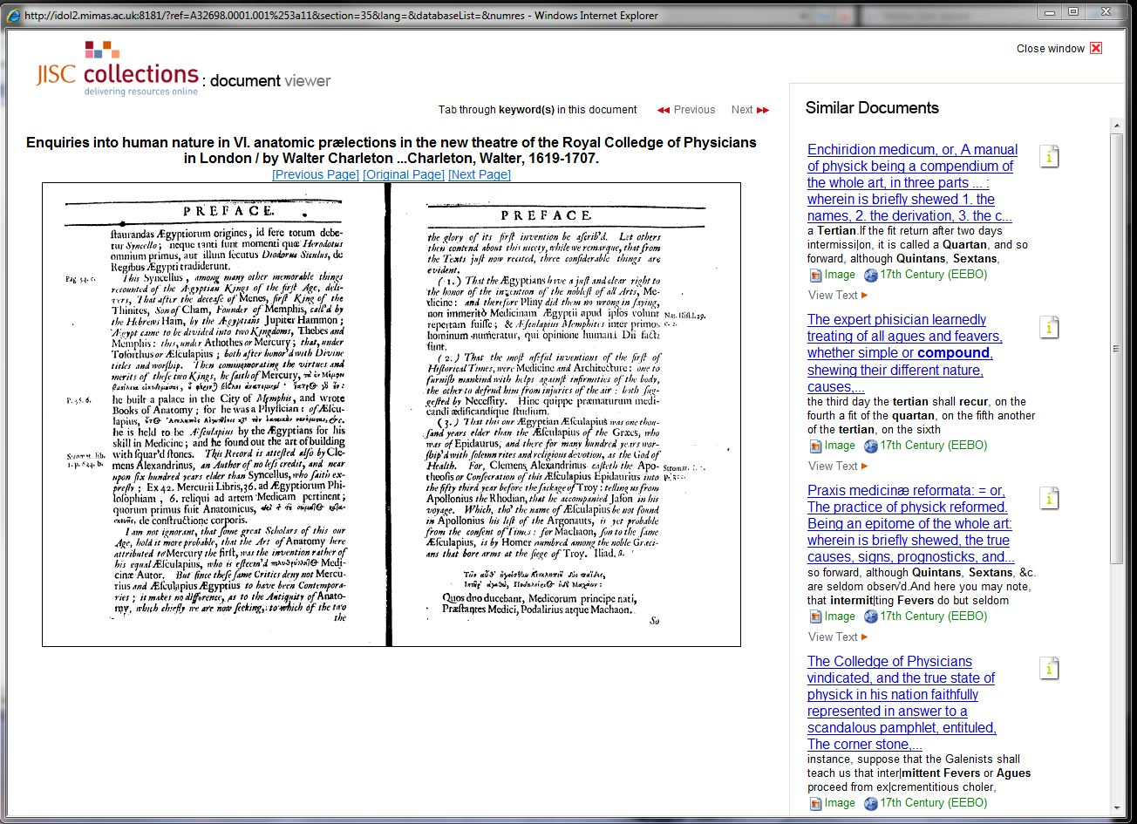
Historic Books Platform

Slide 24

UK Journals Archive
Archives of over 382 leading academic journals, containing in excess of 3,746,000 scholarly articles across the sciences, social sciences and humanities up to 2000
    Brill Journal Archive Online
    Institution of Civil Engineers (ICE) Virtual Library Archive
    IOP Journal Archive
    Oxford Journals Archive
    Periodicals Archive Online – JISC Collections Selection
    RSC Journals Archive
    Taylor & Francis Geography, Planning, Urban and Environment Online Archive
Launched January 2011
http://ukjournals.mimas.ac.uk
Notes:
data

Slide 25

Media Hub
Media Hub is a new JISC Collections service containing a collection of images of world events of the last 25 years
Aim is to support teaching and learning in UK universities
The real value-added service is the procurement of high-quality metadata, including geo-tagging and strict quality assurance procedures

Slide 26

Haiti Earthquake
Haiti Earthquake

Slide 27
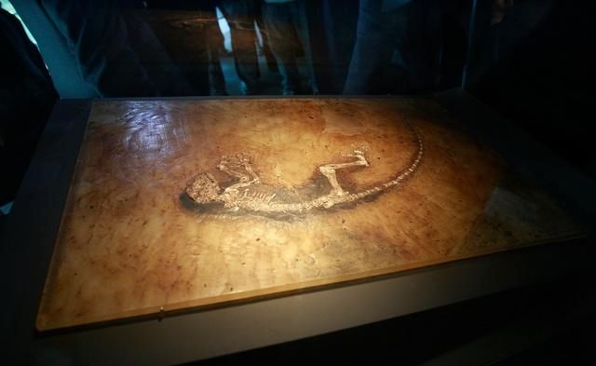
World’s most complete fossil primate found, 2009
The world’s most complete fossil primate found in 2009

Slide 28

Services for libraries
Academic Databases Assessment Tool (ADAT)
Compare journal titles lists covered by databases and the features of different databases
Drill into the ‘dashboard’ for a given database and find:
  Total number of titles
  Publication types
  Top 10 languages occurring in the database
  Top 10 publishers occurring in the database
“Neat site – check it out”
The Distant Librarian Blog, July 2009

Slide 29
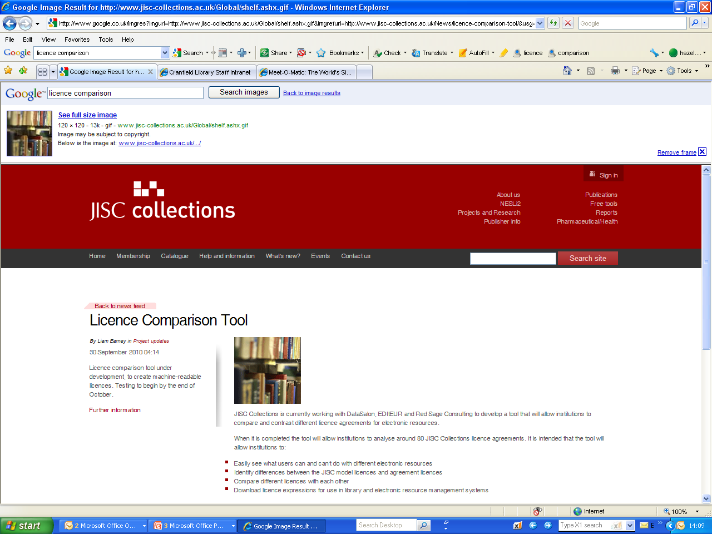
Services for libraries
Licence Comparison Tool
Creation of machine-readable ONIX licences for JISC deals
Libraries can download licences to their own ERM
Use as a comparison tool to check, for example:
  The definition of an ‘authorised user’
  The definition of a ‘site’
  Does the licence allow use of content in course packs
Huge value to libraries in terms of time saving and replication of effort

Slide 30
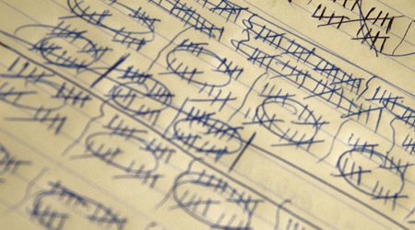
Services for libraries
JISC Usage Statistics Portal (JUSP)
Being developed to assist and support libraries in the collection and analysis of NESLi2 e-journal usage statistics and the management of their e-journals collections
20 NESLi2 e-journal publishers
132 universities
3 Intermediaries (gateways/hosts)

Slide 31
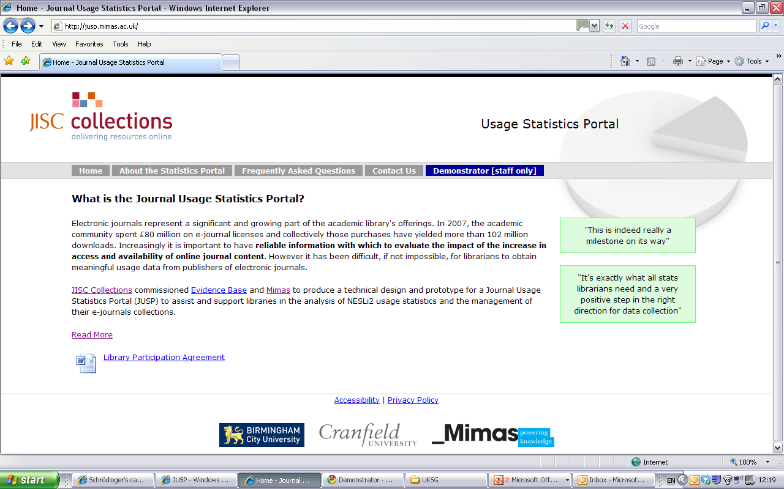
Notes:
JUSP : https://www.jusp.mimas.ac.uk/
Manchester
Mimas pmeehan/naheemp
http://cclibweb-2.dmz.cranfield.ac.uk/juspguest/
Guest/guest
jisc/??????????

Slide 32
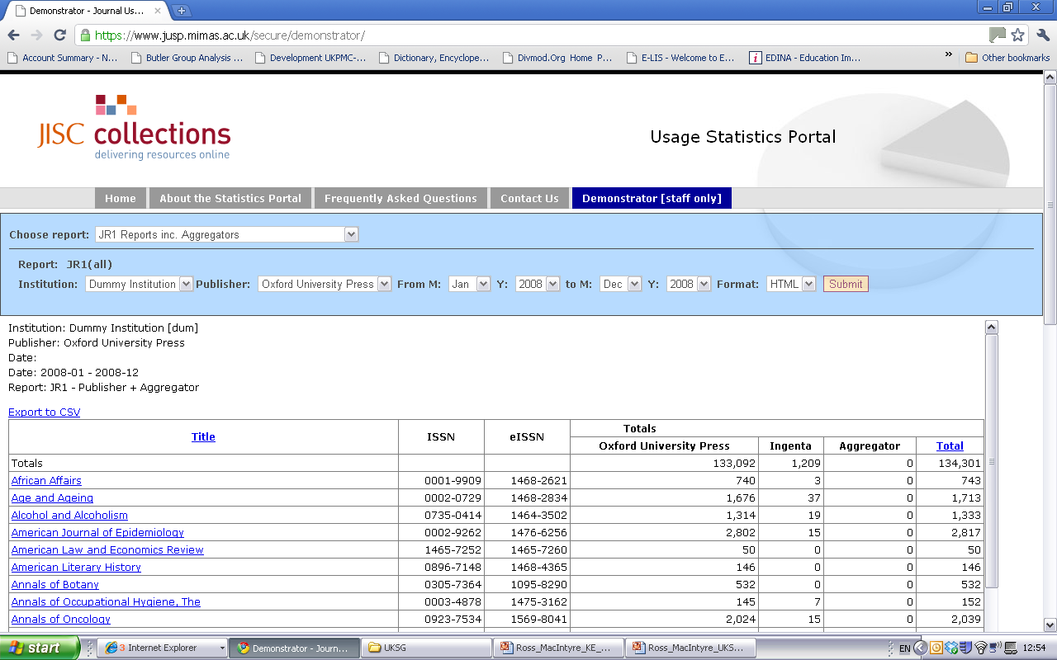

Slide 33

Services for libraries - JUSP
Usage data is even more important to librarians in the current economic climate
JUSP will provide a service which:
  Does the task of usage data collection once for many libraries
  Is a huge time-saver & a huge effort saver for librarians
  Does the task of implementing SUSHI once for many libraries
  Allows benchmarking
“It’s exactly what all stats librarians need and a very positive step in the right direction for data collection”
SCONUL (Society of College, National and University Libraries)

Slide 34


