Slide 1
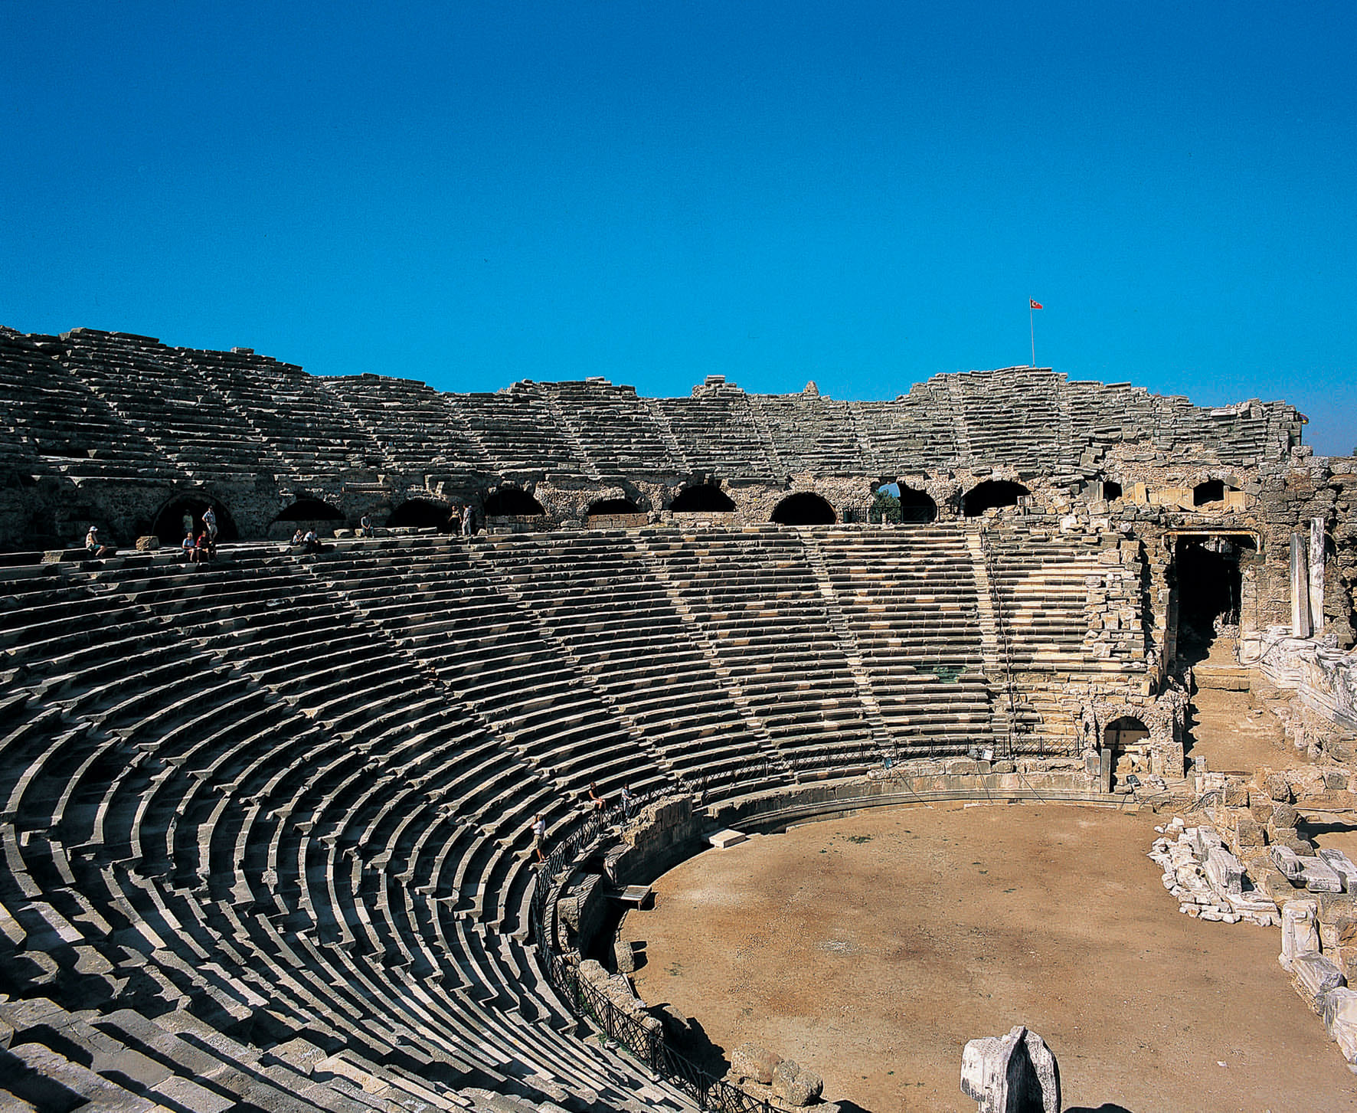
EKUAL, Antalya 23-25 May 2011
Taylor & Francis – world initiatives
Rod Cookson, Editorial Director

Slide 2
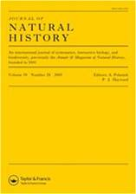
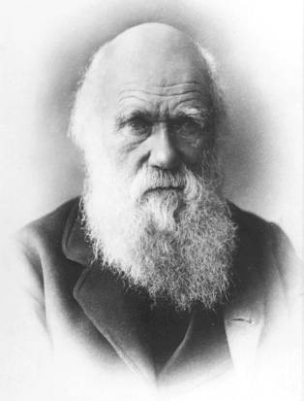

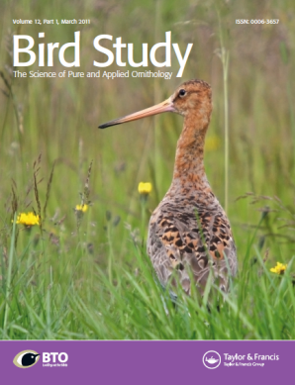
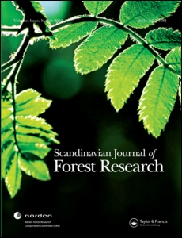
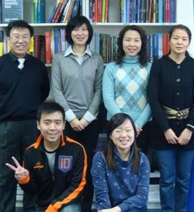
Who are we?
Publisher of scholarly journals since 1798
Heritage – T&F authors include Charles Darwin, Sigmund Freud, Albert Einstein, Alfred Russel Wallace, Sir Humphry Davy, James Prescott Joule, Bertrand Russell and Claude Lévi-Strauss!
Scope – 1,562 journals across all subject areas
Collaborative – 460 society & university partners; 40 new societies joining T&F for 2011
Global – 20 offices incl. Philadelphia, Stockholm, Oxford, Beijing, Tokyo, Singapore and Melbourne
Quality – today we publish the top journal in 15 subjects; citations  15% for T&F jnls in 2009

Slide 3
1 Research in Turkey today

Slide 4
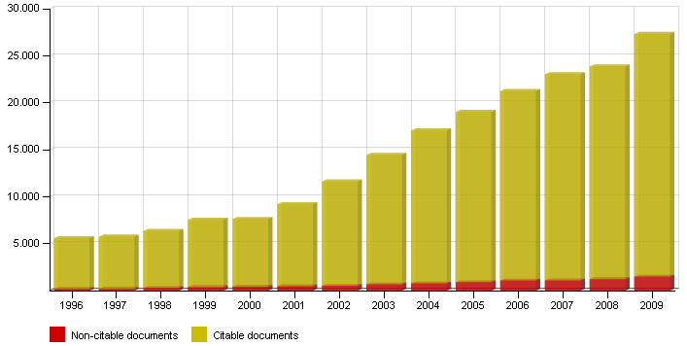
Turkish research output is growing fast
Turkish research  289% since 1996
Notes:
The CIBER-RIN report goes on to pose a series of interesting questions about reading behaviour and research outputs
This chart shows that for the 10 UK institutions studies, a strong negative correlation between reading time and research rating exists, ie better researchers read faster

Slide 5
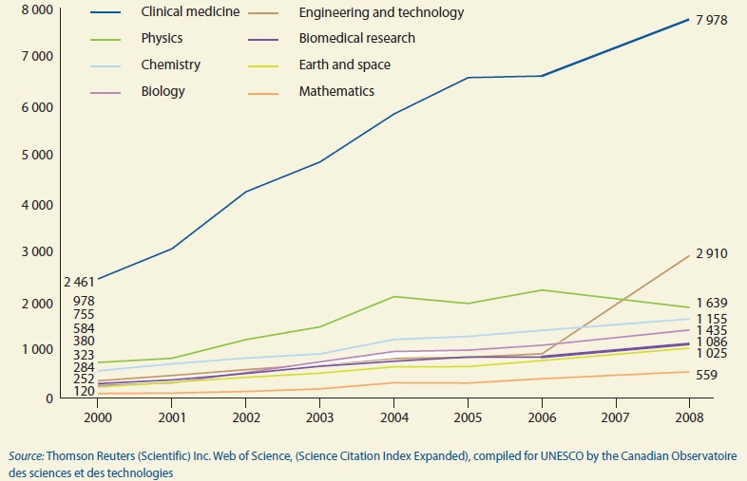
What are Turkey’s research specialities?
Notes:
The CIBER-RIN report goes on to pose a series of interesting questions about reading behaviour and research outputs
This chart shows that for the 10 UK institutions studies, a strong negative correlation between reading time and research rating exists, ie better researchers read faster

Slide 6
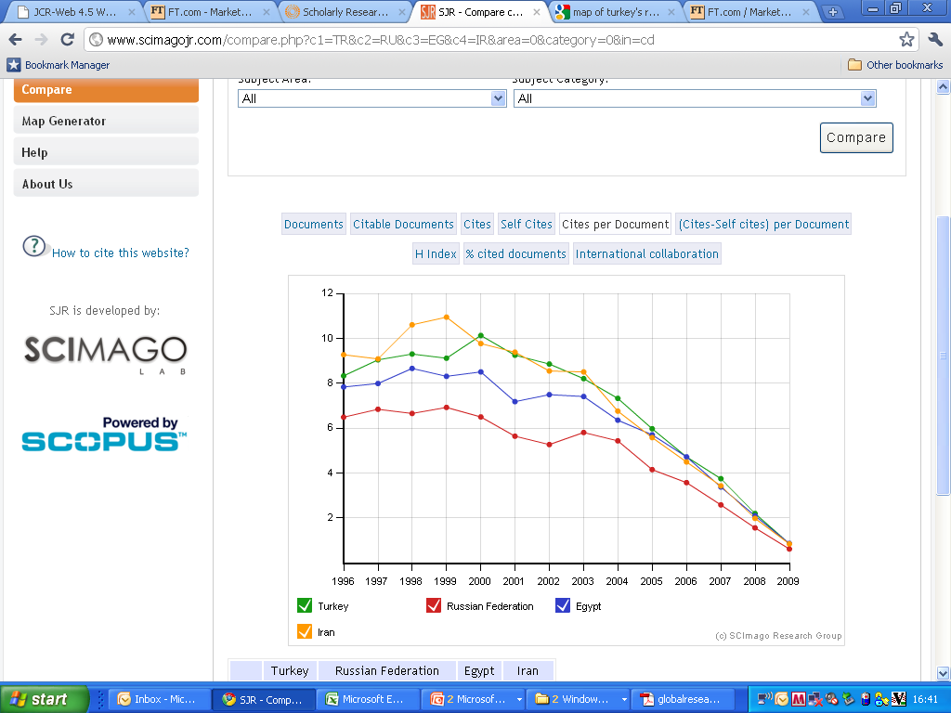
Quality matches regional competitors
Turkish papers cited as often as Iran; more than Russia or Egypt
Notes:
The CIBER-RIN report goes on to pose a series of interesting questions about reading behaviour and research outputs
This chart shows that for the 10 UK institutions studies, a strong negative correlation between reading time and research rating exists, ie better researchers read faster

Slide 7
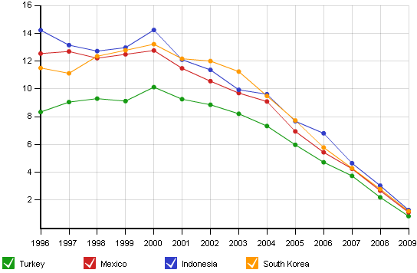
BUT trails emerging TIMS economies
Turkish research needs wider global exposure
Notes:
The CIBER-RIN report goes on to pose a series of interesting questions about reading behaviour and research outputs
This chart shows that for the 10 UK institutions studies, a strong negative correlation between reading time and research rating exists, ie better researchers read faster

Slide 8
“Since the majority of [Turkey’s] research is performed by universities, it is important to encourage ... the diffusion of knowledge generated by universities.”
UNESCO Science Report 2010

Slide 9
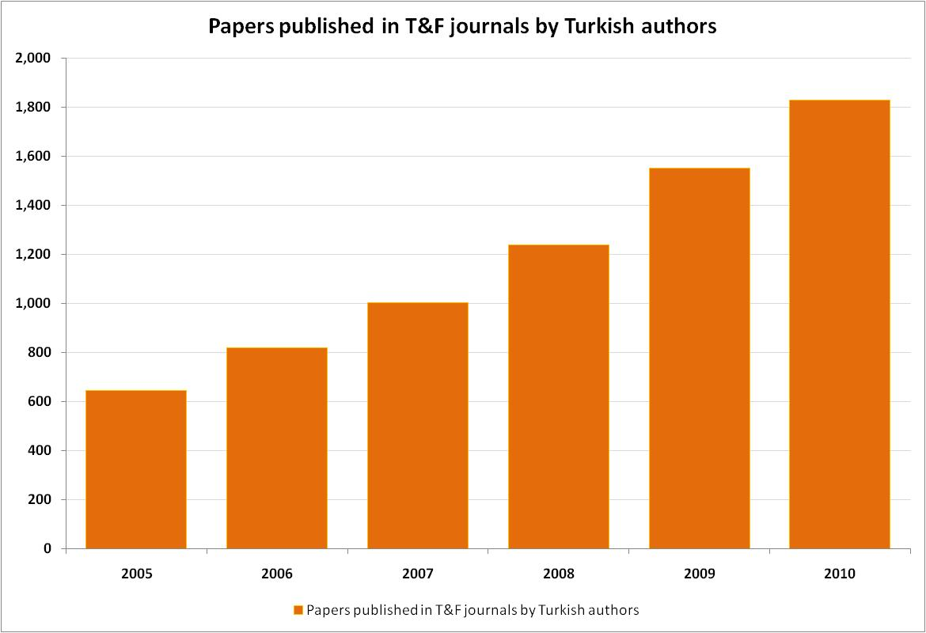
T&F is publishing more Turkish authors
T&F published 7.1% of all Turkish research papers in 2010 – up from 3.6% in 2005
Notes:
The CIBER-RIN report goes on to pose a series of interesting questions about reading behaviour and research outputs
This chart shows that for the 10 UK institutions studies, a strong negative correlation between reading time and research rating exists, ie better researchers read faster

Slide 10

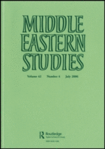
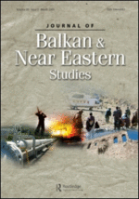
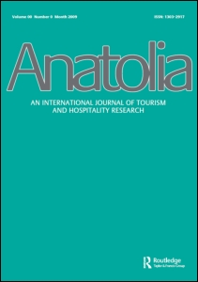
T&F journals on Turkey and region
Turkish Studies – published with the Global Research into International Affairs Center; accepted for JCR listing
Middle Eastern Studies – now in v47; JCR listed
Journal of Balkan and Near Eastern Studies – 2007 special issue on Turkey and EU, 2010 special issue on Turkish domestic and foreign policy; JCR listed
Anatolia (new to T&F for 2011) – edited from Anadolu and Mogla universities

Slide 11

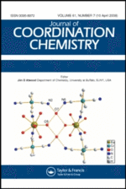


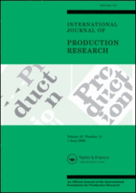
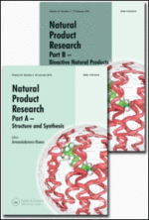

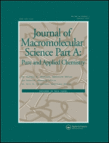

T&F journals with strong Turkish connection
Energy Sources, Part A – published 123 articles by Turkish authors in 2010!
Journal of Coordination Chemistry – 57 articles
Journal of Plant Nutrition – 43 articles
Separation Science and Technology – 41 articles
International Journal of Production Research – 36 articles
Radiation Effects and Defects in Solids – 31 articles
Natural Product Research – 30 articles
Journal of Macromolecular Science – 28 articles
British Poultry Science – 27 articles

Slide 12
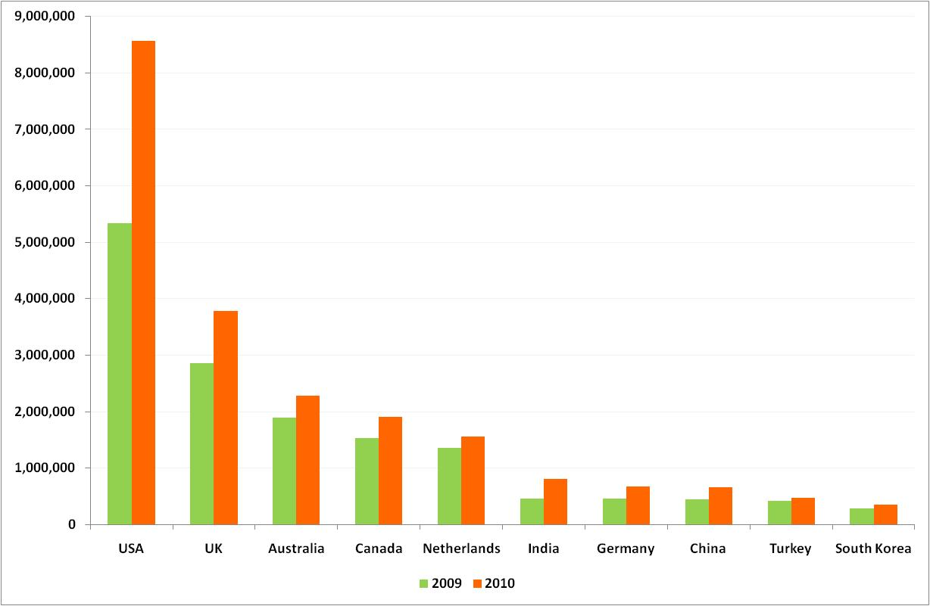
T&F usage from Turkey, vs other countries
Turkish researchers downloaded 479,378 articles from T&F in 2010 – one of our Top 10 users
Notes:
The surprises began when we ventured from core research activities
There was no interest in, or passion for, Open Access
Likewise, Web 2.0 was deemed irrelevant (life is too short)
Our senior researchers were also disparaging about their younger colleagues, who they felt lack adequate information skills
Enthusiasm was saved for subjects like ScholarOne Manuscripts Optima (which helps identify referees using data from Web of Science) and back digitisation – practical, bread-and-butter issues.

Slide 13
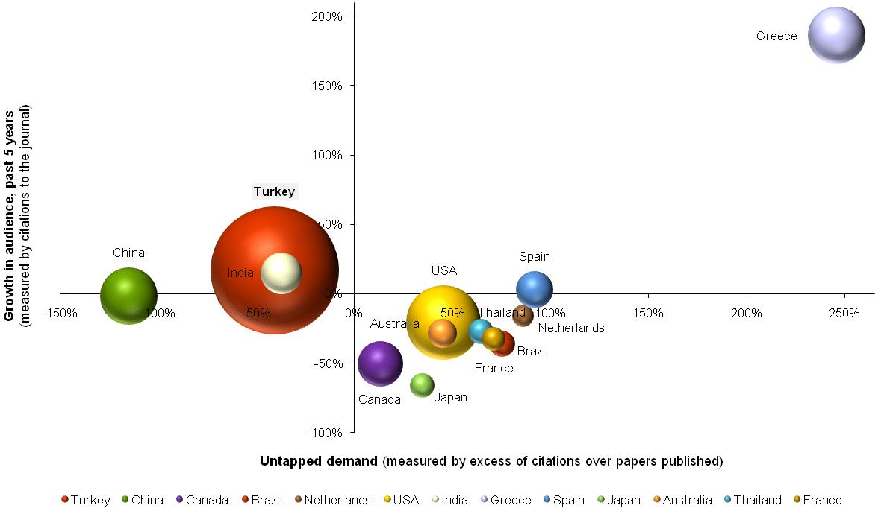
Case study – readership of Energy Sources
Energy Sources’ authors and readers predominantly Turkish
Notes:
The same sentiments carried on to online platforms. Researchers have little awareness of whose platform they are on.
The journal brand is key. This is what we have always believed ourselves, and is the basis of our Marketing strategy.
The role of publishers, like that of librarians, is to be invisible unless problems arise
The group articulated a strong desire for simple, quick and reliable online services, with little appetite for ‘bells and whistles’. Our CIBER facilitators characterise this as ‘fast bag pickup’ – collect the article wanted with minimal interference and leave. They also call this behaviour ‘bouncing’.
One point summed up the attitude – it is good for online platforms to know what researchers like and suggest more (like Amazon), but personalisation features (like FaceBook) are intrusive and unwanted
Online pre-prints – papers posted online before typesetting and copy-editing for rapid dissemination – highlighted another dimension. Most attendees strongly liked them – but a few felt equally hostile. One size doesn’t fit all online

Slide 14
2 Taylor & Francis – excellent publishing services

Slide 15
The Taylor & Francis publishing vision
High quality production – benefits from technology with human checking to maximise quality
Continuous innovation online – enhancing platform to ensure that researcher and librarian needs are met
Vigorous, targeted Marketing – combining proven, trusted strategies with smart new technologies
Global sales reach – moving toward Universal Access
Friendly, professional staff – service with a smile!
Result – building revenue whilst optimising readership and citation of our authors’ research

Slide 16
What do authors think of T&F?
Authors rate our Production services highly...

Slide 17
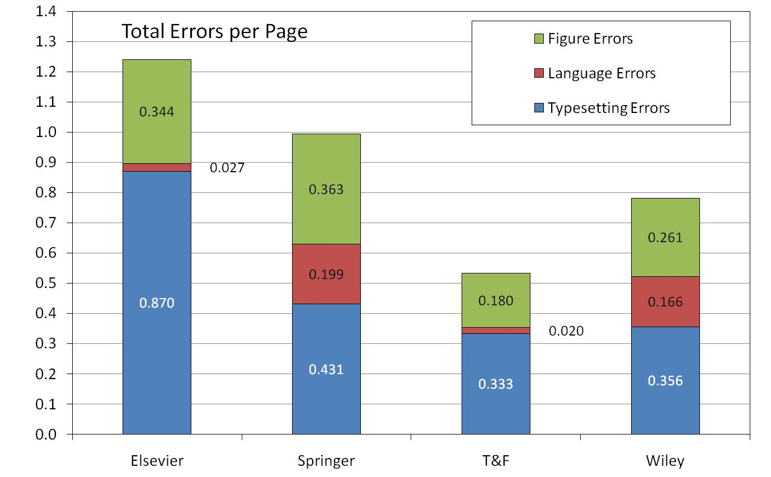
How do our Production services compare?
...because we are good at Production!

Slide 18
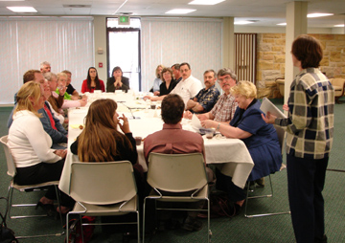
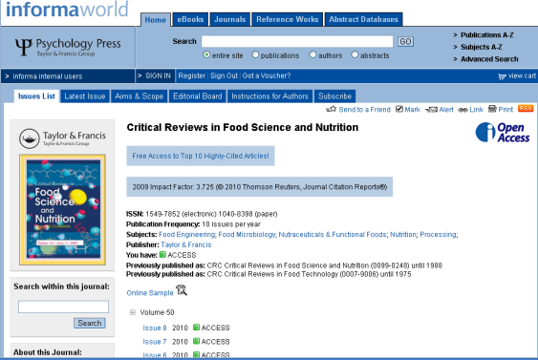
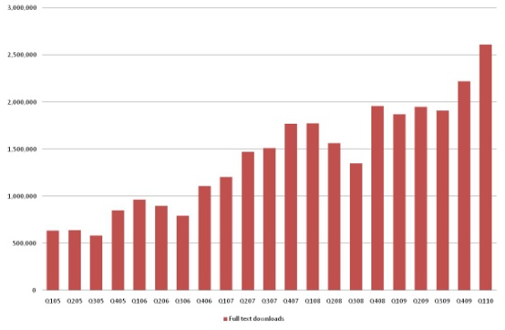
Continuous improvement of InformaWorld
Focus groups in USA and UK to clarify user requirements
Global survey to identify future needs
New releases of IW every two months
Now faster, simpler, more reliable
Presentation of related articles being improved – aiding serendipity & navigation
Organic usage growth in 2010 of 38% –double improvement in 2009
Further enhancement of IW speed, interface and reliability in 2011
Notes:
IW has always been a work in progress – and always will
We have held subsequent focus groups to nail down priorities, in the US and UK
Regular updates of the platform are now being rolled out
We have simplified IW pages, making them faster to load, and now have more servers with better design to improve reliability
Details like related article display are being redesigned to make them more useful
Usage is already 33% higher in 2010 on like-for-like titles. The improvements are working.
There’s more to come in Q1 2011, with major enhancement of the platform

Slide 19
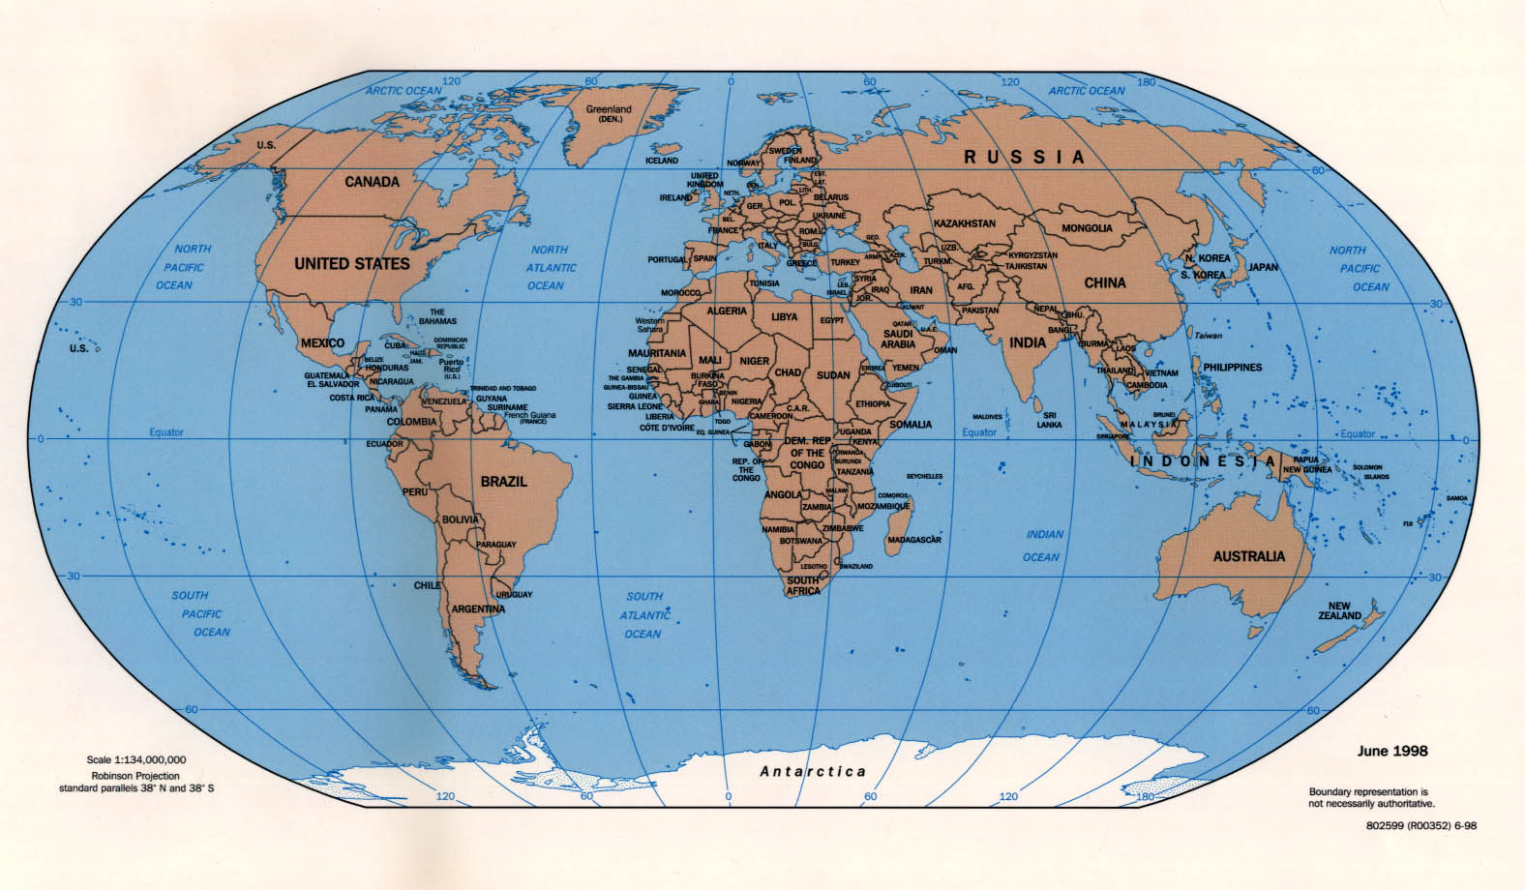
Moving towards Universal Access
1,590 institutions have access via sales deals, 12,000+ via EbscoHost
Sales Deals and Institutional Subscription Access
Developing Country Access
Institutional Subscription Access
Ebsco Publishing Access

Slide 20
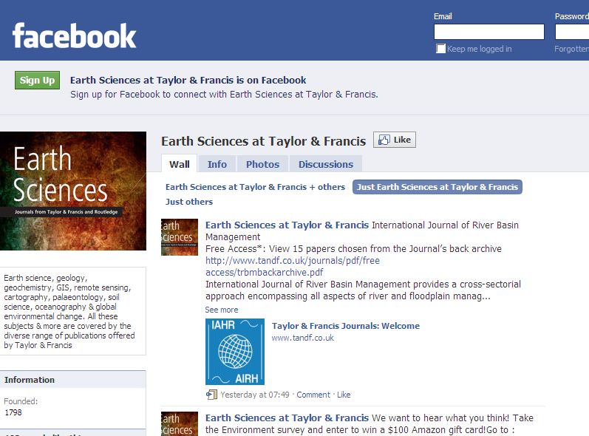
Earth Science FaceBook page
And other social media??
1,300+ people ‘like’ our wall, 1,127 monthly active users
3,000+ visitors last week
Notes:
IW has always been a work in progress – and always will
We have held subsequent focus groups to nail down priorities, in the US and UK
Regular updates of the platform are now being rolled out
We have simplified IW pages, making them faster to load, and now have more servers with better design to improve reliability
Details like related article display are being redesigned to make them more useful
Usage is already 33% higher in 2010 on like-for-like titles. The improvements are working.
There’s more to come in Q1 2011, with major enhancement of the platform

Slide 21
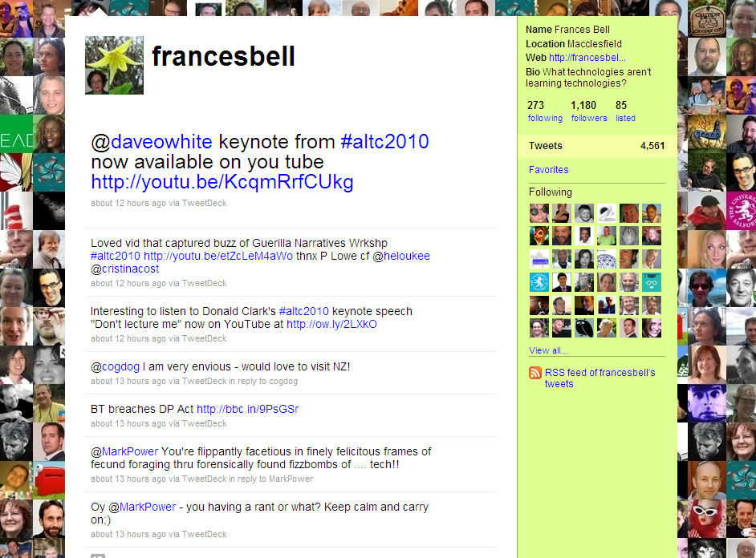
TwitterFeed set up by T&F for ALT-J Editor, Frances Bell – now 1,180 followers
Notes:
IW has always been a work in progress – and always will
We have held subsequent focus groups to nail down priorities, in the US and UK
Regular updates of the platform are now being rolled out
We have simplified IW pages, making them faster to load, and now have more servers with better design to improve reliability
Details like related article display are being redesigned to make them more useful
Usage is already 33% higher in 2010 on like-for-like titles. The improvements are working.
There’s more to come in Q1 2011, with major enhancement of the platform

Slide 22
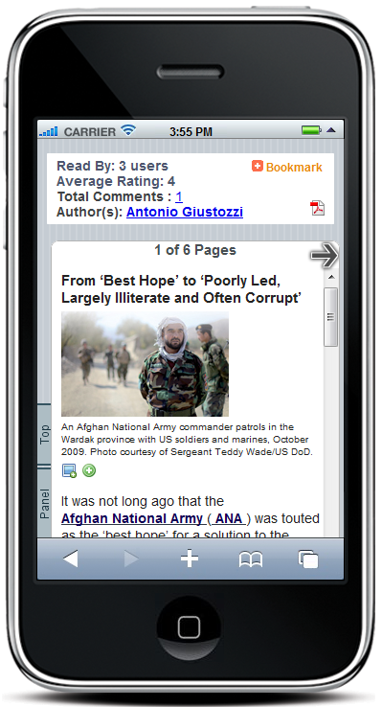
iPhone application rolled out for IISS by T&F early in 2010
Notes:
IW has always been a work in progress – and always will
We have held subsequent focus groups to nail down priorities, in the US and UK
Regular updates of the platform are now being rolled out
We have simplified IW pages, making them faster to load, and now have more servers with better design to improve reliability
Details like related article display are being redesigned to make them more useful
Usage is already 33% higher in 2010 on like-for-like titles. The improvements are working.
There’s more to come in Q1 2011, with major enhancement of the platform

Slide 23
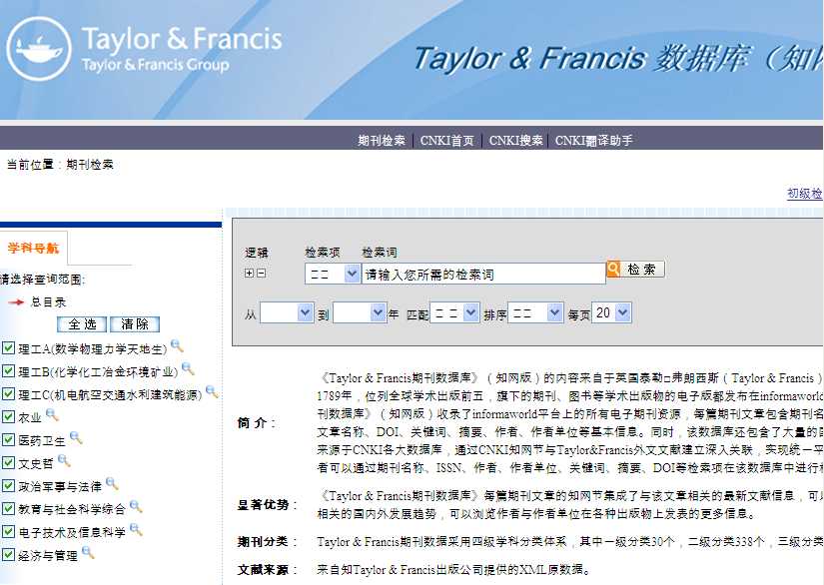
CNKI began indexing InformaWorld in early 2010 – now 30% of our China traffic, and rising fast!
Notes:
IW has always been a work in progress – and always will
We have held subsequent focus groups to nail down priorities, in the US and UK
Regular updates of the platform are now being rolled out
We have simplified IW pages, making them faster to load, and now have more servers with better design to improve reliability
Details like related article display are being redesigned to make them more useful
Usage is already 33% higher in 2010 on like-for-like titles. The improvements are working.
There’s more to come in Q1 2011, with major enhancement of the platform

Slide 24
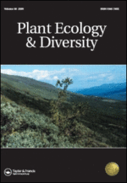
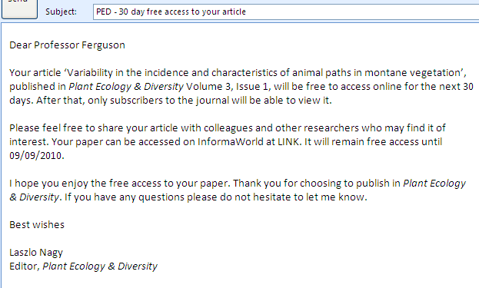
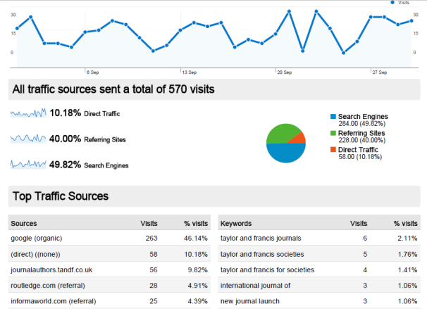
PE&D – encouraging authors to share articles
Trial programme in 2010
New articles in Plant Ecology & Diversity free to access for 30 days on publication
Authors e-mailed on publication, prompt to share access – reminder after 20 days
Recipients can access articles – or share with researchers in their field
Google Analytics to track results
Usage up 11% on first issue – conducted in summer, so may understate potential
64% of articles accessed during trial
Notes:
IW has always been a work in progress – and always will
We have held subsequent focus groups to nail down priorities, in the US and UK
Regular updates of the platform are now being rolled out
We have simplified IW pages, making them faster to load, and now have more servers with better design to improve reliability
Details like related article display are being redesigned to make them more useful
Usage is already 33% higher in 2010 on like-for-like titles. The improvements are working.
There’s more to come in Q1 2011, with major enhancement of the platform

Slide 25
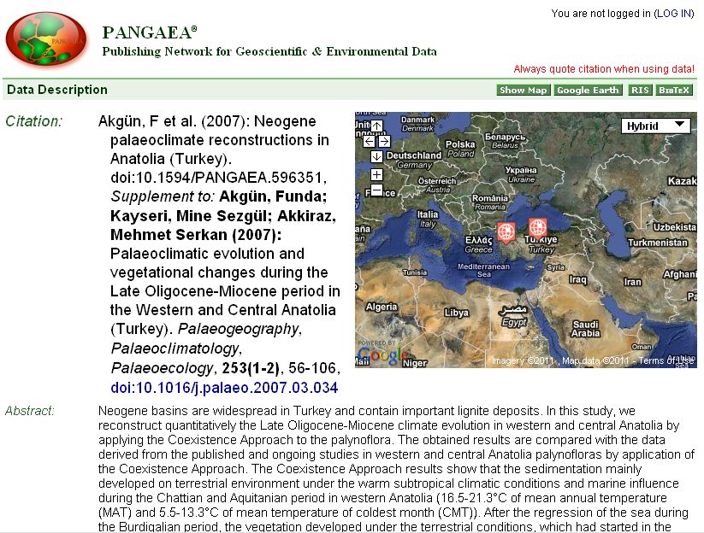
In talks with Pangaea to reciprocally link data and articles in IW
Notes:
IW has always been a work in progress – and always will
We have held subsequent focus groups to nail down priorities, in the US and UK
Regular updates of the platform are now being rolled out
We have simplified IW pages, making them faster to load, and now have more servers with better design to improve reliability
Details like related article display are being redesigned to make them more useful
Usage is already 33% higher in 2010 on like-for-like titles. The improvements are working.
There’s more to come in Q1 2011, with major enhancement of the platform

Slide 26
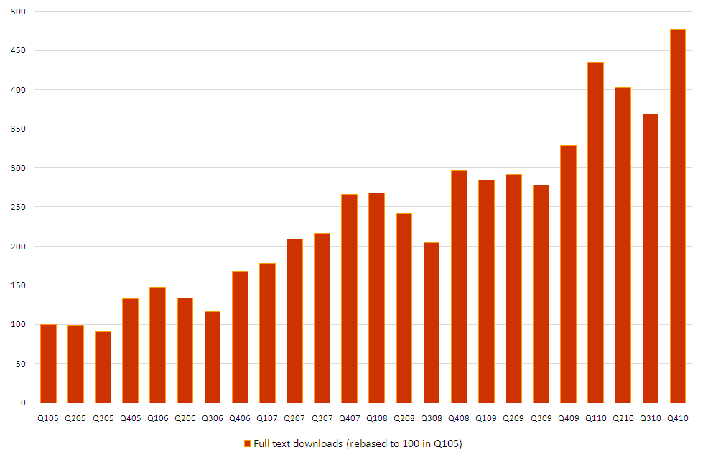
The end product – huge usage growth
Downloads of T&F journals  376% in five years!

Slide 27
3 Helping our partners achieve their goals

Slide 28



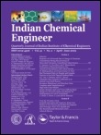
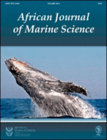
Co-publishing deals – mutual rewards
VGTU Journals – 10 journals for 2011, another 3 for 2012; 8 ISI-ranked
NISC – 10 journals; 9 ISI-ranked
UNISA Press – 22 Arts & Humanities journals
Anamaya Publishers – 5 journals
Partners get global reach,  readership and cutting edge publishing technology
T&F gains quality additions to portfolio
Our goal is to increase partners’ global presence and revenues – the platform for future success

Slide 29
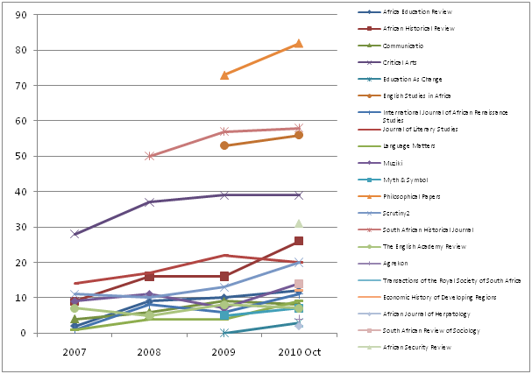
UNISA Press – international subscriptions 

Slide 30
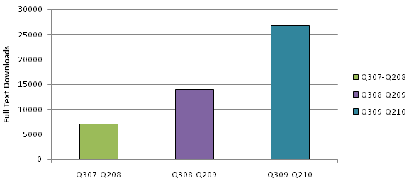
UNISA – online usage up 270% since 2007!

Slide 31
How would you describe T&F + Routledge?
“My experience was absolutely positive from initial contact with the guest editor to publication.”
“‘The process was very fast – I really appreciated it.”
Notes:
We thought we would give you a sneak preview of two comparatives slides from our Canadian survey
First, an attitudinal question on whether T&F is viewed as producing high quality publications in print and online
The response is very favourable, with over 90% of 1,336 respondents agreeing that we place great emphasis on this

Slide 32
T&F vs competitors – high quality publishing?
Notes:
We thought we would give you a sneak preview of two comparatives slides from our Canadian survey
First, an attitudinal question on whether T&F is viewed as producing high quality publications in print and online
The response is very favourable, with over 90% of 1,336 respondents agreeing that we place great emphasis on this

Slide 33
T&F vs competitors – aligned with community?
Notes:
Similarly, we are also viewed as closely aligned with the values of the research community, 78% of respondents agreeing vs 54% for NRC
We are seen as a friend of the community

Slide 34
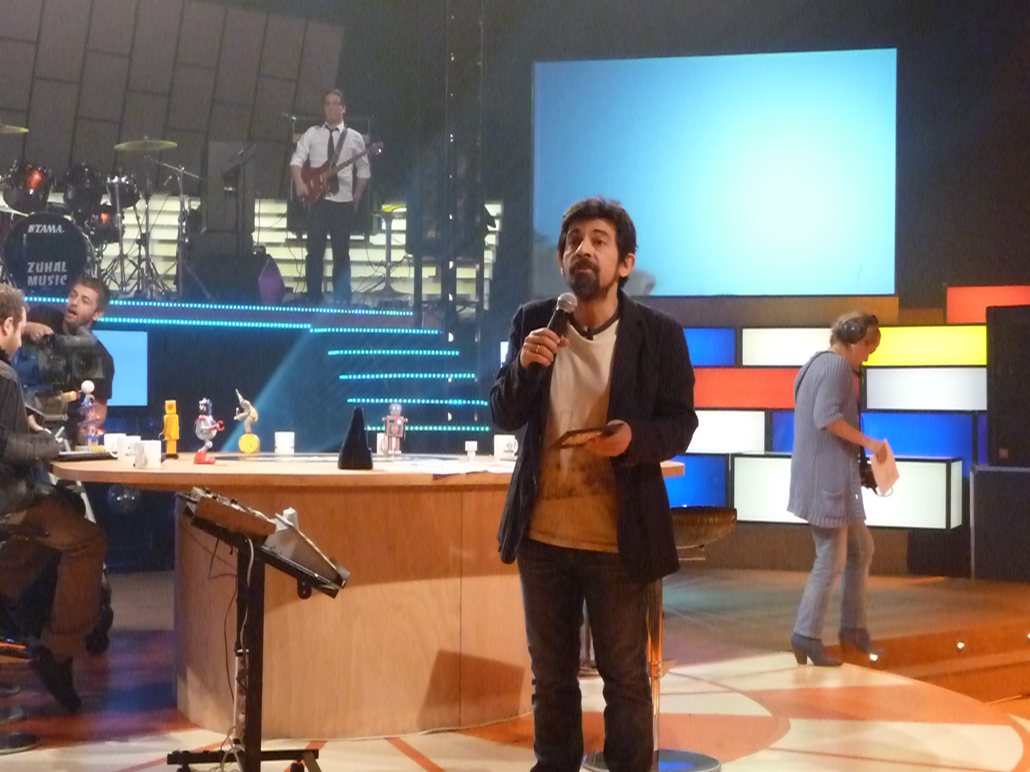
EKUAL, Antalya 23-25 May 2011
Teşekkürler! Herhangi bir sorunuz var mı?
Rod Cookson, rod.cookson@tandf.co.uk

