Slide 1
"New Trends in Science and Global Ecosystem"
“Bilimde ve Global Ekosistemde Yeni Trendler “
Ahmed Rostom
Customer Development Manager
MEA ,CIS, Turkey & Iran

Slide 2
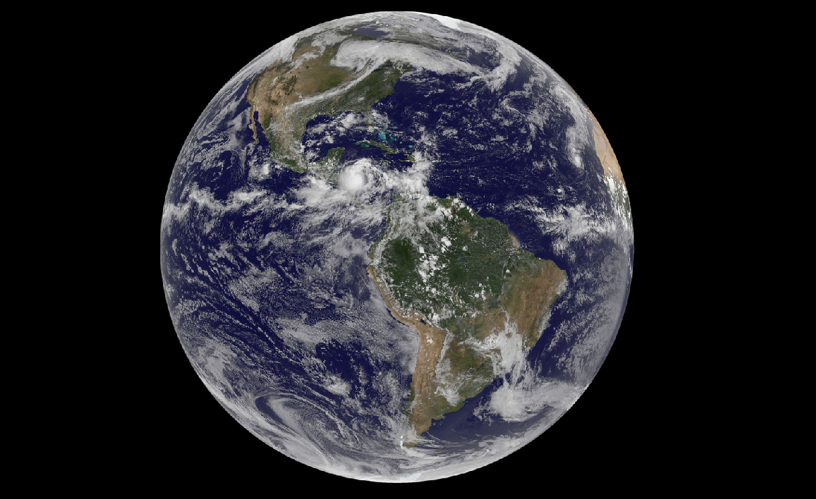
http://www.flickr.com/photos/gsfc/5021482046/sizes/l/in/photostream/
Notes:
Will the

Slide 3

http://www.flickr.com/photos/spursfan_ace/2328879637/sizes/l/

Slide 4
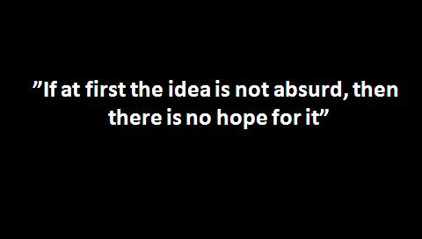

EGER BIR FIKIR ABSURT DEGILSE, ICINDE GELECEK ICIN BIR UMUT ICERMIYORDUR......
Notes:
Dr. Vela mentioned that we have to be imaginative

Slide 5
Notes:
Dr. Vela mentioned that we have to be imaginative

Slide 6
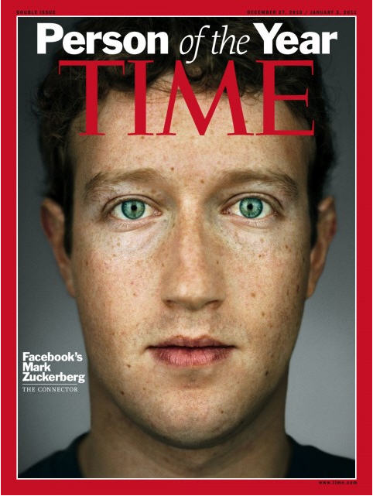

Notes:
But this guy who is responsible letting our partners, wifes and kids sending us be my friend emails gut the award.
But anyway compared to last year

Slide 7

Egypt 2011….
Notes:
There was a lot of indicators to the change .
When we planned the strategy to sell spotlight , we wanted the support of the community involved using the product.
We didnt aim for only the support of the Ministry !!!
Steps and plans were set for that

Slide 8

Egypt 2011

Slide 9

DEGISIM ...
Change ...
Notes:
Or the result would have been ... Like the picture .
We lost in 28 days
President
2 prime minesters
Lifes of 400 poeple
And we would have lost SciVal.....

Slide 10
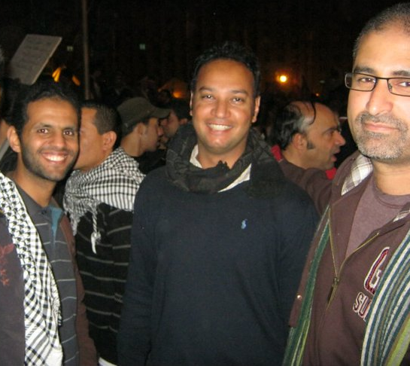
You are involved !!
SIZDE DEGISIMIN ICINDESINIZ !!

Slide 11

Notes:
In 2005 the world was flat

Slide 12
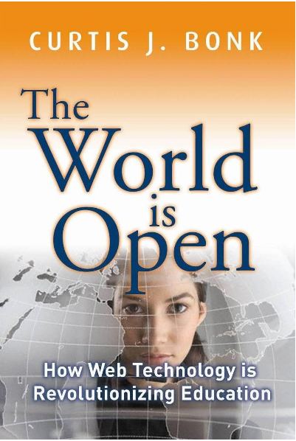
Notes:
Today the world is open, this opennes is not just changing education and our lives

Slide 13
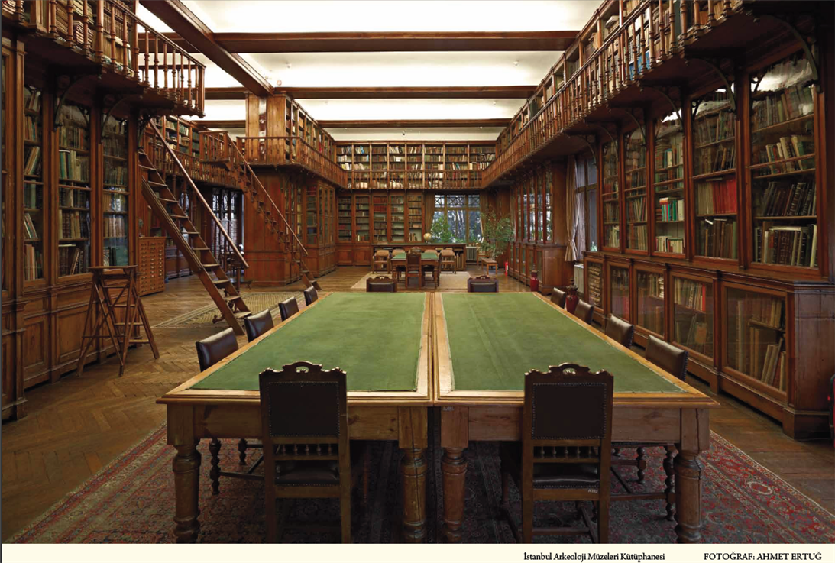
Notes:
With technology advances that we are seeing and changes that are happening he way that we are creating and consuming content, the books that we see in these shelfy eventually will be in our eraders

Slide 14
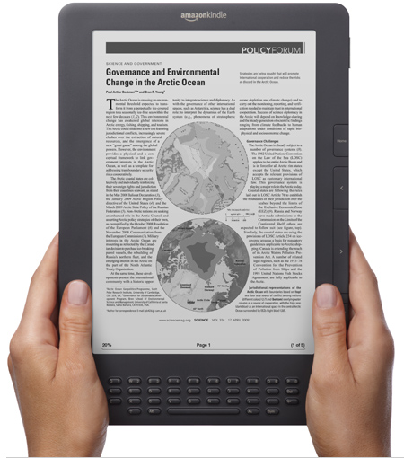

Slide 15
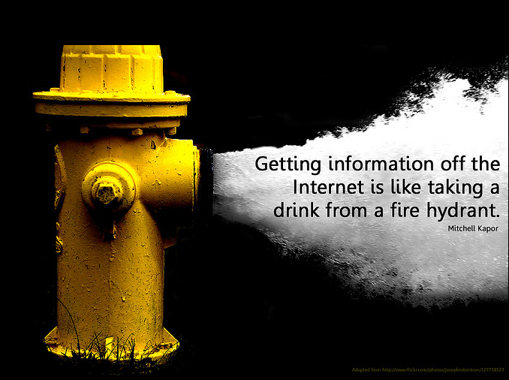

Slide 16
IINTERNETTEN BILGI EDINMEK, YANGIN MUSLUGUNDAN SU ICMEYE BENZEMEKTE.....

Slide 17
Information Overload?
“….Twenty years ago there were one-third as many journals in my field. Now it would take one day each week just to keep up . . .”
“….In a very popular topic, you may hit 500 articles. I try different queries and get 50-100, but only 20% are useful. It’s about the efficiency of the time you spend vs. the output….”
“….I’ve got 5,000 pdf files that I’ve downloaded on my computer, seriously. I’ve tried renaming them so that I can find the right one when I need it, but it hasn’t worked….”
17
Notes:
It has become almost a cliché that we suffer from information overload. There are too many journals, I can’t find what I need in this mountain of data. But look more closely at these comments and the problem isn’t too much information.
Early last year web luminary Clay Shirky coined another phrase with a talk he gave entitled “It’s not information overload, it’s filter failure.” The implication of this is that we need better ways to keep irrelevant information out. Is that what we’re seeing here? Is the solution to apply more filters to the information available, to keep out all the irrelevant information researchers don’t need so they have less to sift through?
There are many ways to do this but better filters aren’t the only solution to the problem. Ask the researcher who is missing the one critical fact or insight he needs to have a breakthrough if he is suffering from having too much information.

Slide 18


Filter Failure?
Q
A
How many hours per week searching and gathering information?
Q
A
How many hours per week organizing, analyzing and applying information?
Researchers spend more time looking for information
than analyzing and applying it.
Source: 2007 Survey by Outsell Inc. on 6,300 knowledge workers
18
Notes:
What is the state of research today? This statistic gets a lot of press because it exposes something that fundamentally just feels wrong - the average researchers still spends more time gathering information than actually doing science. We are in the second decade of the mass internet, virtually all the information a researcher could need is online and available through specialized databases or the wider web, we have incredibly powerful and intelligent search software combined with instant online access to most information, and yet this secondary task still occupies more time than the actual practice of science for most researchers. Why is this?

Slide 19
Filter Failure?
Q
A
How many hours per week searching and gathering information?
Bilgiyi bulmak ve biraraya getirmek icin haftada kac saat harciyoruz ?
Q
A
How many hours per week organizing, analyzing and applying information?
Bilgiyi organize etmek,analiz etmek ve uygulmak icin haftada kac saat harciyoruz?
Researchers spend more time looking for information
than analyzing and applying it.
Source: 2007 Survey by Outsell Inc. on 6,300 knowledge workers
19
Notes:
What is the state of research today? This statistic gets a lot of press because it exposes something that fundamentally just feels wrong - the average researchers still spends more time gathering information than actually doing science. We are in the second decade of the mass internet, virtually all the information a researcher could need is online and available through specialized databases or the wider web, we have incredibly powerful and intelligent search software combined with instant online access to most information, and yet this secondary task still occupies more time than the actual practice of science for most researchers. Why is this?

Slide 20
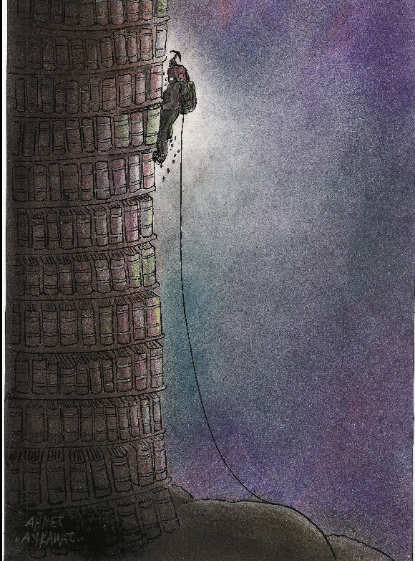

Slide 21
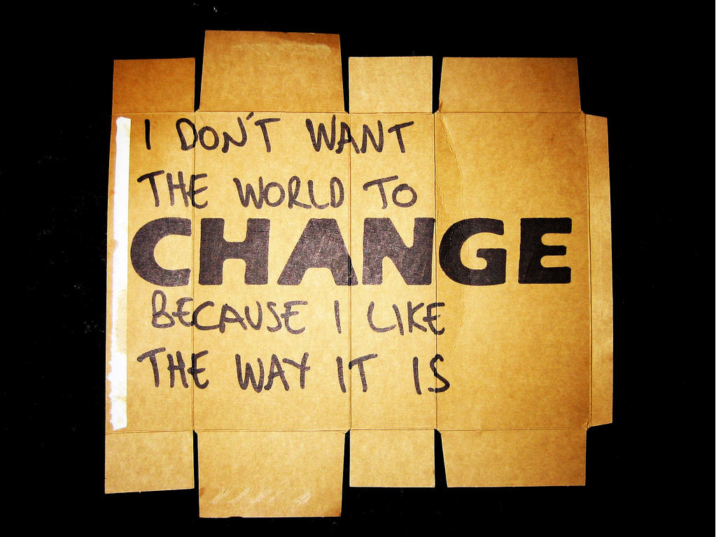
http://www.flickr.com/photos/alshepmcr/3972183138/sizes/l/
Notes:
We like it or not the world is changing

Slide 22
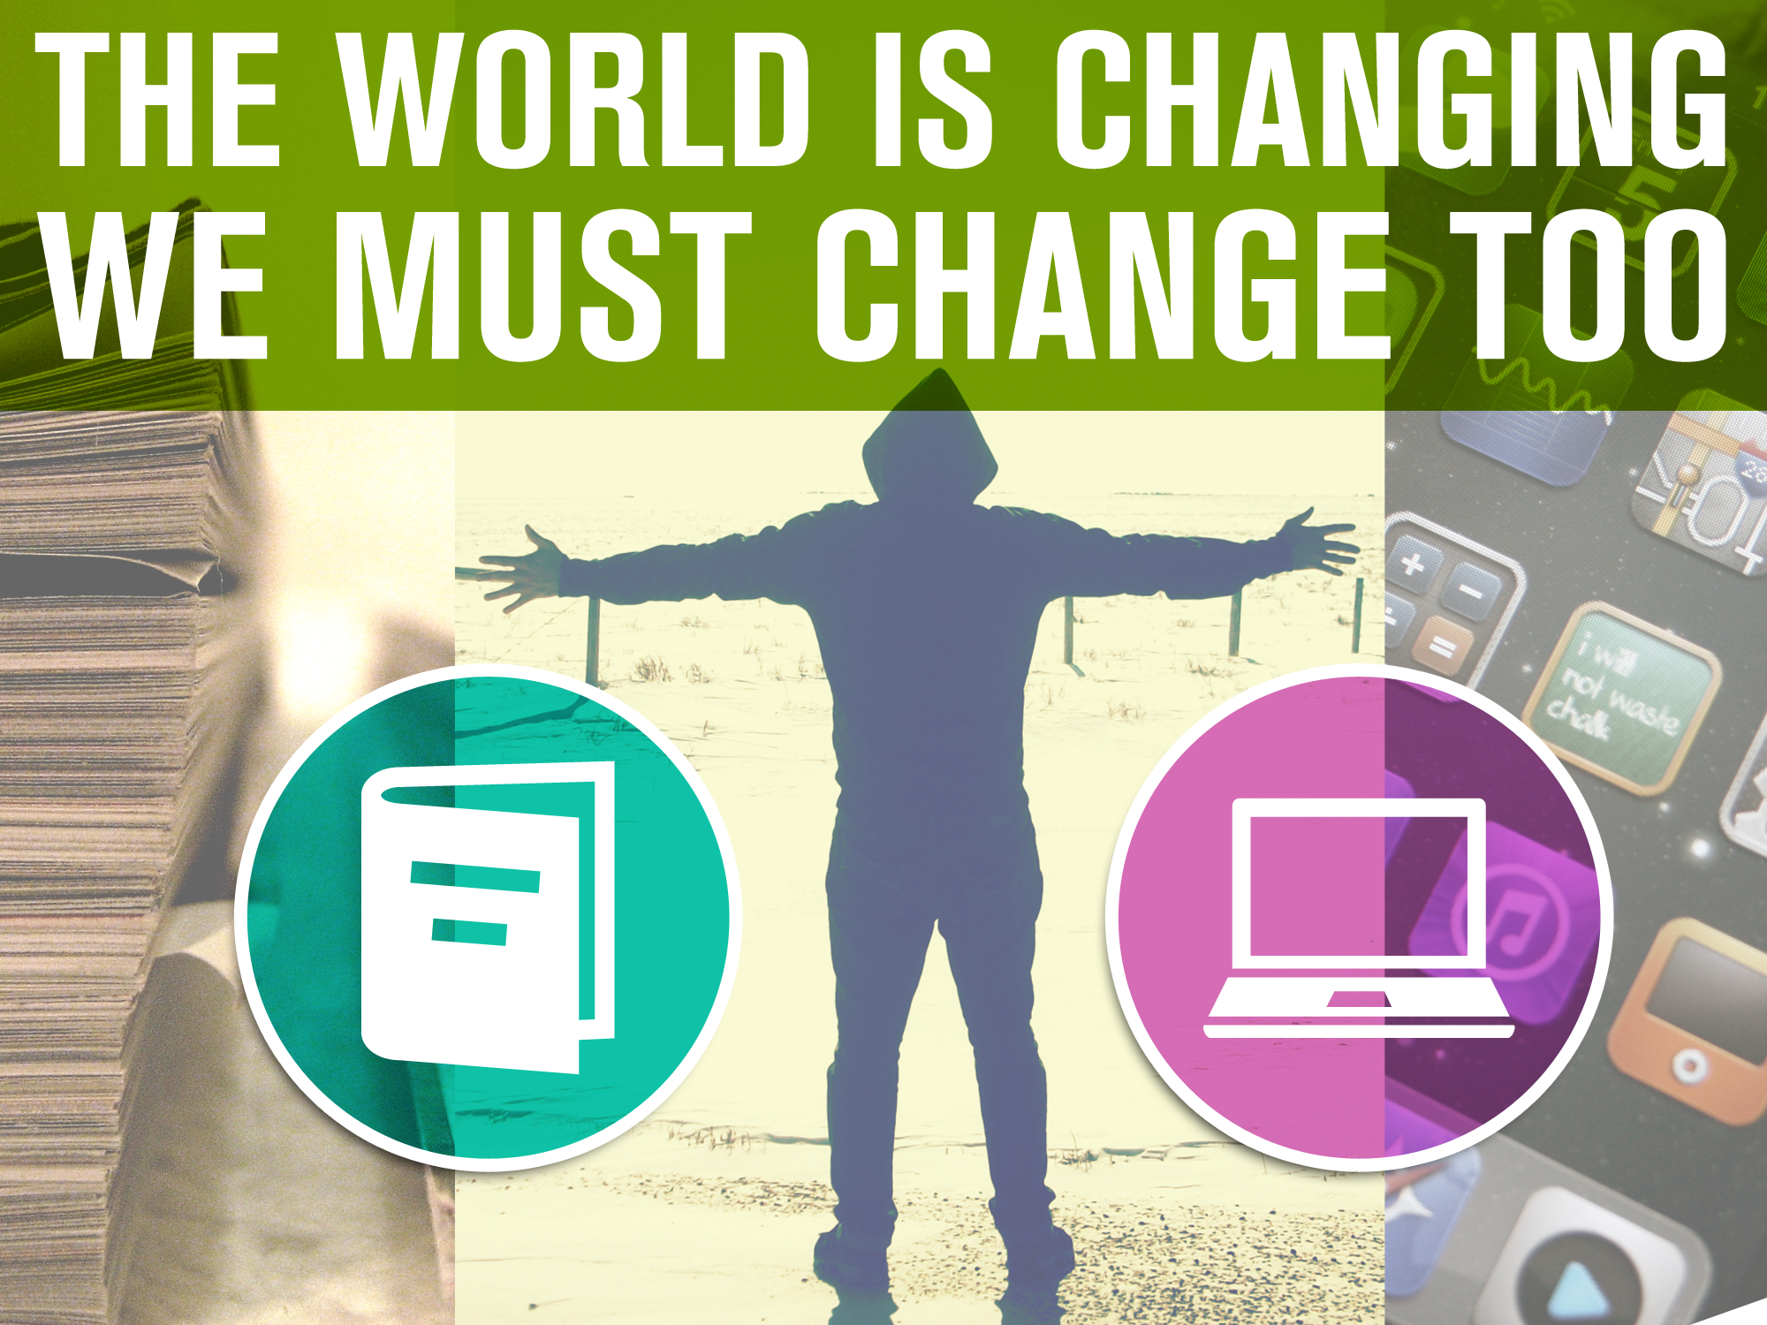

Slide 23
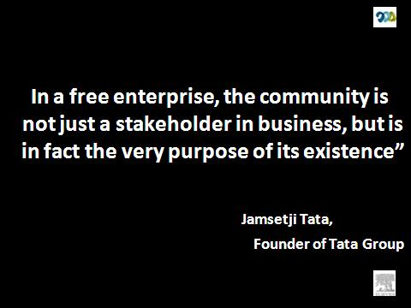
Notes:
When we are changing we should not never and never forget

Slide 24
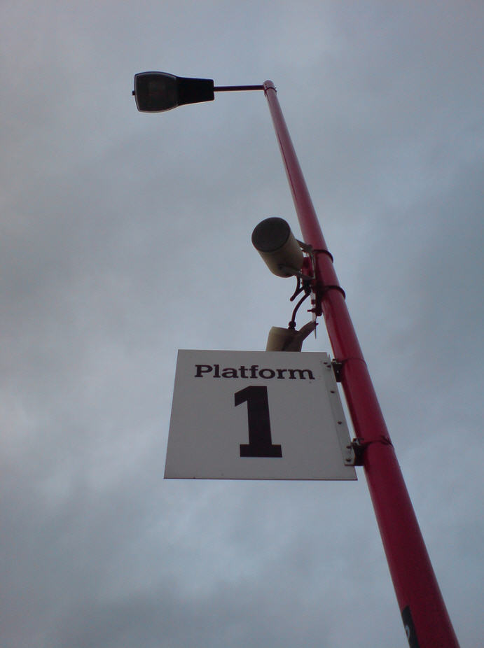
http://www.flickr.com/photos/43772948@N06/5140401153/sizes/l/

Slide 25
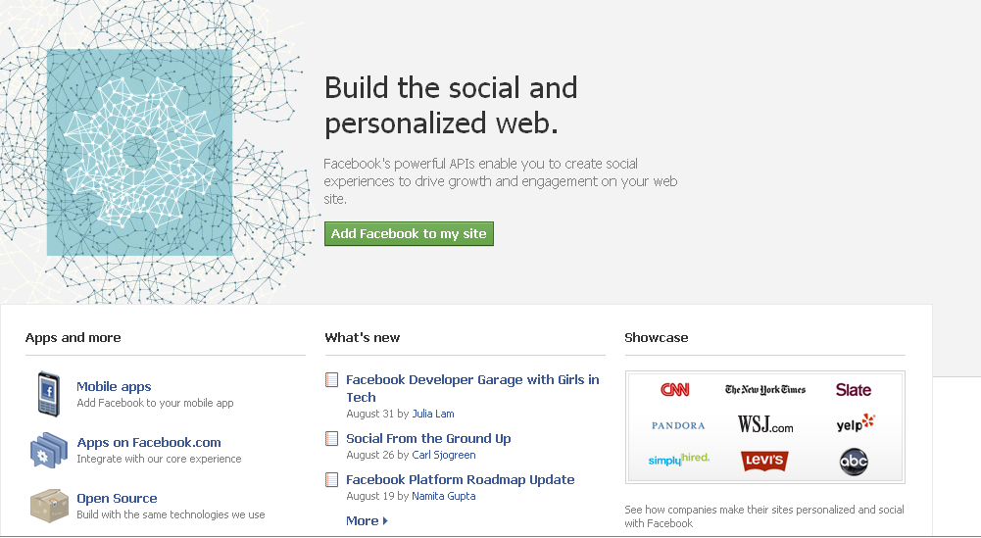
Some Examples of Open Platforms
Notes:
Facebook – the base application is social networking, the experience is enhanced and enriched by applications that use that data.

Slide 26
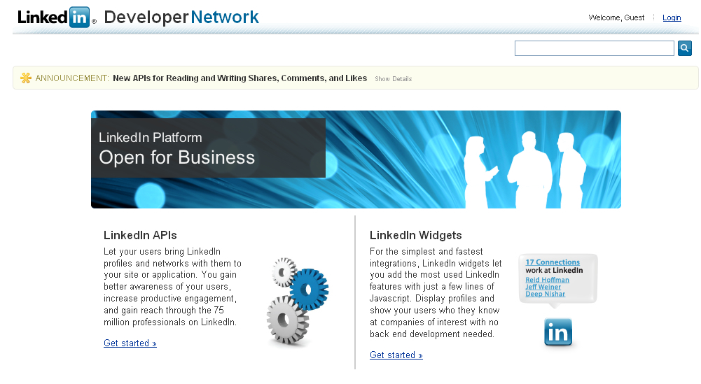
Some Examples of Open Platforms
Notes:
LinkedIn is also moving this direction.

Slide 27
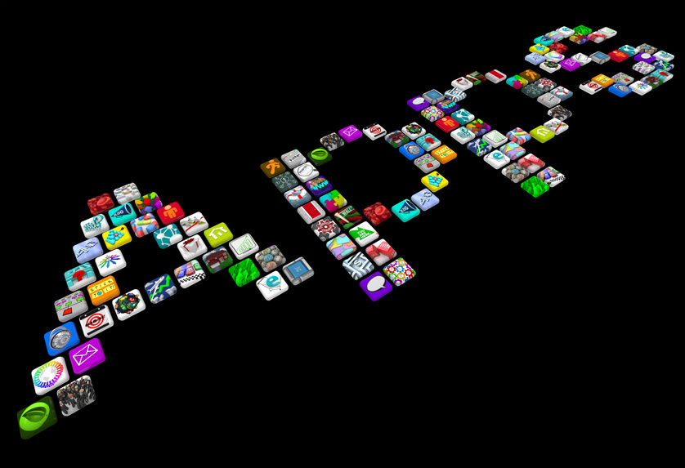
Notes:
and its applications, solutions that are helping us to be more productive

Slide 28
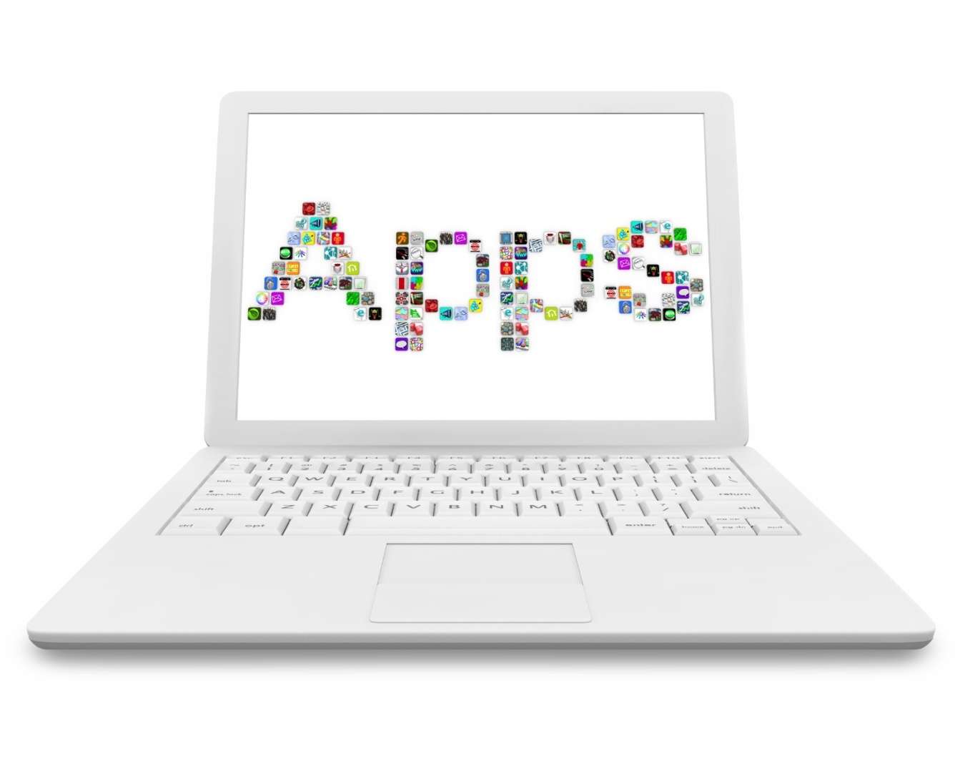
Notes:
From mobile to web we have started using these apps to enhance our productivity.

Slide 29
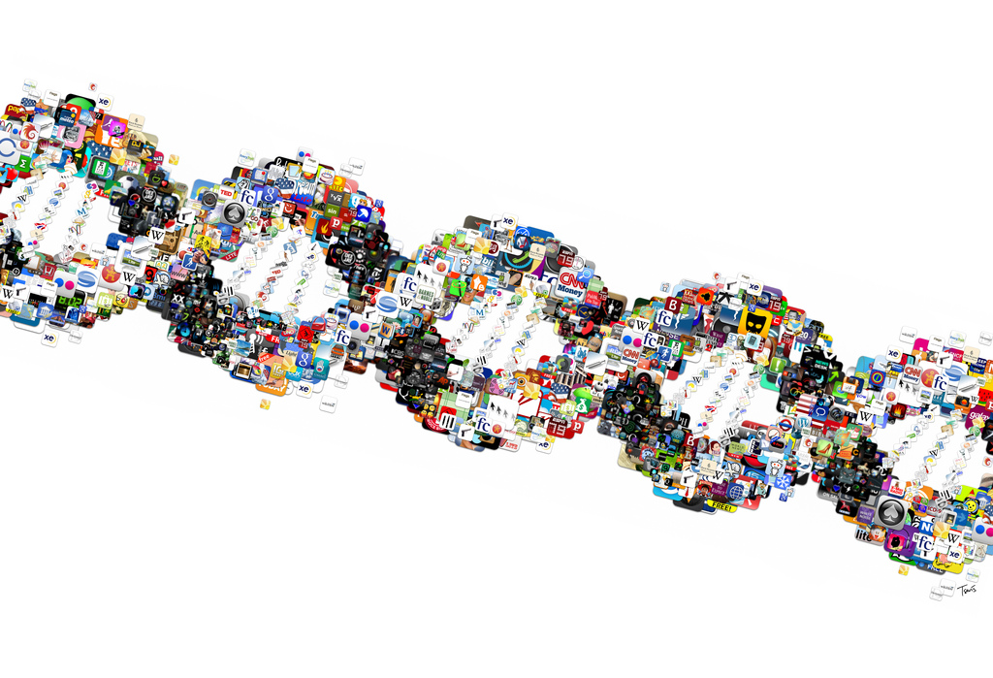
Notes:
And apps are getting into our DNAs

Slide 30

Notes:
we have opened our doors to our garden, and we invited the community in

Slide 31
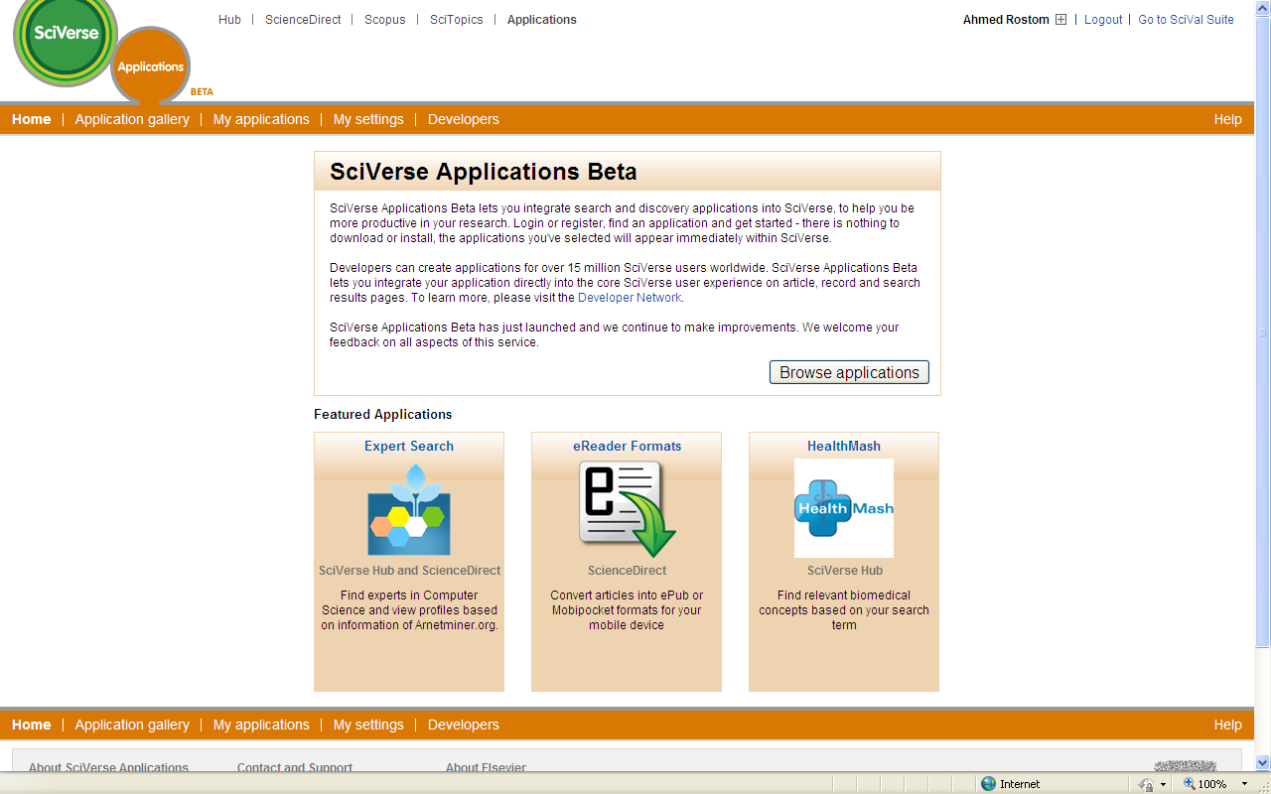
Notes:
we have opened our doors to our garden, and we invited the community in

Slide 32
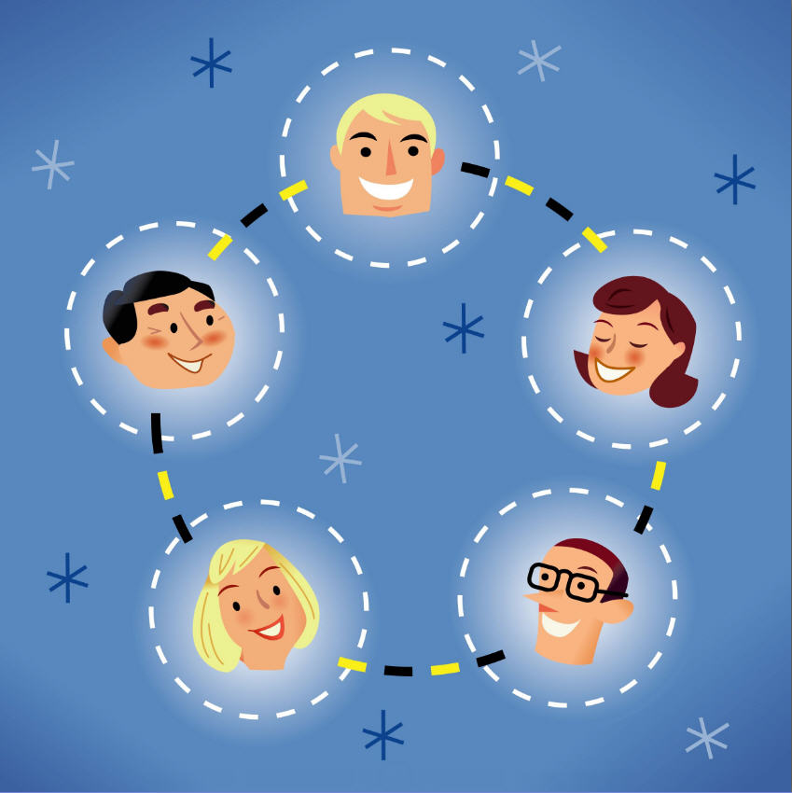
Notes:
To the network of scientist, developers and librarians and we are telling them we want to collaborate with you and create a trusted relationship with you,

Slide 33
What is an Open Platform?
Typically a base layer of functionality or core software, with a framework that enables other software to plug in or connect to it
Allows someone other than the owner to modify or add to a platform by writing programs that plug into the platform.
Achieved by building services and APIs as well as solutions
Notes:
What is an open platform?
- First of all, what is this word platform? A platform is essentially a word for a program which allows other programs to run on top of it. An open platform is a platform means that someone other than the owner of the platform can modify or add to the platform without changing the actual platform software, by writing programs that plug into the platform.
This is generally done through api's, which are really just ways for programs to talk to one another. An open platform generally will have a base layer of functionality, usually composed of something people find useful on its own. On top or alongside of that is a framework that acts as a stage for other programs written by other people (developers) to run alongside the base program, and maybe also interact with it.
Apart from allowing other programs to plug into the base platform, the framework may also provide those other programs with data via api's. In the case of the iphone, there is input data like sounds coming into the mic, or the viewfinder image, or the gps location of the phone. On facebook or linked-in, this may be your friends or your connections, or your friends' status updates. This data allows the other program to add its own special sauce to the overall experience on the platform, to bring in content or functionality that the platform didn't think of or perhaps didn't get around to building themself.

Slide 34
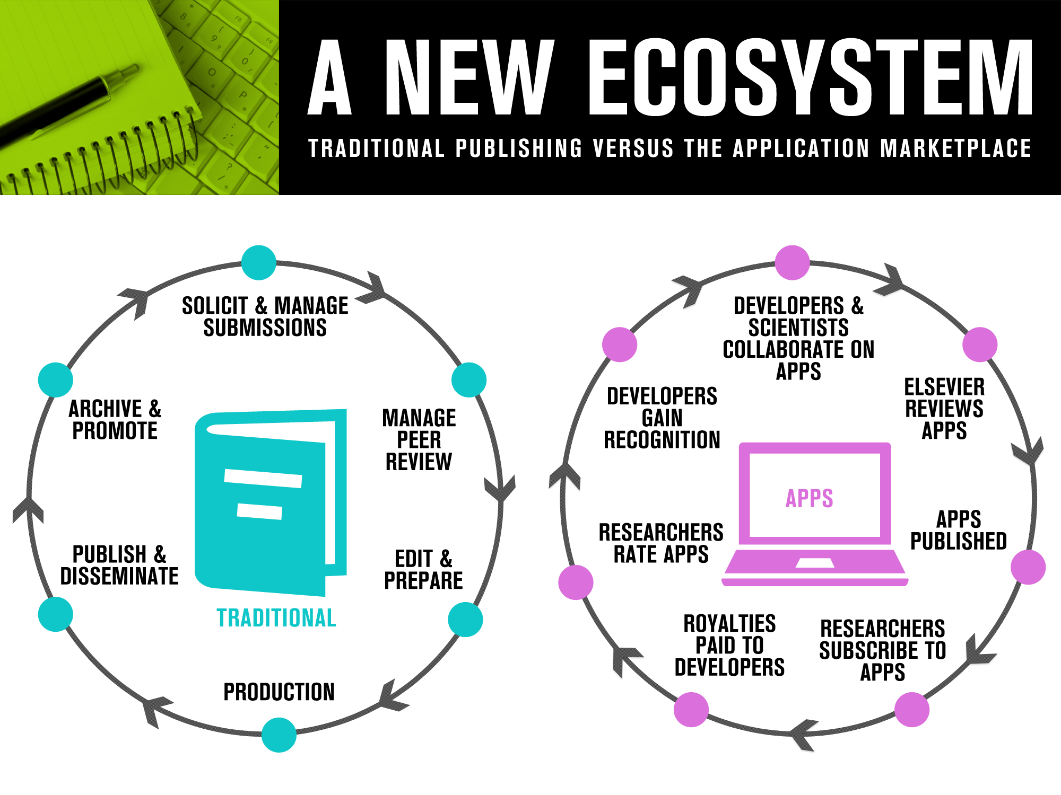
Notes:
The new information ecosystem that we took the leadership and introduced a new information ecosystem, our community now can collaboarte around application, built it and share with the all scientific community similar the way they were doing with journal artciles.
In this new ecosystem the apps are the new content.

Slide 35
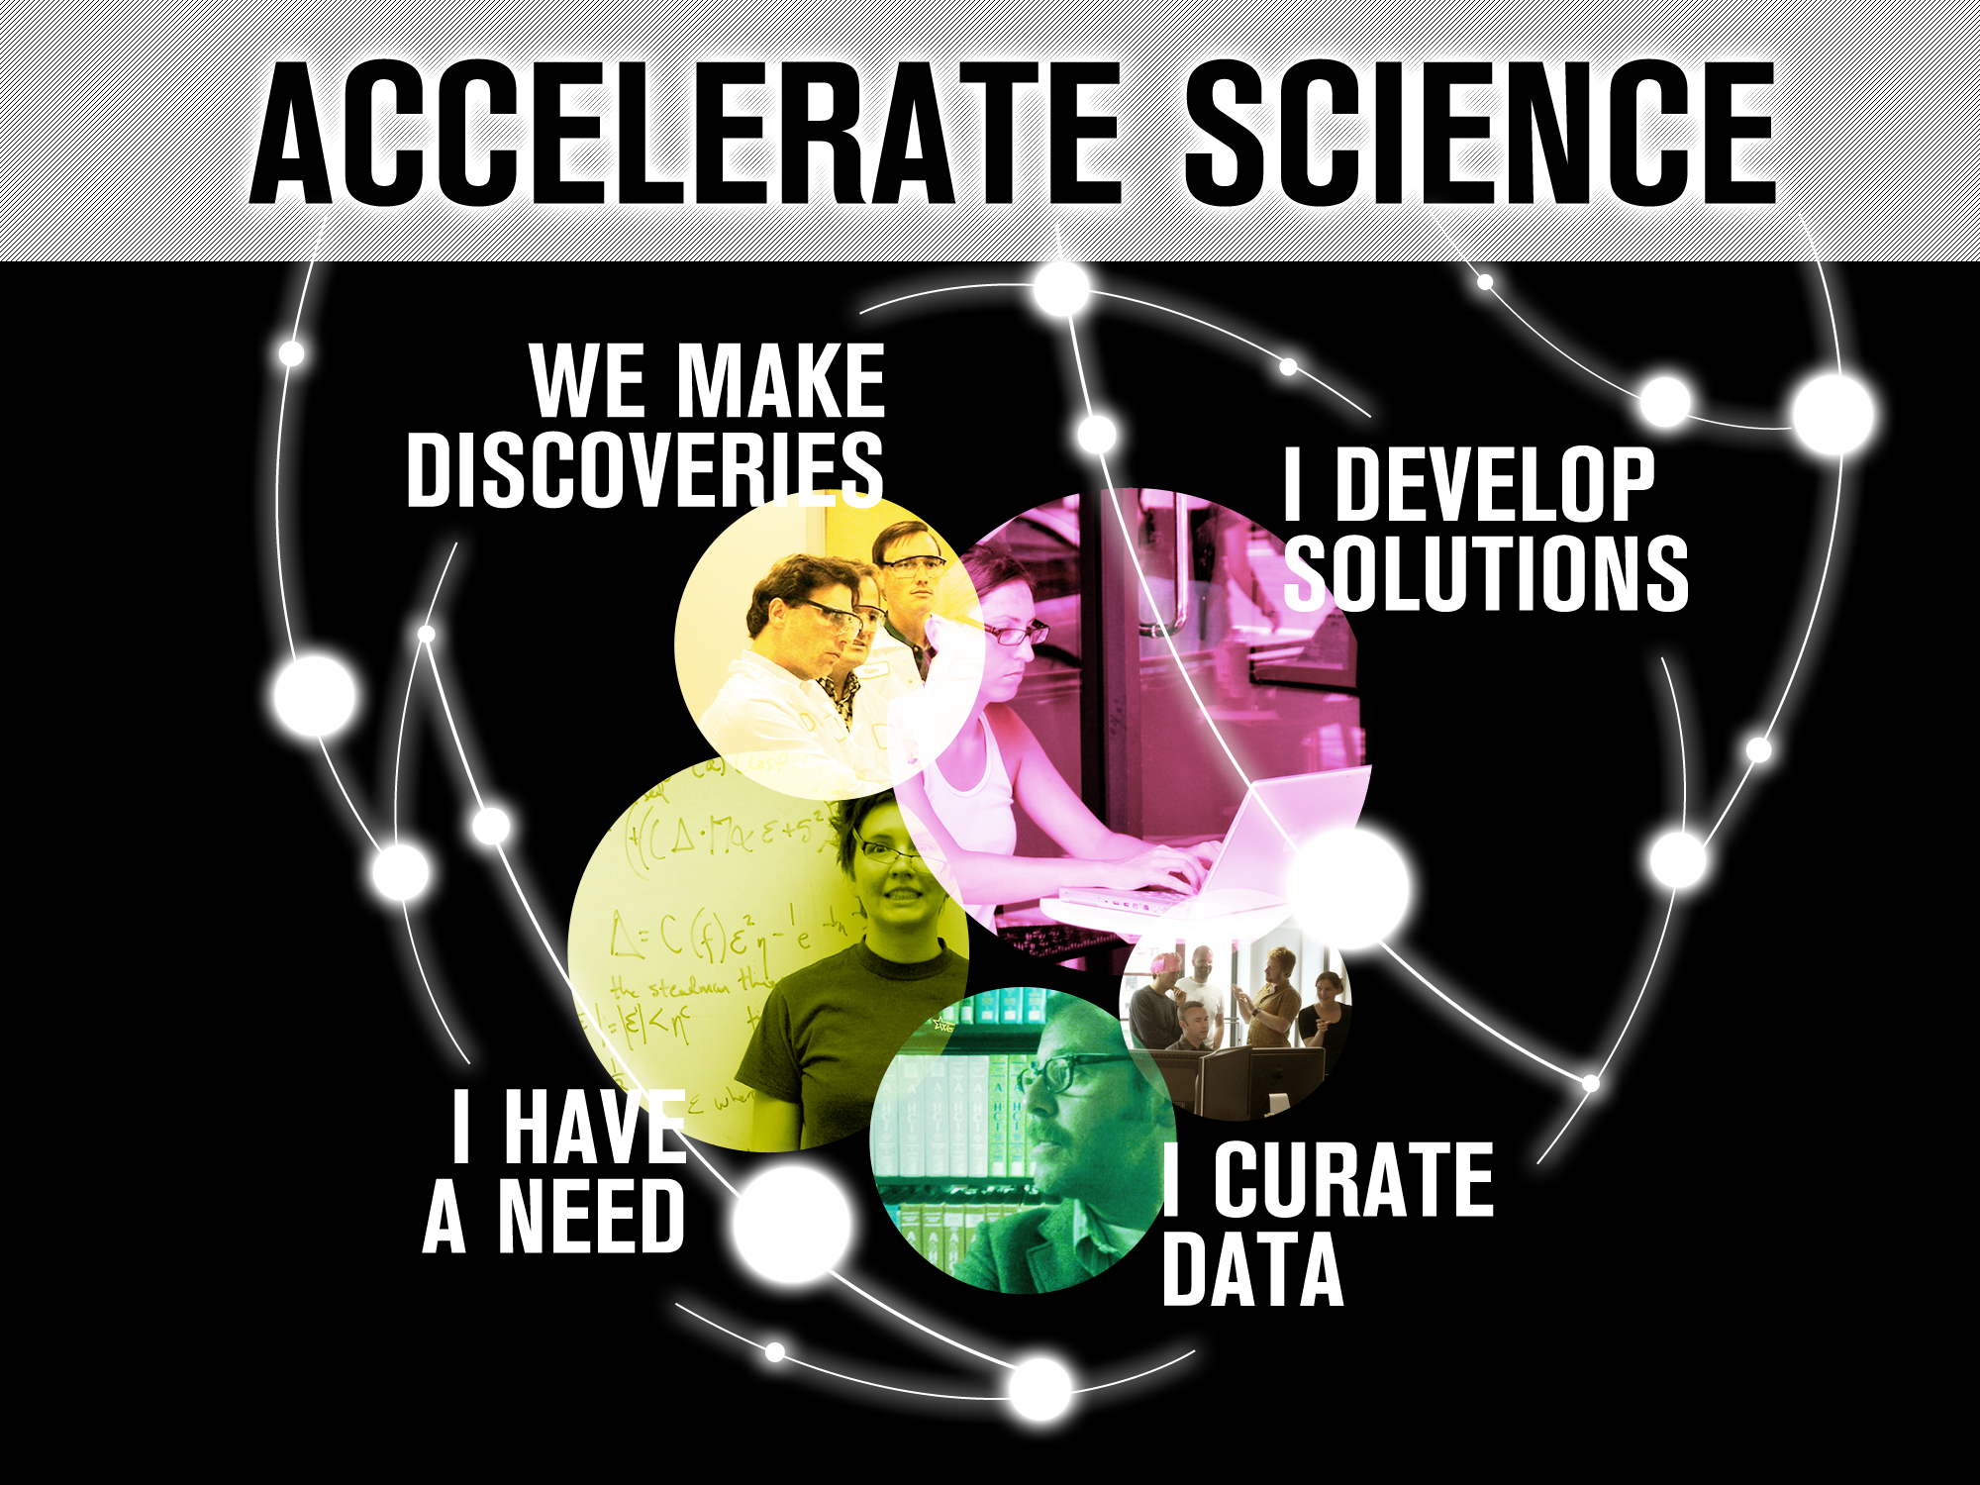
Notes:
One think that you can tell to the librarians is the the key principle and raison d’etre of the application marketplace is to accelerate science
In this new ecosystem we are bringing govrnemnt, academia, startup together to collaboarate

Slide 36
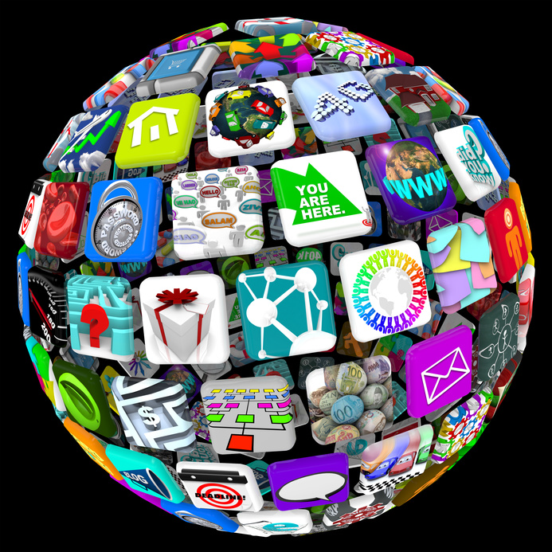
Notes:
As app-dev team we believe that we took the leadership in the industry to build this applications platform.
We believe that apps that will be built on this platform will make the world a better place,
Now, not just with content but now with applications we will improve the lives of millions of people around the world.

Slide 37
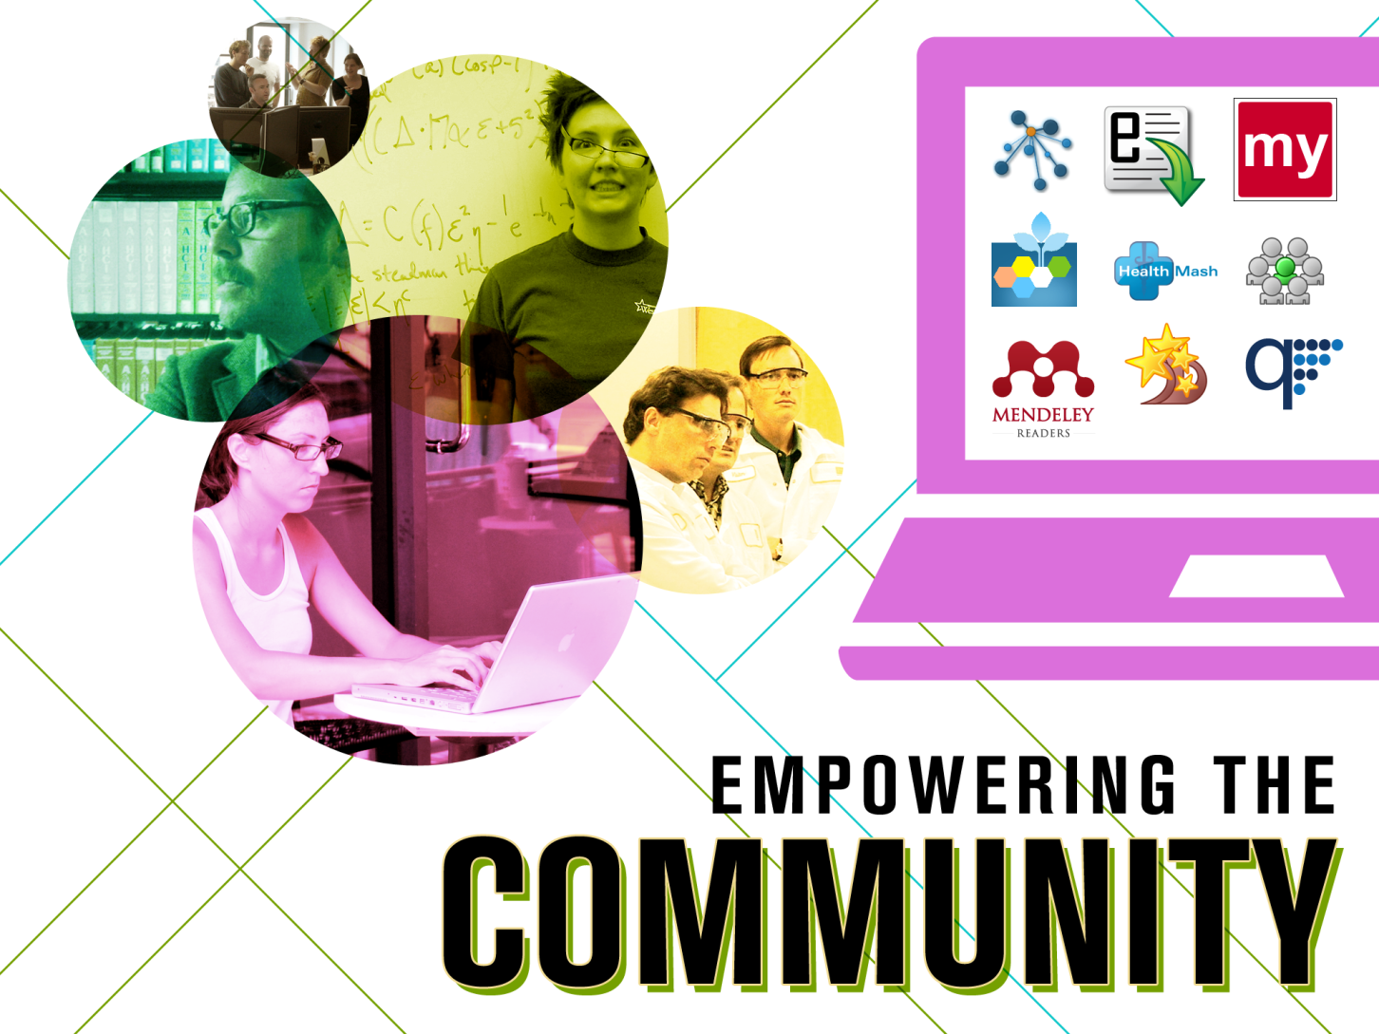
Notes:
At the end what we are doing we are empowering our community, we are enabling them to be successful in what they are doing, enabling them to be successful in their life

Slide 38
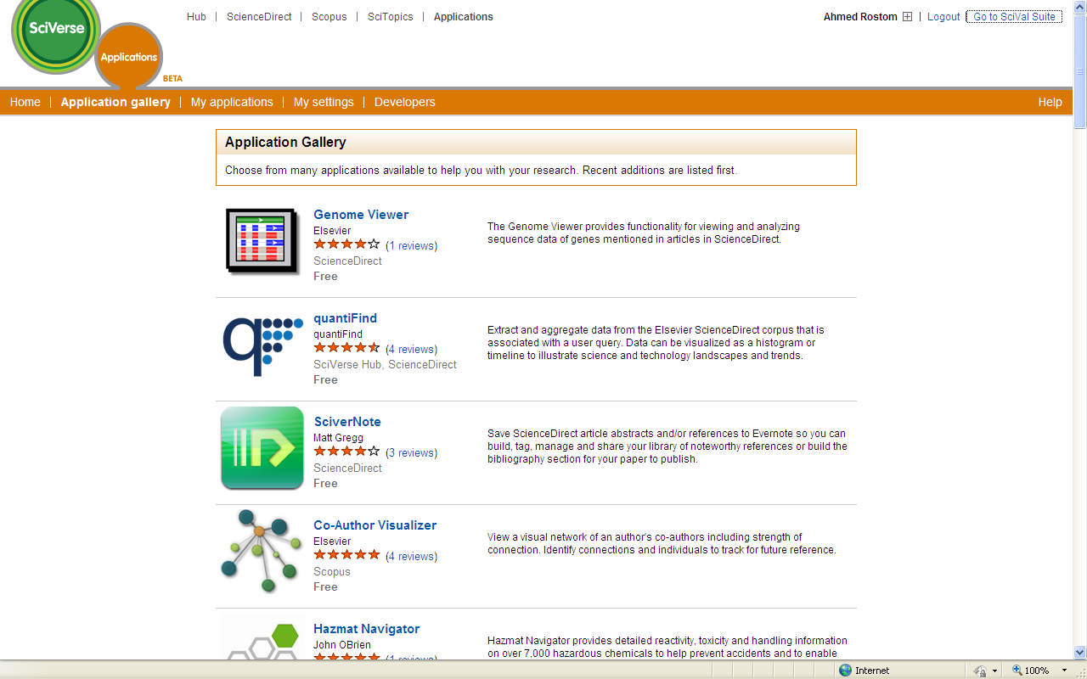
Notes:
Insert a screen shot about the appication market place Sciverce

Slide 39
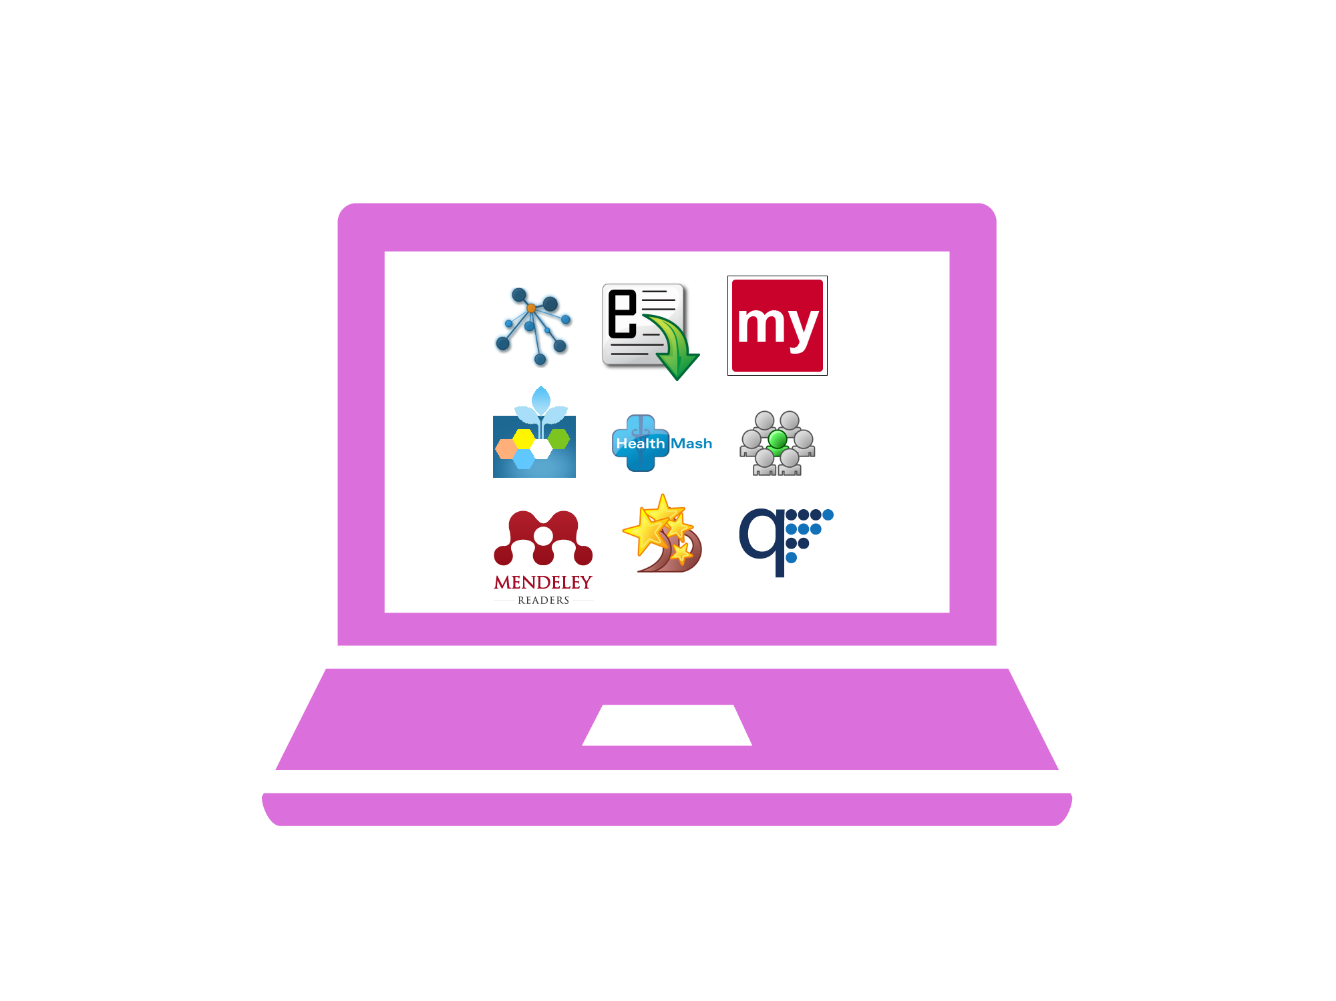
Notes:
We’ll bring more customized solutions to the market.
It will improve our agility in responding to customer needs.
Also we will identify new products, that we can acquire and create the next scopus or the next geofacet

Slide 40
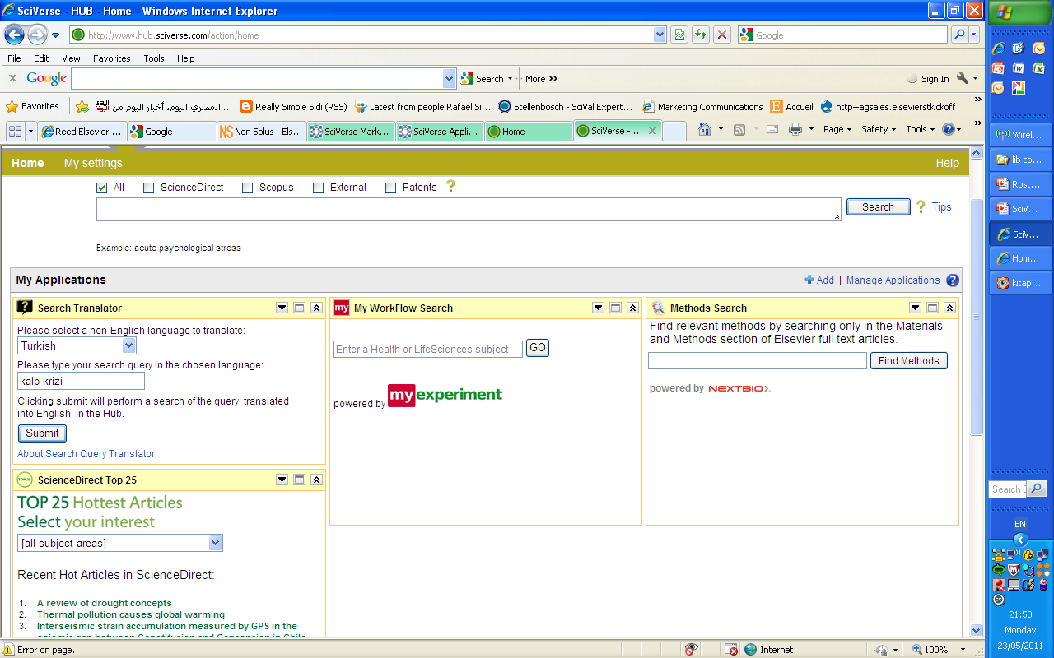
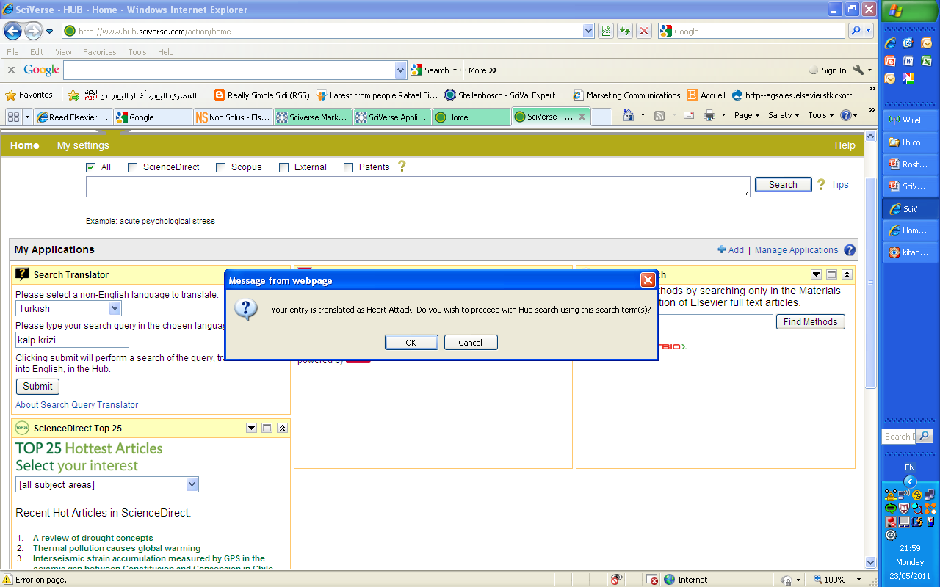
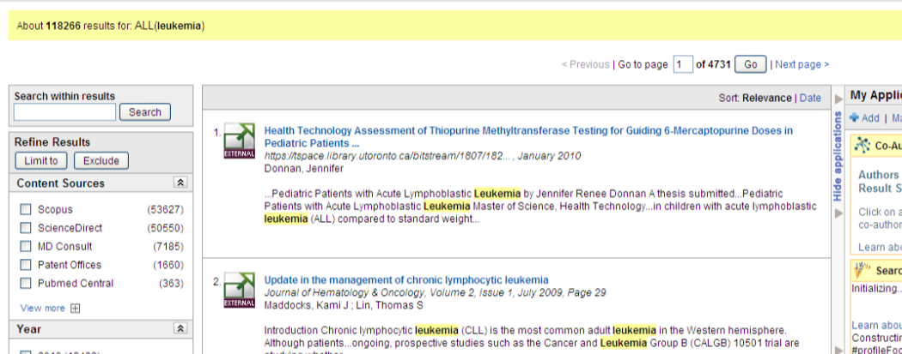
Search Translator

Slide 41
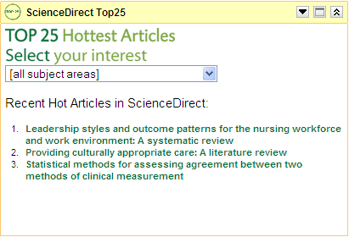
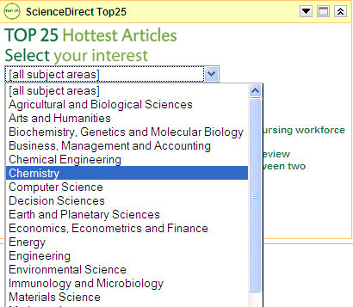
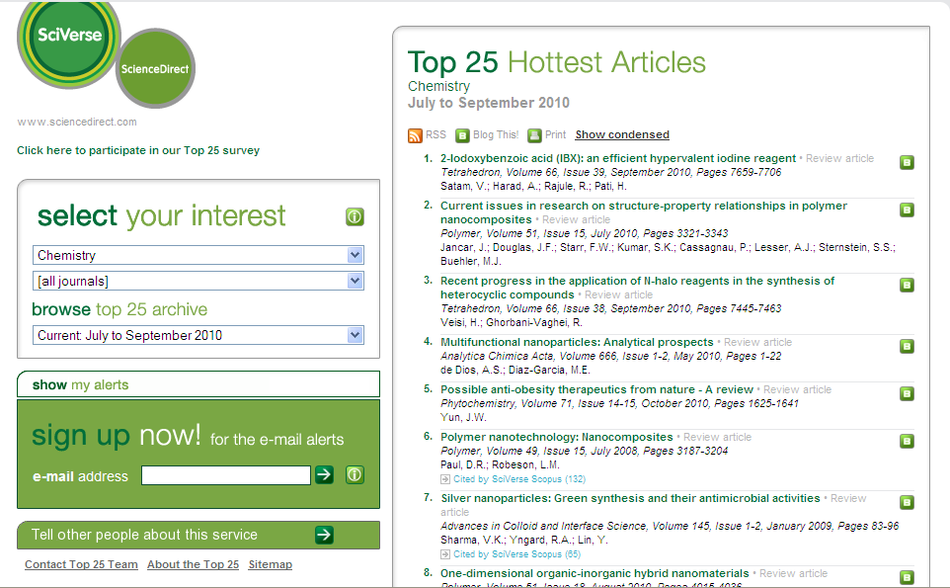
ScienceDirect Top 25

Slide 42
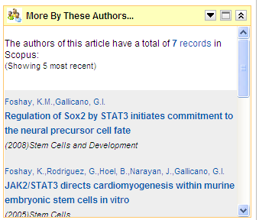
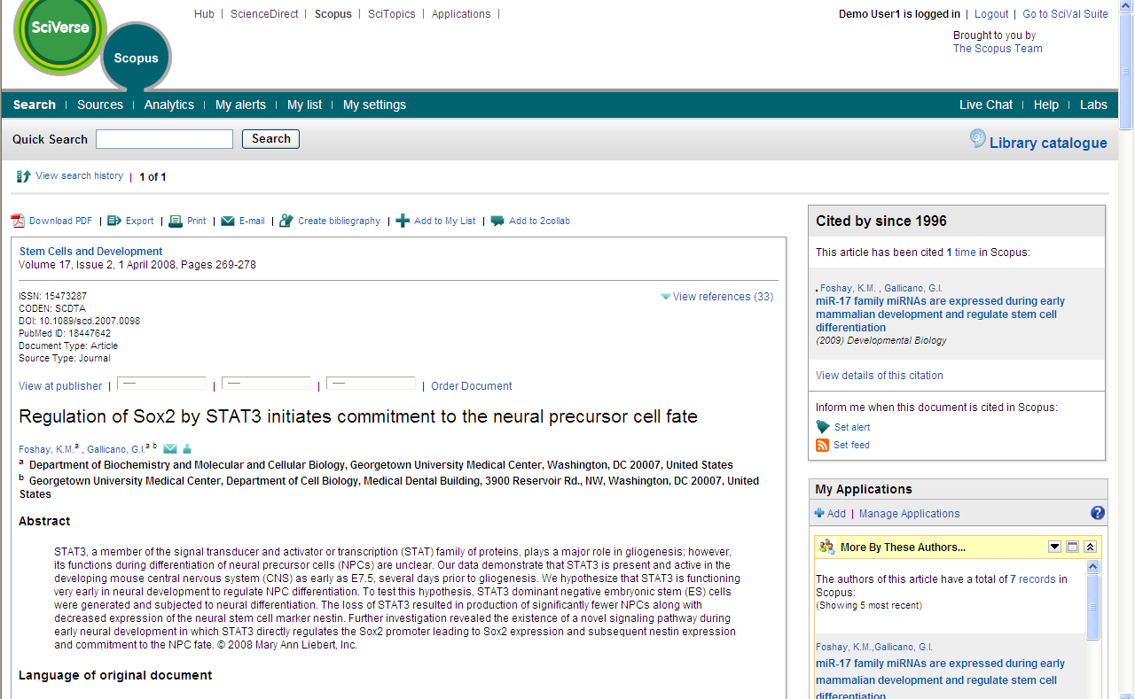
More By These Authors

Slide 43
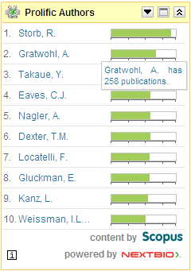
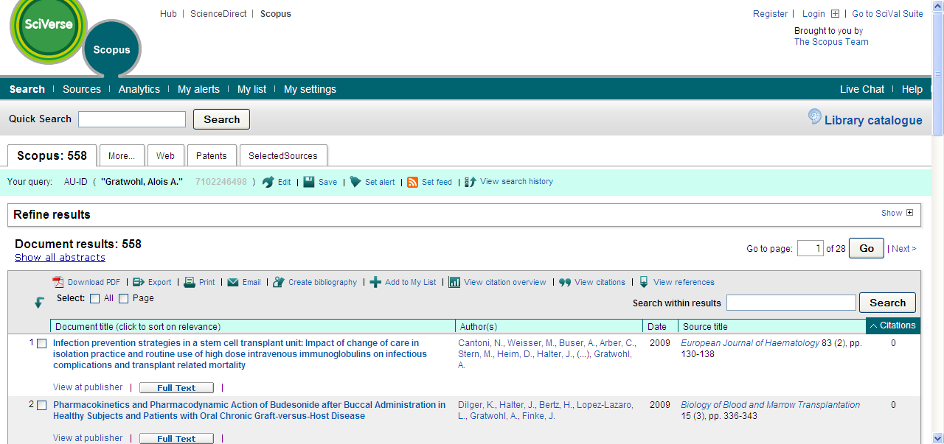
Prolific Authors

Slide 44


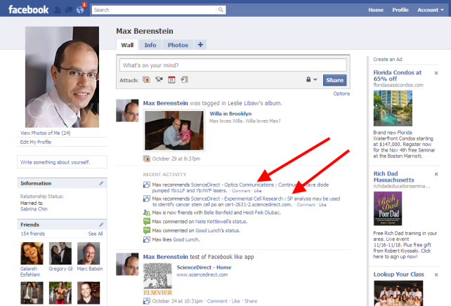
Recommend This

Slide 45
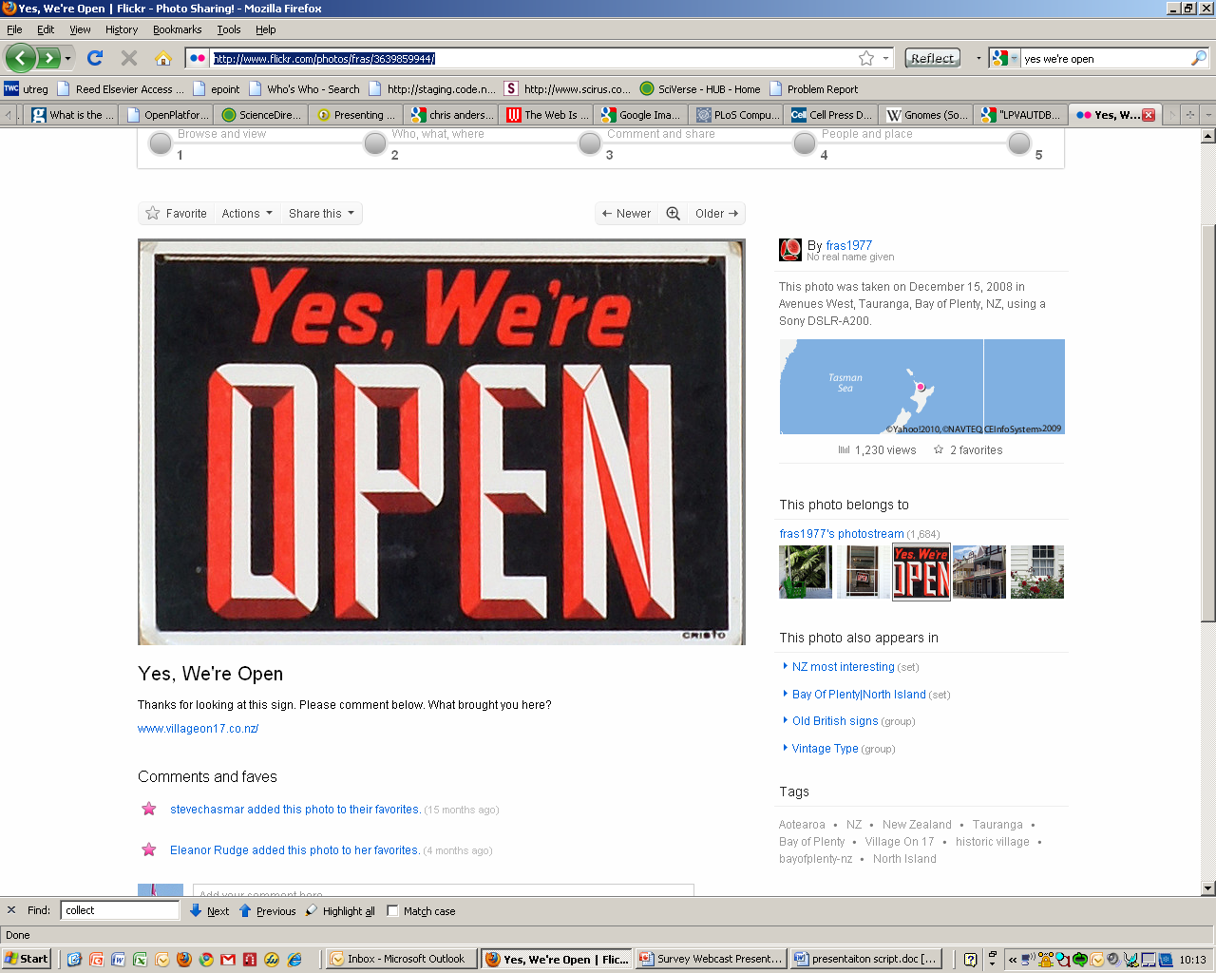
Rethinking Current Roles
Platform providers – By offering content and services through APIs and opening up their platforms, publishers and platform providers
could present the scientific community with the necessary tools to build
applications which can better meet the changing needs of researchers.
http://www.flickr.com/photos/fras/3639859944/
Notes:
First of all, publishers and platform providers need to think about how they can get beyond one-size-fits all search and discovery, to enable the new experiences researchers needs. Chances are users are not going to find everything they need in your products, and chances are you won’t be able to deliver all the solutions users need or identify all the information they need to find. So rather than try to be everything to everyone and maintain complete control over what you deliver, why not instead look at how you can focus on better organizing and systematically exposing the data you have. Pare back “control”, and open up as many channels and plug-in points as possible. By offering content and services through APIs and opening up their platforms, publishers and platform providers could present the scientific community with the necessary tools to build applications which can better meet the changing needs of researchers.
If you can turn a product or application into a true platform, then you can enable the right solutions to flourish on their own. In a web world, the opportunities to add value via software which connects data and information and helps people consume it in new and more efficient ways are limited only by the creativity and resources of those who can deliver the solutions. And recent history suggests that working with the web is a better bet than working against the web.

Slide 46

Rethinking Current Roles
Platform providers – Opening up could mean disruption of the current market for research platforms and providers. Most content and platform providers have
struggled to find a balance between “open” and
“sustainable” in the Internet age. Access and re-use are
key issues which will need to be dealt with.
Notes:
First of all, publishers and platform providers need to think about how they can get beyond one-size-fits all search and discovery, to enable the new experiences researchers needs. Chances are users are not going to find everything they need in your products, and chances are you won’t be able to deliver all the solutions users need or identify all the information they need to find. So rather than try to be everything to everyone and maintain complete control over what you deliver, why not instead look at how you can focus on better organizing and systematically exposing the data you have. Pare back “control”, and open up as many channels and plug-in points as possible. By offering content and services through APIs and opening up their platforms, publishers and platform providers could present the scientific community with the necessary tools to build applications which can better meet the changing needs of researchers.
If you can turn a product or application into a true platform, then you can enable the right solutions to flourish on their own. In a web world, the opportunities to add value via software which connects data and information and helps people consume it in new and more efficient ways are limited only by the creativity and resources of those who can deliver the solutions. And recent history suggests that working with the web is a better bet than working against the web.

Slide 47
Rethinking Current Roles
Researchers – Researchers could have new control over how they find and use content, as well as new opportunities to influence and even create the software solutions to their own problems.
Notes:
Researchers could have new control over how they find and use content, as well as new opportunities to influence and even create the software solutions to their own problems. One interesting issue identified in the survey is that the question of whether researchers have the institutional support they need to devote time to this, with only 31% saying they felt their institution will be supportive.

Slide 48
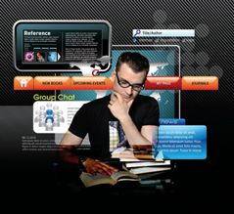
Rethinking Current Roles
Librarians – Librarians as developers? “Librarians need to develop their programming skills...to provide access to the increasingly large mounts of data, combine the data in new and innovative ways...a basic level of
proficiency in data collection and manipulation could become as important a skill to the future librarian as search engines are today.”
– David Stuart, Programming skills could transform librarians' roles, Research Information, 12/2009
Notes:
For librarians, this presents both new challenges and new opportunities. Librarians could facilitate the development of these applications, working with developers to explain the unique needs of their research constituency and broker the necessary \solutions – or provide these solutions themselves. Indeed, an article in the December issue of Research Information makes just this point: “Librarians need to develop their programming skills. Such skills will enable librarians to provide access to the increasingly large amounts of data, combine the data in new and innovative ways and enable access to it in the places that customers want... As we increasingly move towards a web of data rather than a web of documents it would seem that a basic level of proficiency in data collection and manipulation could become as important a skill to the future librarian as search engines are today.”

Slide 49
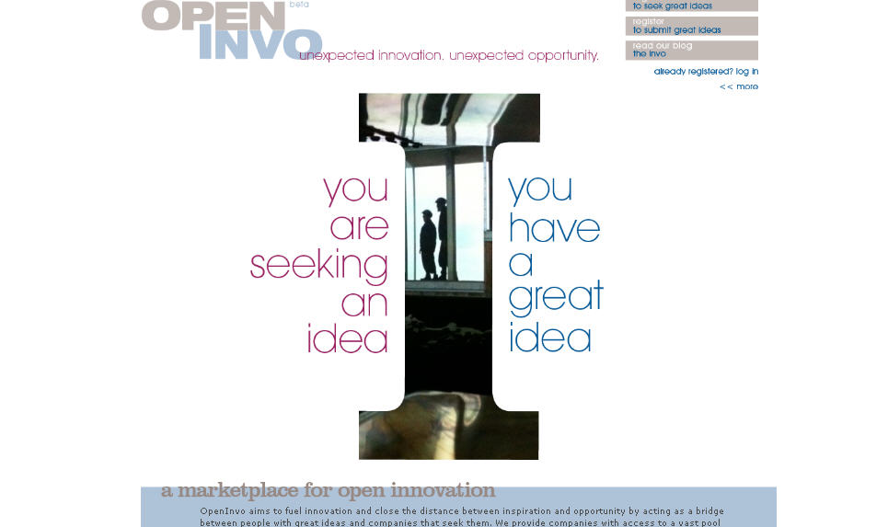
Notes:
We have built a platform where anyone can submit an idea and community can develop the app, this is another value that you are bring to your customers, you don’t like what you see or do you need something that we are not offering, here you you can build this yourself and integrate into the products that you are paying to us

Slide 50
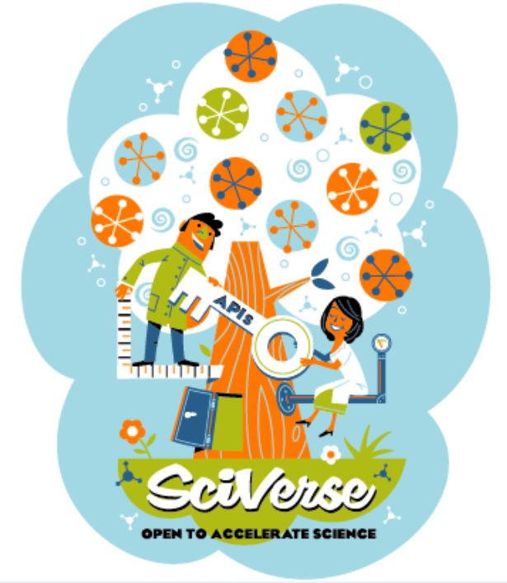
Notes:
We need to bring our users under our tree and give them the key to innovate in a new garden that will be be open for researchers and scientists

Slide 51
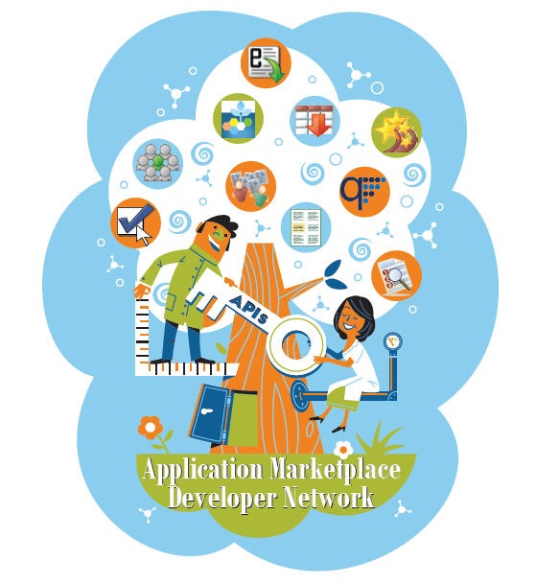
Notes:
In a short period of time we started our beautiful tree has started to blossom, and this is just the beginning, we are ready to change the way our customers use content and find solutions for their problem

Slide 52


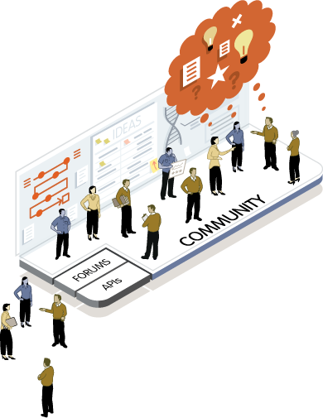
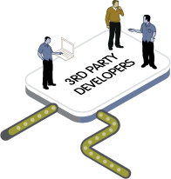
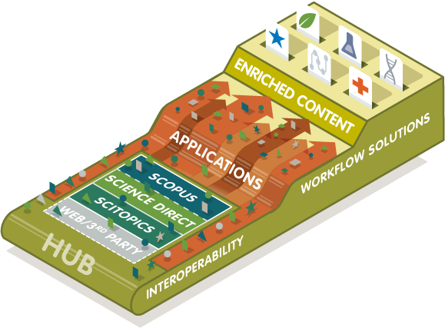

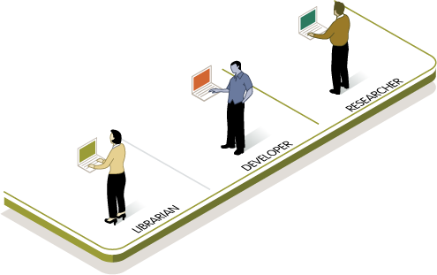
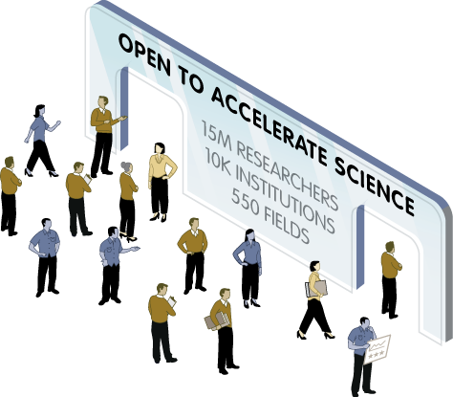
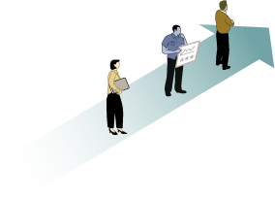
Open to accelerate science
Notes:
Our vision – collaborating with the scientific community
Adding to our reputation for publishing the industry’s most trusted content
By publishing services that empower scientists to develop applications that meet their needs
And creating a marketplace/forum for the industry to identify new opportunities, bring them to market, and watch for the community feedback that continuously enhances those applications

Slide 53

Notes:
Nonsolus mean “not Alone”
Scholars can’t do it without publishers, and publisher can’t publish without scholar, so we are interconnected.
We can’t accomplish the new journey alone too internally and externally
Librarians and researchers, authors will play a key role in the execution of this new vision

Slide 54
Thank you

