Slide 1
SciVal -
Making data more visible and accessible for effective research management
" Bilimsel Araştırmalarda Performans Değerlendirme ve Rekabet"
Sherif ELShamy
Product Sales Manager – Africa, Middle East, Turkey, Iran & Central Asia.
May 2011

Slide 2
WHAT DO WE HEAR?
funding
OPEN ACCESS
competencies
health
metrics
evaluation
mobility
getting published
collaboration
challenges
infrastructure
interdisciplinary
hypercollaboration
Brazil
challenges
recruitment
science
South Africa
UK
USA
leading indicators
co-authored
networks
China
India
research maps
brain drain
information
research
strengths
global issues
ROI
quality
access
competition
decisions
Notes:
Globally we see the research environment becoming more output focused, with a growing need for metrics. Access remains an important topic in many markets, from alternative publishing models to securing blanket access to scientific output for all researchers in a country.

Slide 3
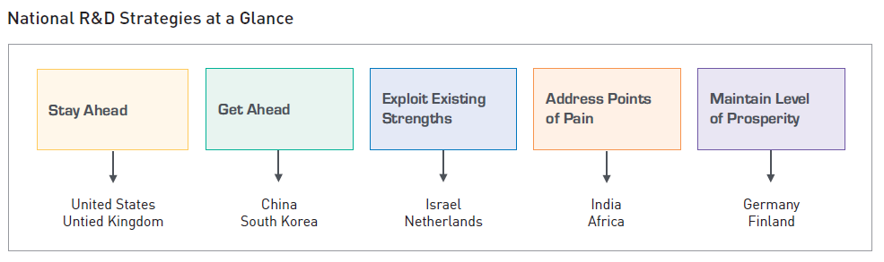
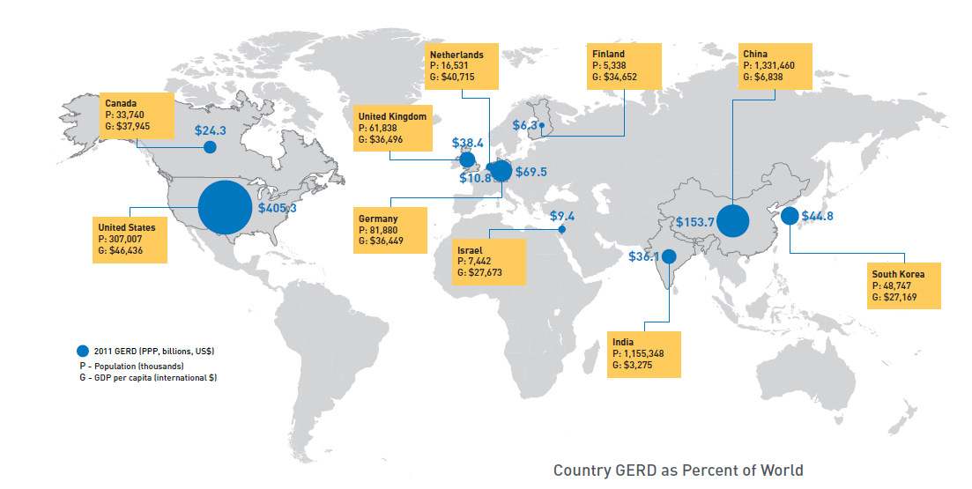
REASONS VARY, BUT GLOBAL R&D INVESTMENTS ARE GROWING
GERD - Gross Expenditure on Research and Development
The Race for Global Innovation, Toronto Region Research Alliance, 2011

Slide 4
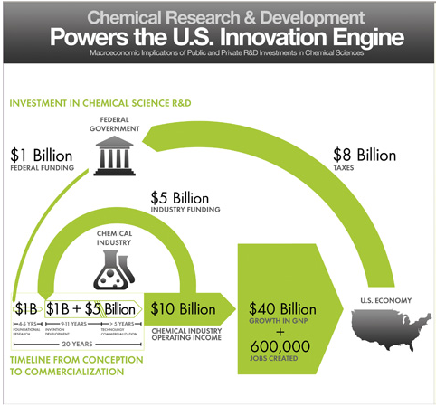
THE POWER OF R&D INVESTMENTS – AN EXAMPLE
Council for Chemical Research. 2009. Chemical R&D Powers the U.S. Innovation Engine. Washington, DC. Courtesy of the Council for Chemical Research. In Katy Börner & Elisha F. Hardy (Eds.), 5th Iteration (2009): Science Maps for Science Policy Makers, Places and Spaces: Mapping Science. http://scimaps.org (accessed 5/21/2010).

Slide 5
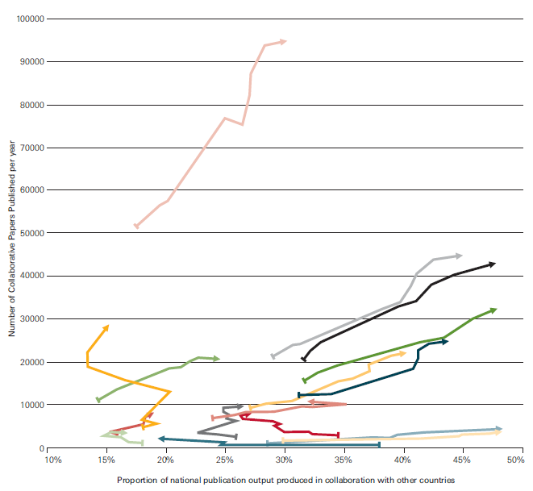
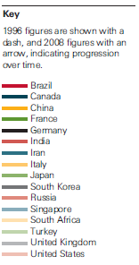
AS INVESTMENT IN RESEARCH EVOLVES, SO DOES THE LANDSCAPE…
Increasing Collaboration
Knowledge, Networks and Nations: Global scientific collaboration in the 21st century, The Royal Society, 2011

Slide 6
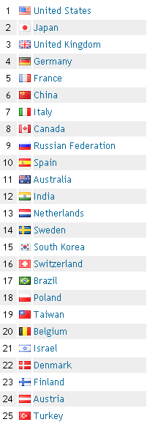
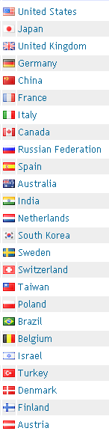
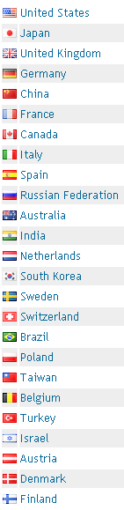
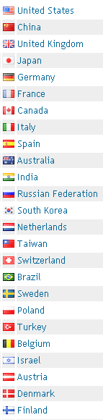
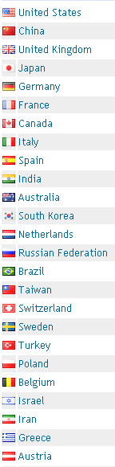
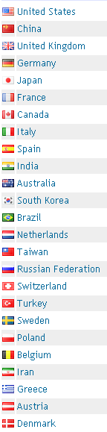
New global leaders are emerging
2000
2001
2003
2005
2007
2009
Source: SCImago Journal & Country Rank (http://www.scimagojr.com/countryrank.php)

Slide 7
METHODOLOGY
Analyzed individual papers included in the “Scopus” database
  Did not take into account which journal the papers is published in
Conducted Co-citation Analysis
  Basic way of thinking:
  If two papers are citing the same paper, we assume that they are conducting similar research
Identified papers which were published by your country/university’s researchers
  Important information to define if your university has strength in the research area

Slide 8




THE COMPONENTS OF SCIVAL
Online Tools
Identify expertise and enable collaboration
Shed light on research strengths
Maximize chances for award success
Measure and compare individual and team performance
Funding Bodies
Source Data
Scopus Dataset

Slide 9
IMPLICATIONS
HOW CAN WE USE THESE DATA FOR FUTURE PLANNING?
Data Available
Implications (Example)
Your
University’s
Strengths
Which global
institutions are
conducting research
in similar areas?
Identifying Potential
Collaboration Targets
Which researchers are actively conducting research in those areas?
Identifying Potential
Recruitment Target
Measuring Expected
Impact from Recruitment
9

Slide 10
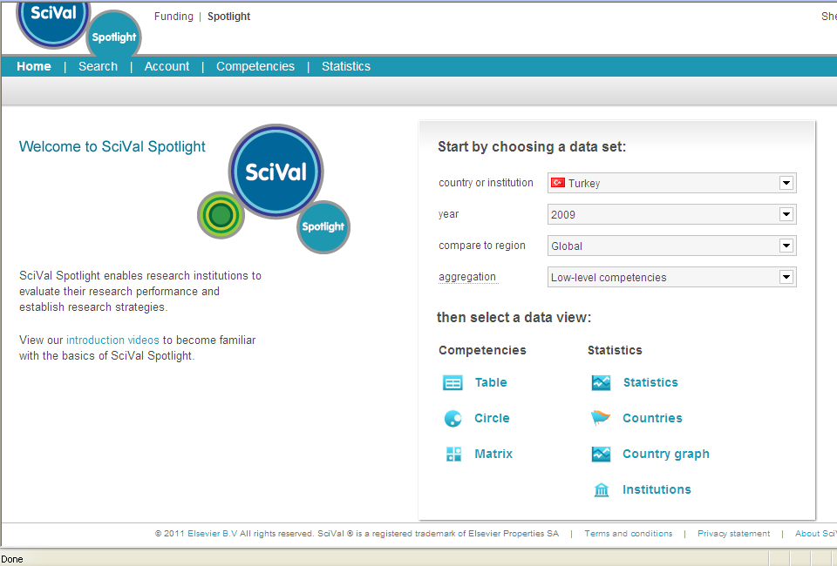
SCIVAL SPOTLIGHT – HOME PAGE

Slide 11
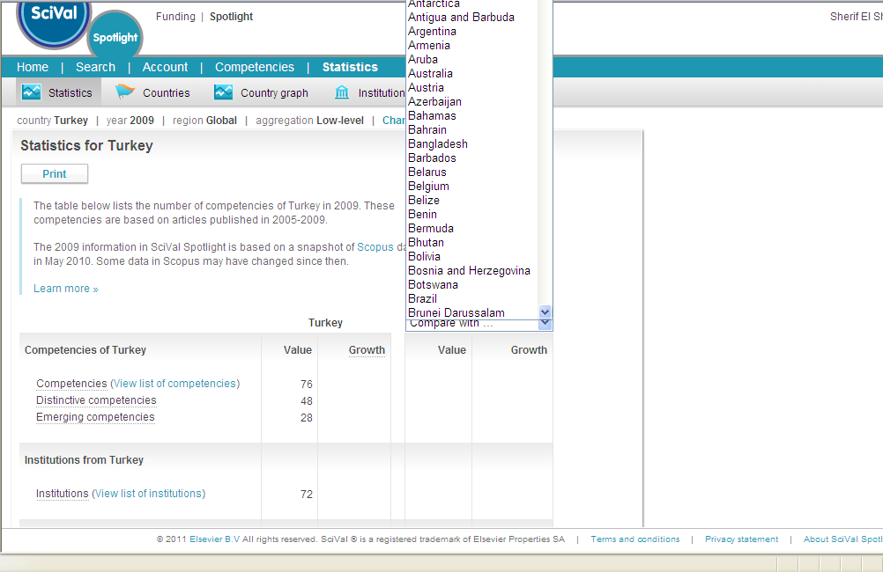
STATISTICS

Slide 12
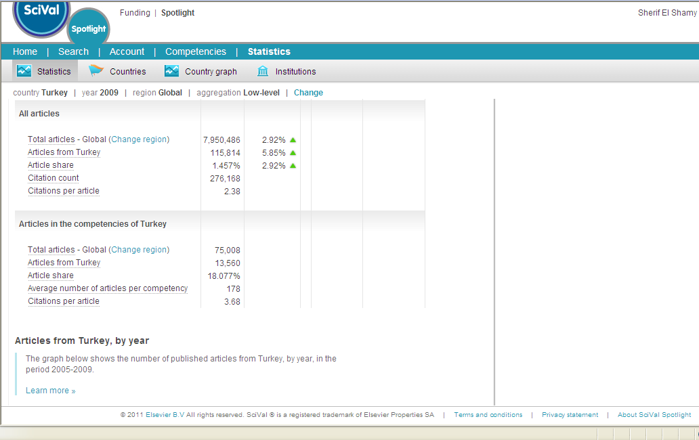
STATISTICS ... CONTINUED

Slide 13
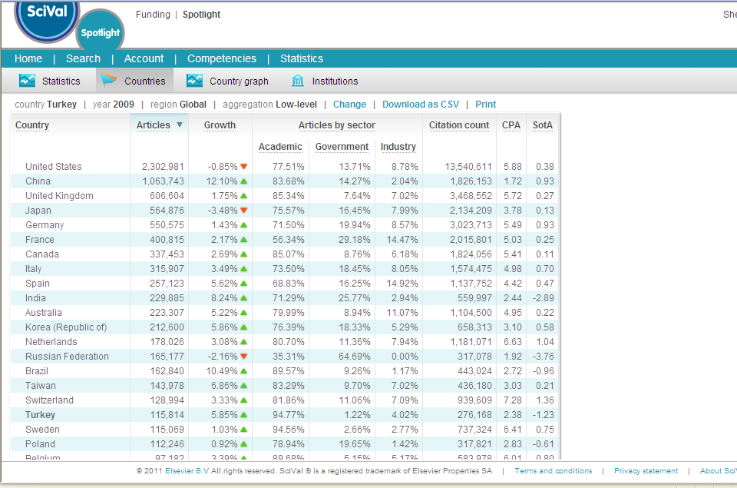
Top Countries in the World

Slide 14
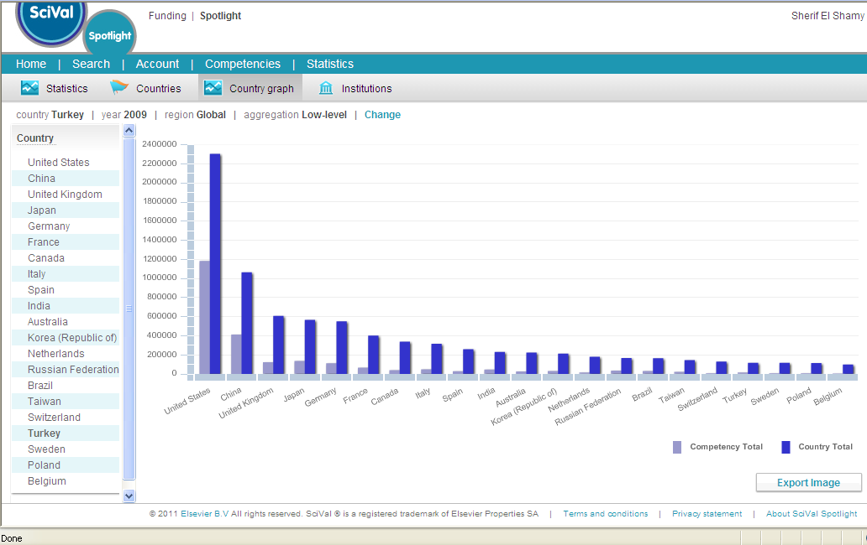
Countries Graph...Based on No of Articles

Slide 15
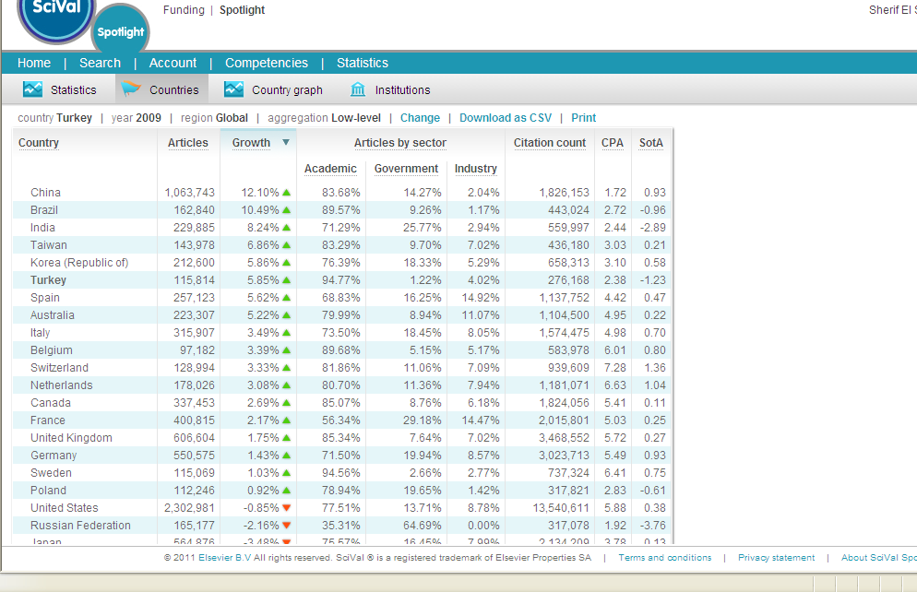
Top Countries in the World ... Based on Growth

Slide 16
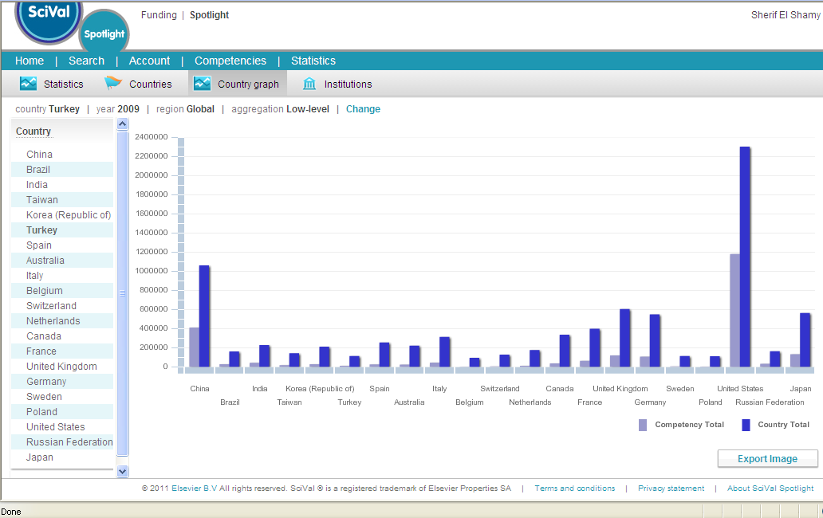
Countries Graph...Based on Growth

Slide 17
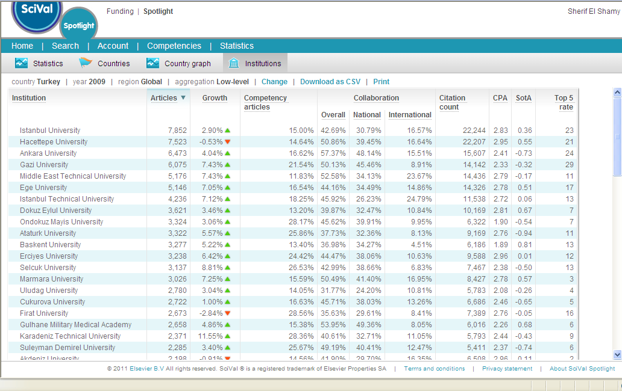
Turkish Institutions

Slide 18
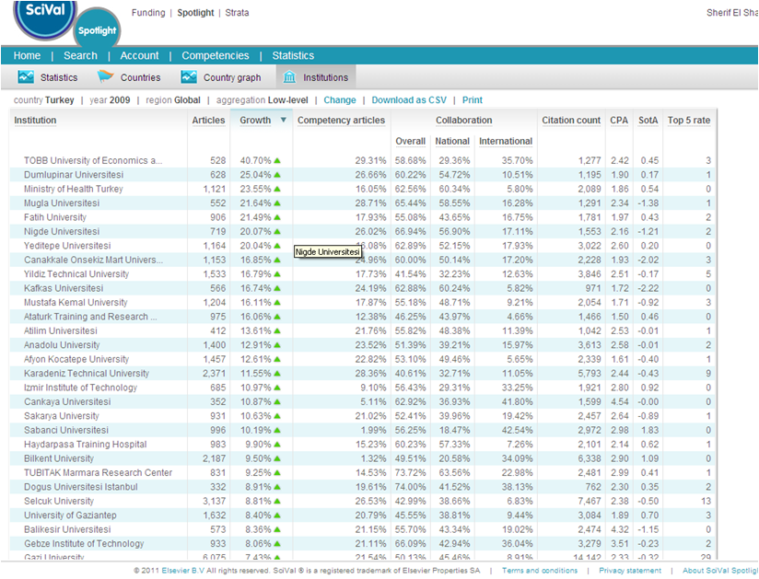
Turkish Institutions

Slide 19
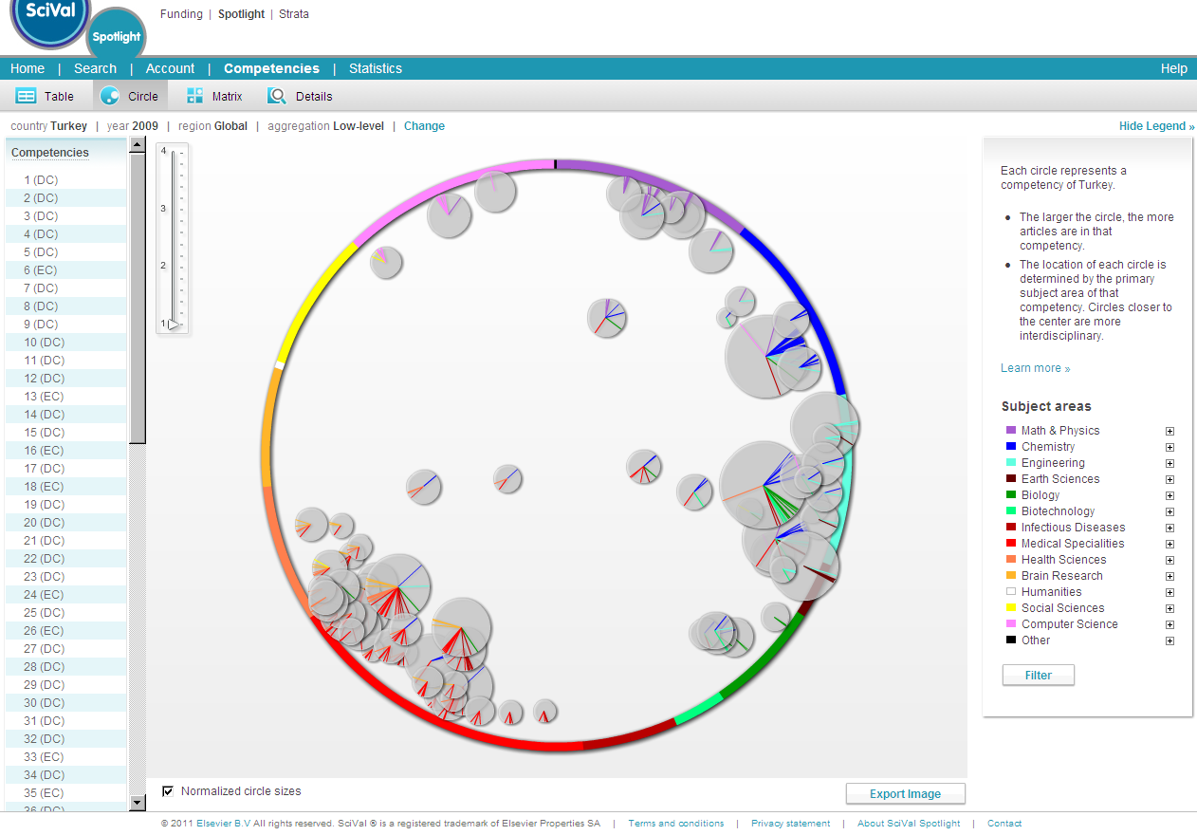
Turkey’s National Strengths
Research Topics
of Turkey’s
National Strengths
Computer Science
Physics/Math
Social Science
Chemistry
Competencies with
multiple colored lines
are multi-disciplinary
research areas
Brain Research
Engineering
Health Science
Earth Science
Biology
Medical Specialties
Biotechnology
Infectious Disease
Source: SciVal Spotlight (Turkey Map) (May 2011)
19

Slide 20
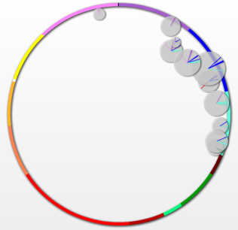
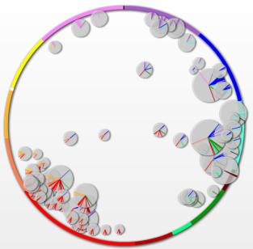


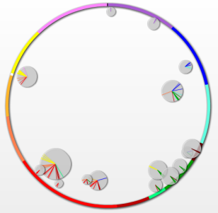
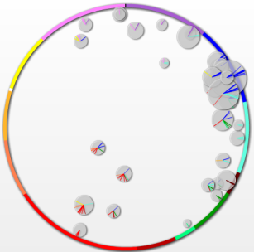


“Snapshot” of national research strength areas
EGYPT
TURKEY
11
Global Strength
Areas
76
Global
Strength
Areas
SOUTH
AFRICA
IRAN
16
Global Strength
Areas
34
Global
Strength
Areas

Slide 21
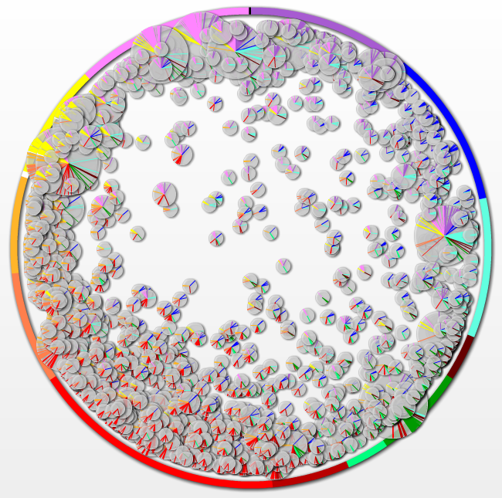
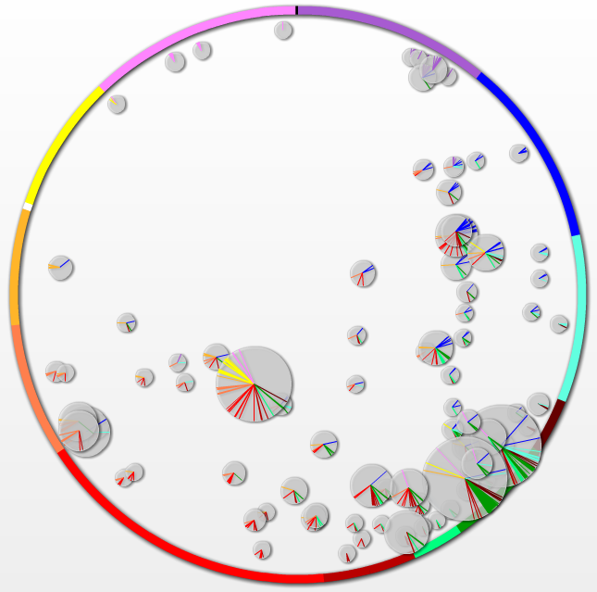
Research Strengths of other Nations
USA
Brazil
The maps of other nation across the world are available in SciVal Spotlight, allowing you to assess
Turkey’s strengths relative to other nation as well as for strategic planning and to identify opportunities for collaboration.
Source: SciVal Spotlight (US and Brazil Map) (May 2011)
21

Slide 22
Countries conducting research activity in areas as Turkey’s national strengths
80
70
60
50
Gross number of competencies*
40
30
20
10
0
USA
BRAZIL
INDIA
IRAN
CHINA
UK
ITALY
GREECE
SPAIN
TAIWAN
EGYPT
GERMANY
NETHERLAND
CANADA
Note: Gross total of competencies where institutions from each countries appeared as top 10 institutions in terms of number of fractionized
publications in each of Turkey’s global research competencies.
Source: SciVal Spotlight (Turkey Map) (May 2011)
22

Slide 23
Collaboration targets? – Brazilian Institutions actively conducting research in Turkey’s strength areas
# of Papers
Total Citations
900
1,600
800
1,400
700
1,200
600
1,000
500
800
400
300
600
200
400
100
200
0
0
Universidade de Sao Paulo
Universidade Estadual
de Campinas
Universidade de Sao Paulo
Universidade Estadual
de Campinas
Universidade Estadual Paulista
Julio de Mesquita Filho
Universidade Estadual Paulista
Julio de Mesquita Filho
Note: Numbers of papers and citations from each institution within areas of Turkey’s global research competencies.
Source: SciVal Spotlight (Turkey Map) (May 2011)
23

Slide 24
Collaboration targets? – Indian Institutions actively conducting research in Turkey’s strength areas
# of Papers
Total Citations
120
500
100
400
80
300
60
200
40
20
100
0
0
University of Madras
Anna University
Anna University
University of Madras
Aligarh Muslim University
CSIR - Chemistry and Physics
Note: Numbers of papers and citations from each institution within areas of Turkey’s global research competencies.
Source: SciVal Spotlight (Turkey Map) (May 2011)
24

Slide 25
Collaboration targets? – Iranian Institutions actively conducting research in Turkey’s strength areas
# of Papers
Total Citations
180
450
160
400
140
350
120
300
100
250
80
200
60
150
40
100
20
50
0
0
Islamic Azad
University
University of Tehran
Islamic Azad University
Amirkabir University
of Technology
Mazandaran University
Amirkabir University
of Technology
Mazandaran University
University of Tehran
Note: Numbers of papers and citations from each institution within areas of Turkey’s global research competencies.
Source: SciVal Spotlight (Turkey Map) (May 2011)
25

Slide 26
Collaboration targets? – US Institutions actively conducting research in Turkey’s strength areas
# of Papers*
Total Citations*
600
1,400
500
1,200
400
1,000
800
300
600
200
400
100
200
0
0
US Department
of Agriculture
University of
North Carolina
Baylor College
of Medicine
Medical College
at Georgia
US Department
of Agriculture
Harvard University
Harvard University
Washing ton University
at St. Louis
* Note: Numbers of papers and citations from each institution within areas of Turkey’s global research competencies.
Source: SciVal Spotlight (Turkey Map) (May 2011)
26

Slide 27
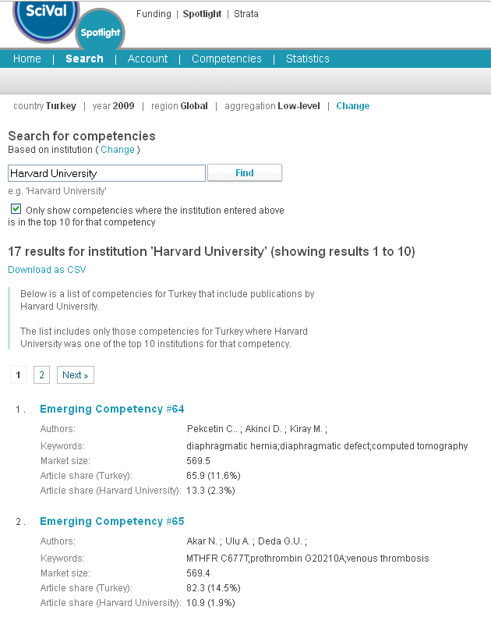
HARVARD UNIVERSITY AND TURKEY
What collaboration opportunities are available?
Find out where Harvard are also researching in Turkey’s strengths

Slide 28
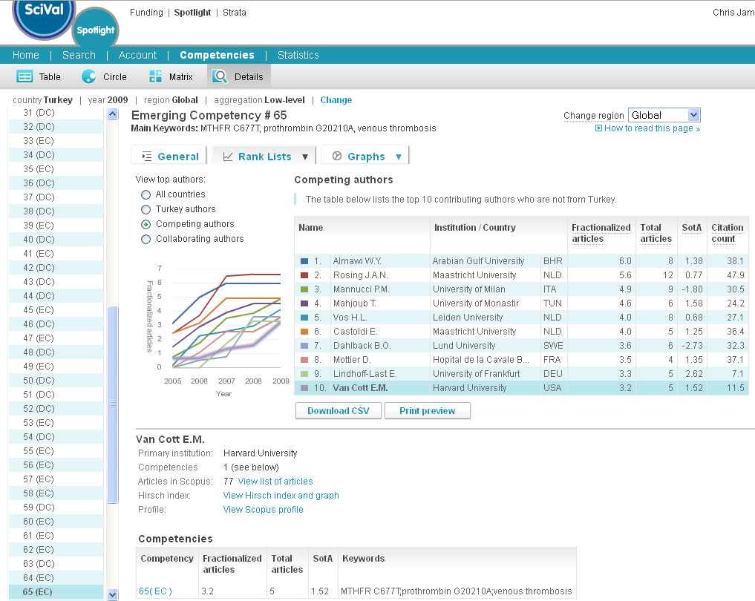
COMPETING AUTHORS IN A TURKEY STRENGTH
See the competing authors in this competency
Link to their author profile in SciVerse Scopus

Slide 29
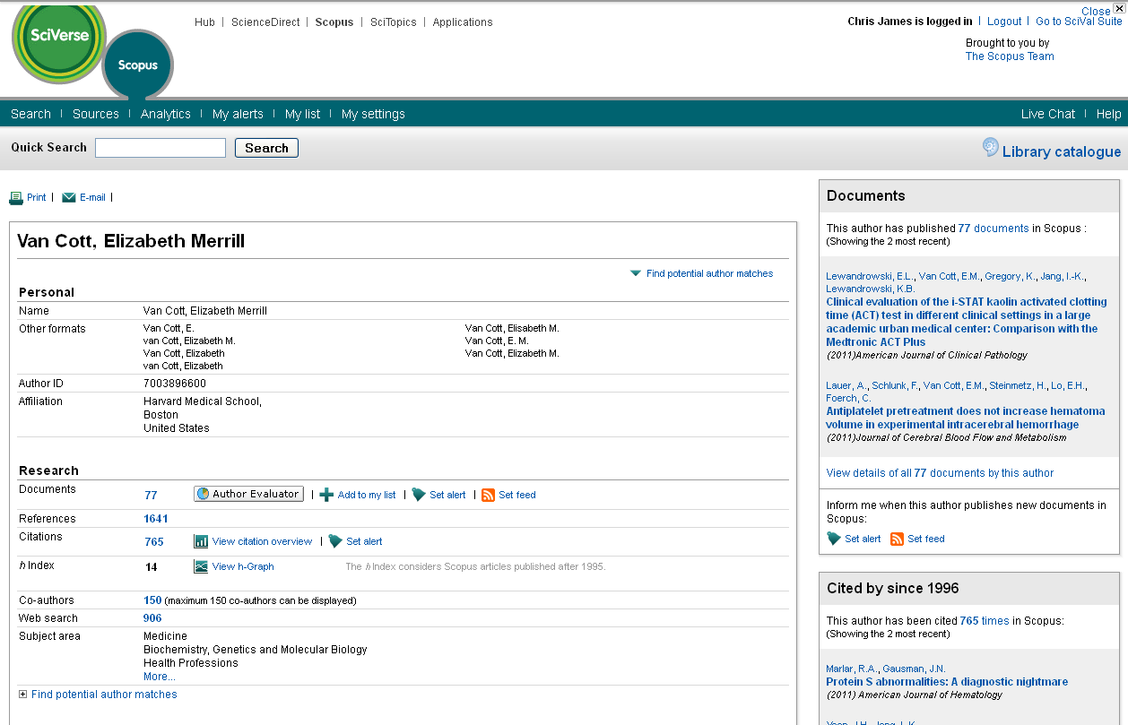
LEARN MORE ABOUT THE AUTHOR IN SCIVERSE SCOPUS
Look at their papers, citations references and h-index for high level information

Slide 30
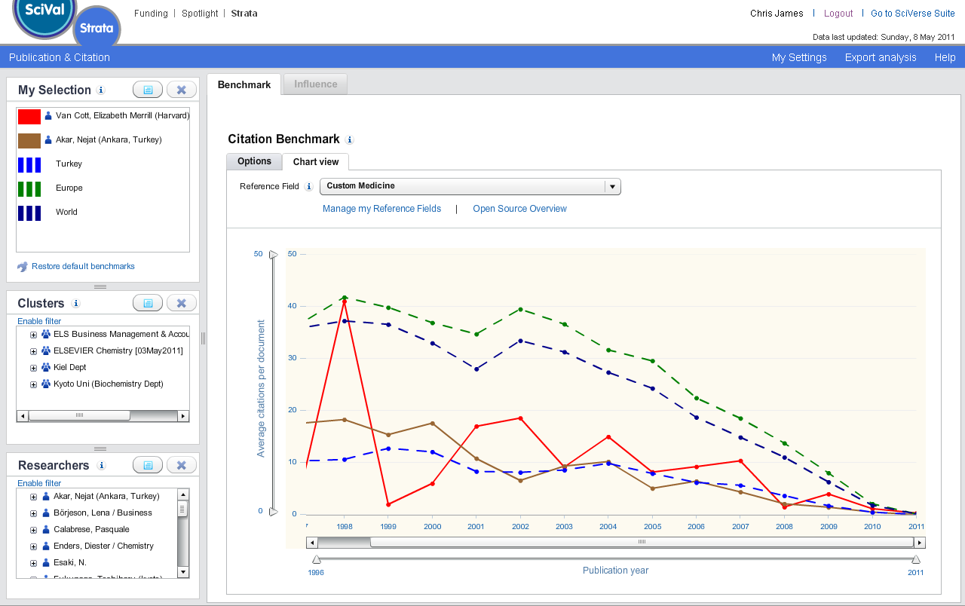
COMPARE AUTHOR PERFORMANCE
Compare the researcher against a top performing Turkish researcher in the same competency
Ankara researcher
Harvard researcher

Slide 31
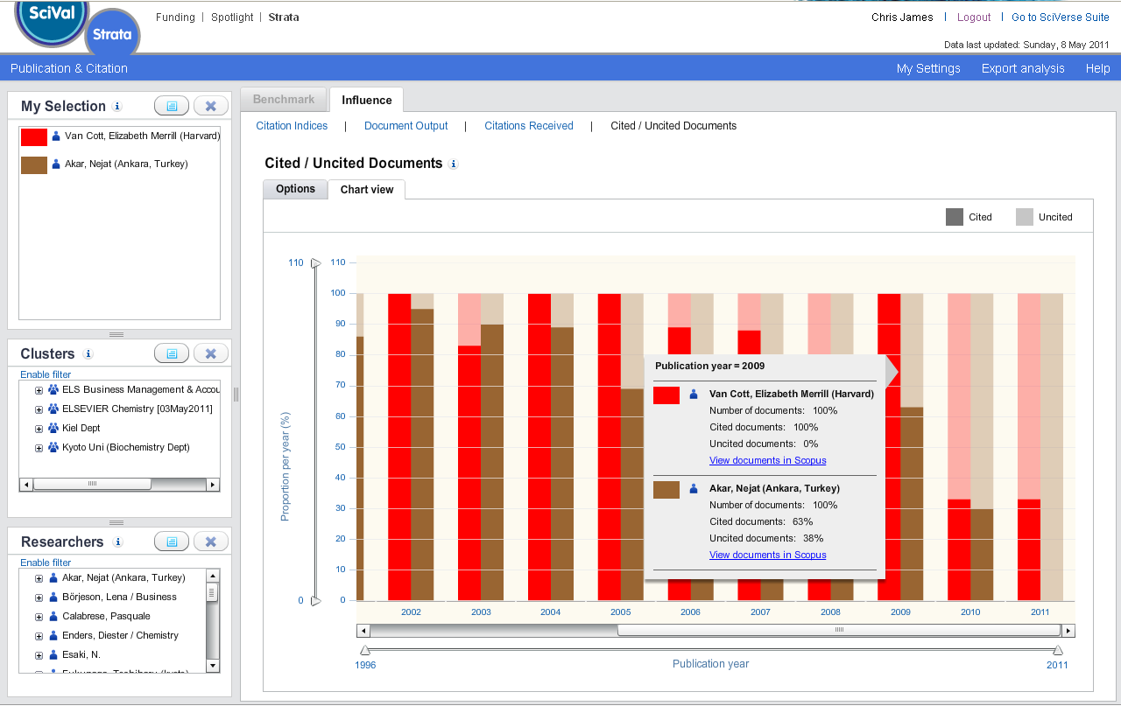
CITED VS UNCITED DOCUMENTS
Compare the quality of their work over time and link back to the source data in SciVerse Scopus

Slide 32
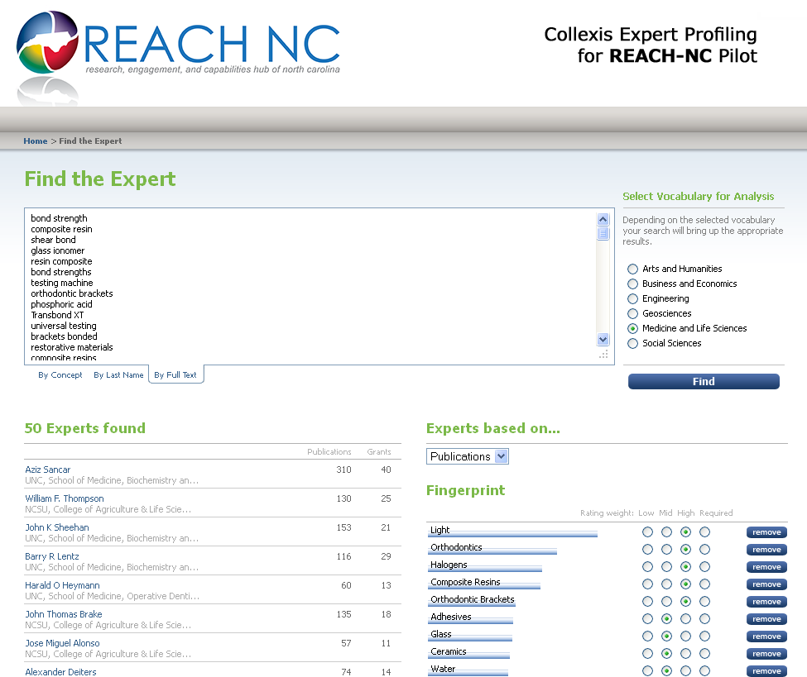
FIND RESEARCHERS USING SCIVAL EXPERTS
Copy and paste the keywords from the competency into North Carolina’s SciVal Experts implementation, to find relevant researchers
http://www.experts.scival.com/reachnc/

Slide 33
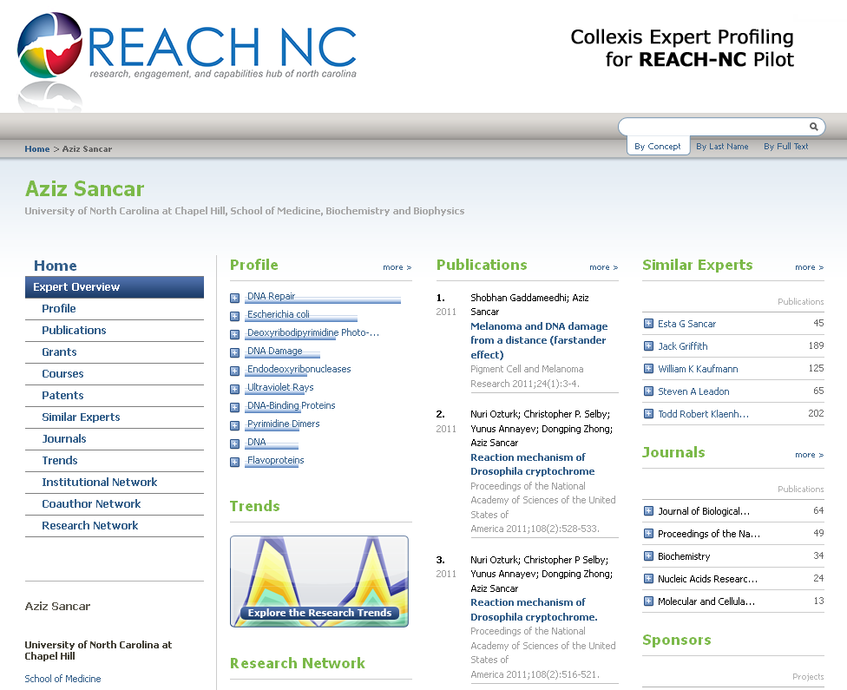
SCIVAL EXPERTS
Dig deeper to see further information about this researcher and who they work with

Slide 34








BASE DATA FOR ANALYSIS - SCIVERSE “SCOPUS”
SciVerse Scopus: The largest abstract and citation database of research information
18,000+ active titles from more than 5,000 international publishers including coverage of:
        Life Sciences
        Health Sciences
        Physical Sciences
        Social Sciences
        Arts and Humanities
Independent journal metrics
        SNIP: The Source-Normalized Impact per Paper corrects for differences in the frequency of citation across research fields.
        SJR: The SCImago Journal Rank reflects prestige of source - value of weighted citations per document.
34

Slide 35
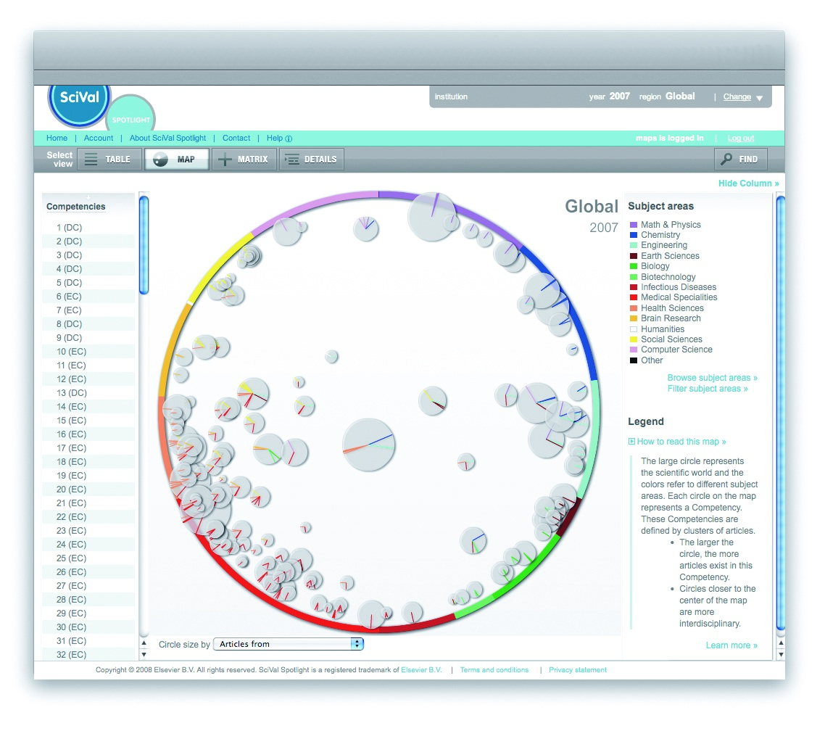
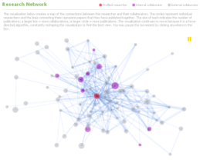
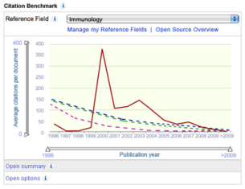
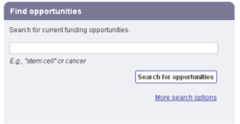
ELSEVIER
VARIOUS “SOLUTIONS” FOR VARIOUS “CHALLENGES”
Challenges
Solutions
Need to Identify Strengths
SciVal Spotlight
(Country, Institutional Map)
Encouraging “Collaborations”
SciVal Experts
Benchmarking Performance
SciVal Strata
Identifying Funding
Opportunities Effectively
SciVal Funding
Various analysis on your own
Scopus Custom Data
35

Slide 36
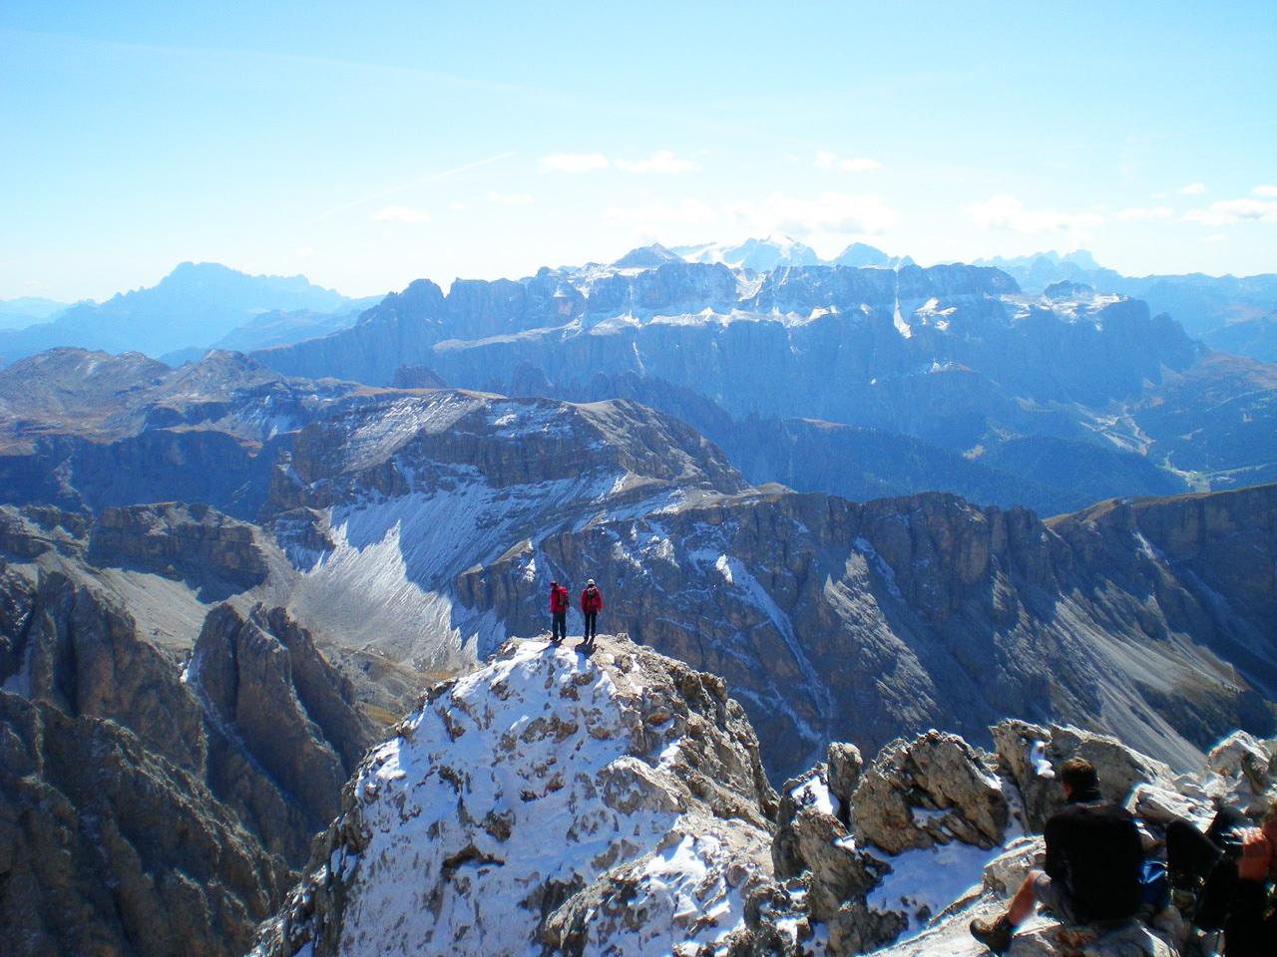


Summary
Thank You
Measuring research performance is getting more and more challenging
  Due to factors such as; emerging multi-disciplinary research,
  research activities conducted at a granular level
Combination of traditional metrics and new methodology can provide
various insight to research performance
  Evaluate whether past investments has contributed to
  the creation of a national level competency
  Identify emerging areas to focus going forward

