Slide 1

Scientific & Academic Research
Journal Evaluation Principles
and Process
Dr. Mila Cahue
Web of Science Europe Editor
V National Academic Publishing Mtng
Antalya, Turkey
2nd-3rd November, 2017

Slide 2
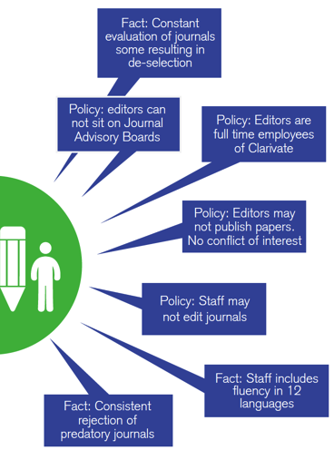


Web of Science is objective
Clarivate is not a commercial publisher; our editorial policies ensure we are publisher-neutral.
Notes:
Our editorial team works full-time on evaluations and collection management and has done so for many decades, day-in and day-out with no other professional commitments or conflicts of interest. The journal selection process is publisher neutral and applied consistently to all journals from our 3,300 publishing partners. Existing titles are constantly under review to ensure they maintain initial quality levels. Journal evaluation factors include: basic publishing standards, editorial content, international focus, citation analysis.

Slide 3
Web of Science champions ethical publishing practices
Clarivate Analytics requires strict standards of ethical publishing that include but are not limited to:
Refraining from misrepresenting the names, qualifications, or involvement of editorial board members.
Displaying clear and transparent statements regarding business models: subscription based or open access - article processing charges (APCs) or similar fees.
Refraining from all forms of plagiarism and copyright infringement.

Slide 4
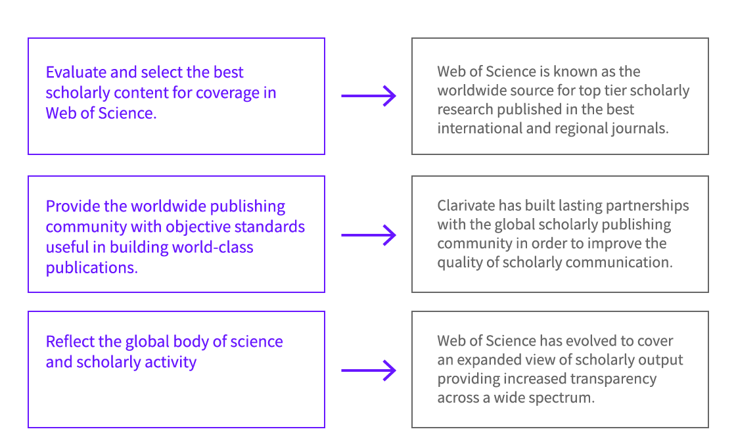
The Web of Science journal evaluation process has three main objectives that are independent from commercial activities.

Slide 5
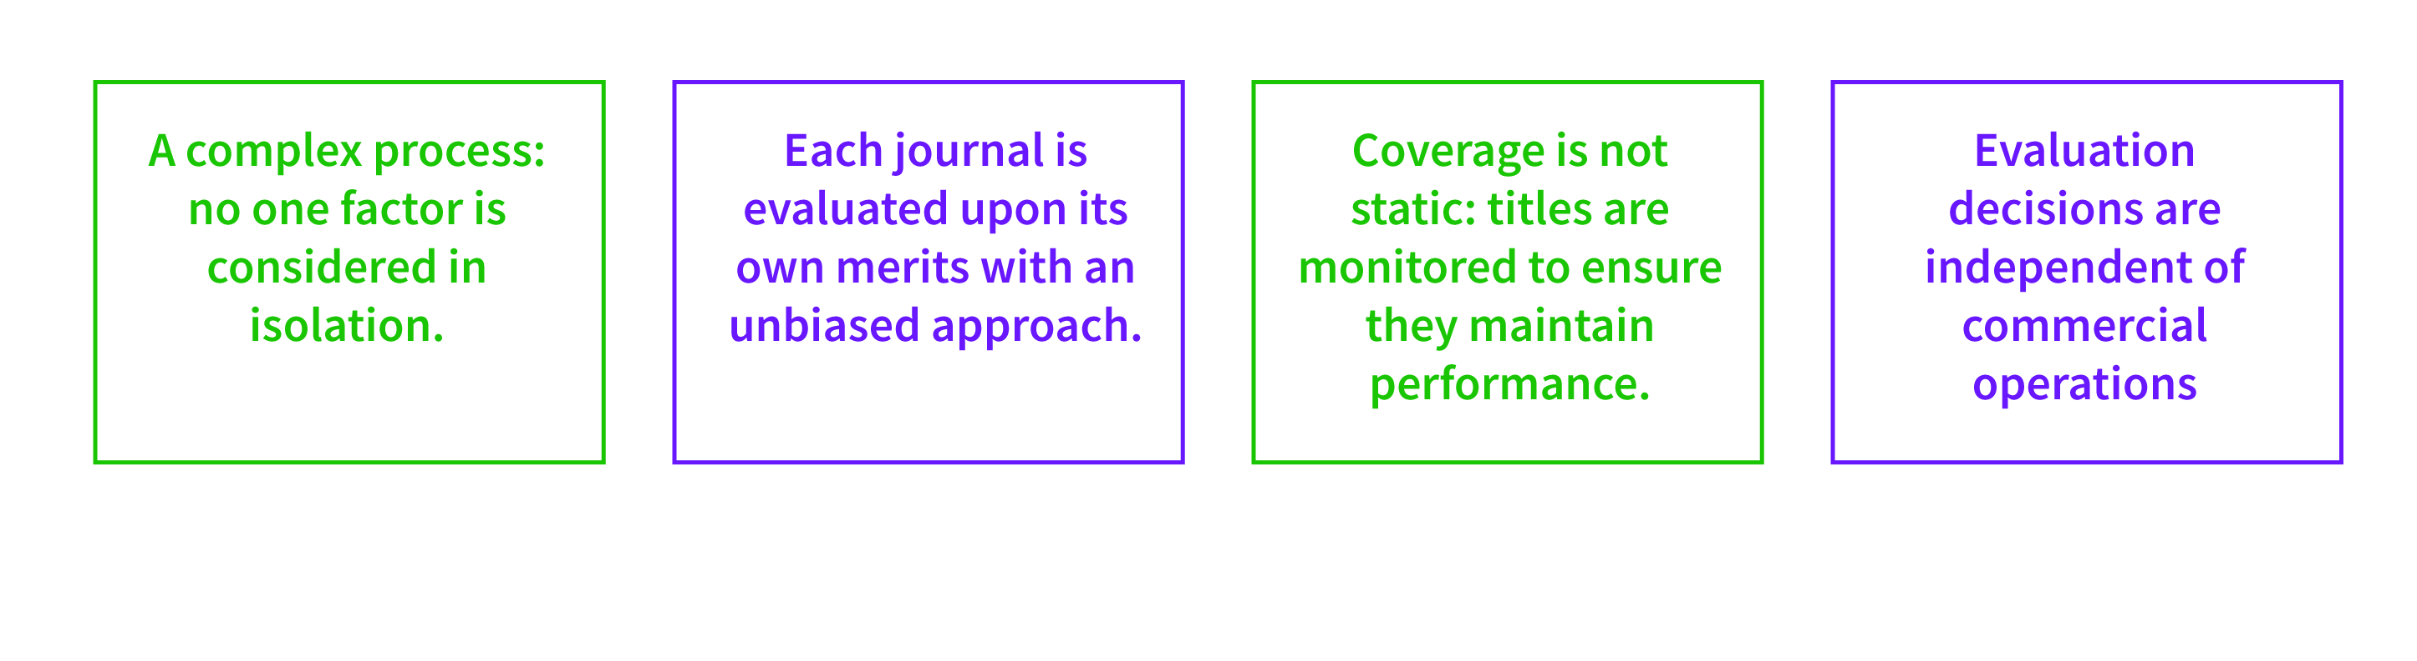
The guiding principles of the Web of Science journal selection process have remained consistent over 50 years
Selectivity – Objectivity - Transparancy
Each journal is evaluated based on consistent rigorous selection criteria including publishing standards, editorial content, citation performance, and collection enrichment
Evaluation decisions are publisher and geography neutral
Existing journal coverage is continuously assessed in order to maintain a stable collection and provide new content
Unbiased approach independent of sales creates a trusted and objective information resource

Slide 6
Evaluation process
Journal
submission
Continuous content curation enables movement between collections while maintaining stability of coverage
ESCI evaluation
High performing ranking titles may be added directly to SCIE, SSCI, or AHCI
Evaluation for additional products
Acceptance
Rejection
Acceptance
Quick decision
Add to SCIE SSCI A&HCI JCR
Add to ESCI
ESCI journals monitored for performance
Continous curation
To submit a journal: http://wokinfo.com/publisher_relations/journals/
6

Slide 7

Journals covered in ESCI are eligible for further evaluation and potential selection in the Science, Social Science, or Arts & Humanities citation indexes
Journals are first evaluated for ESCI (Emerging Sources Citation Index)
Then monitored and periodically evaluated for SCIE, SSCI, or AHCI
Journal may be added to SCIE/SSCI/AHCI or remain covered in ESCI
Journal continues coverage either in ESCI or SCIE, SSCI, AHCI
Evaluated for
SCIE, SSCI, AHCI
Evaluated/accepted for ESCI
SCIE – Science Citation Index Expanded (included in JCR)
SSCI – Social Sciences Citation Index (included in JCR)
AHCI – Arts & Humanities Citation Index
ESCI – Emerging Sources Citation Index
Notes:
ESCI ensures global research coverage while providing a corpus of journals for rigorous evaluation and selection to SCIE, SSCI, and AHCI.
Minimal criteria for ESCI - content
must exhibit:
Peer Review
Ethical Publishing Practices
High Interest to a scholarly community
(Scholars, researchers, funding bodies,
research administrators)
The ability to meet Clarivate indexing requirements
Full assessment SCIE, SSCI, AHCI
Globally Accepted Editorial conventions
English Bibliographic Information
Timeliness
Peer Review
Strong Editorial board
Ethical Publishing Practices
Regional Diversity and Global Collaboration
Appropriate Diversity of Editorial Board
Appropriate Diversity of Authorship
The ability to meet our technical requirement
Consistently high interest to the global scholarly community (Scholars, researchers, funding bodies, research administrators)
Significant Global Impact relative to its field (citation and ranking in category)
Reasons for rejection can include:
Low author diversity
% of articles written by editorial board
Low citation impact of journal in WoS
Authors not well cited
Non-diversity of editorial board
High self-citation rate
Content and scope is already well covered

Slide 8
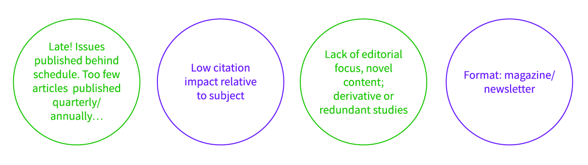
Journals that no longer meet the rigorous criteria for coverage are deselected
Re-evaluation will be subject to the same criteria and principles applied when the journal was initially accepted for coverage.
Most frequent reasons for rejection or de-selection
Journals rejected for SCIE, SSCI, and AHCI can remain indexed in their current databases and be scheduled for a re-evaluation.

Slide 9
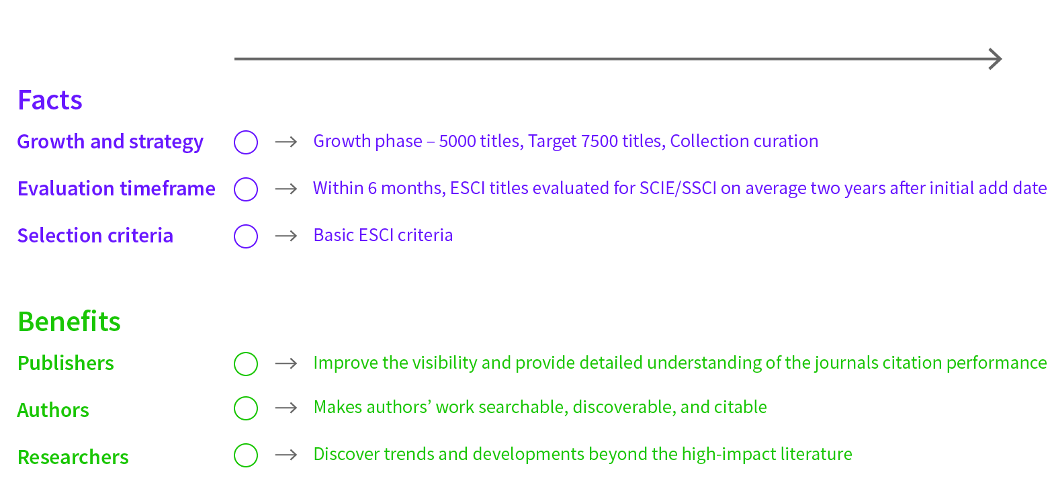
ESCI ensures global research coverage while providing a corpus of journals for rigorous evaluation and selection to SCIE, SSCI, and AHCI

Slide 10
Selection Process for ESCI follows our rigorous criteria, being the minimum:
Evidence of peer review
Ethical publishing practices
Titles, Abstracts, Keywords in English.
Current contents online
(XML / PDF)
Timeliness

Slide 11
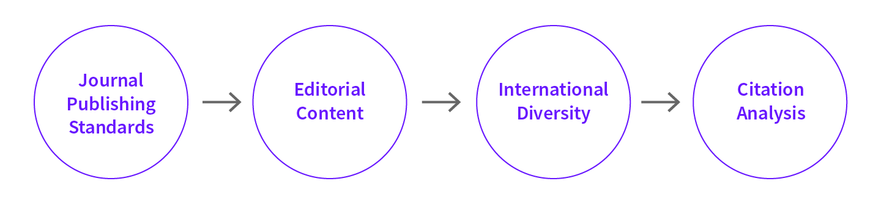
Journal Selection Criteria are applied consistently and objectively to each journal
Timeliness of publication
International Editorial Conventions
English language Bibliographic Information
Peer Review
How does this journal compare with covered journals of similar scope?
Is this subject already well covered?
Will this journal enrich WoS with novel content?
Does this journal target an International or Regional audience?
Is international representation among Authors and EAB members appropriate for this journal?
Total Citations:
Integration of the journal into the literature over time
Impact Factor:
Recent citation activity
Author, EAB citations in the literature.

Slide 12
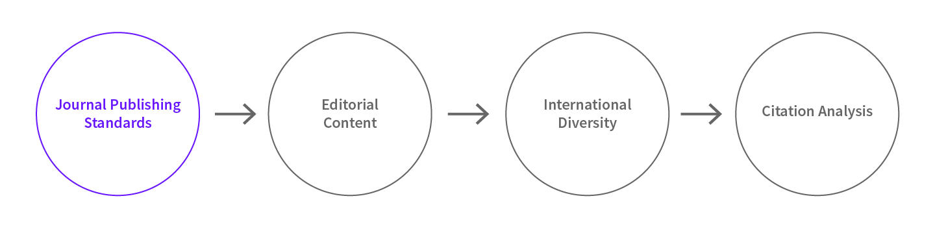
Journal Selection Criteria - Timeliness
Timeliness of publication
International Editorial Conventions
English language Bibliographic Information
Peer Review

Slide 13
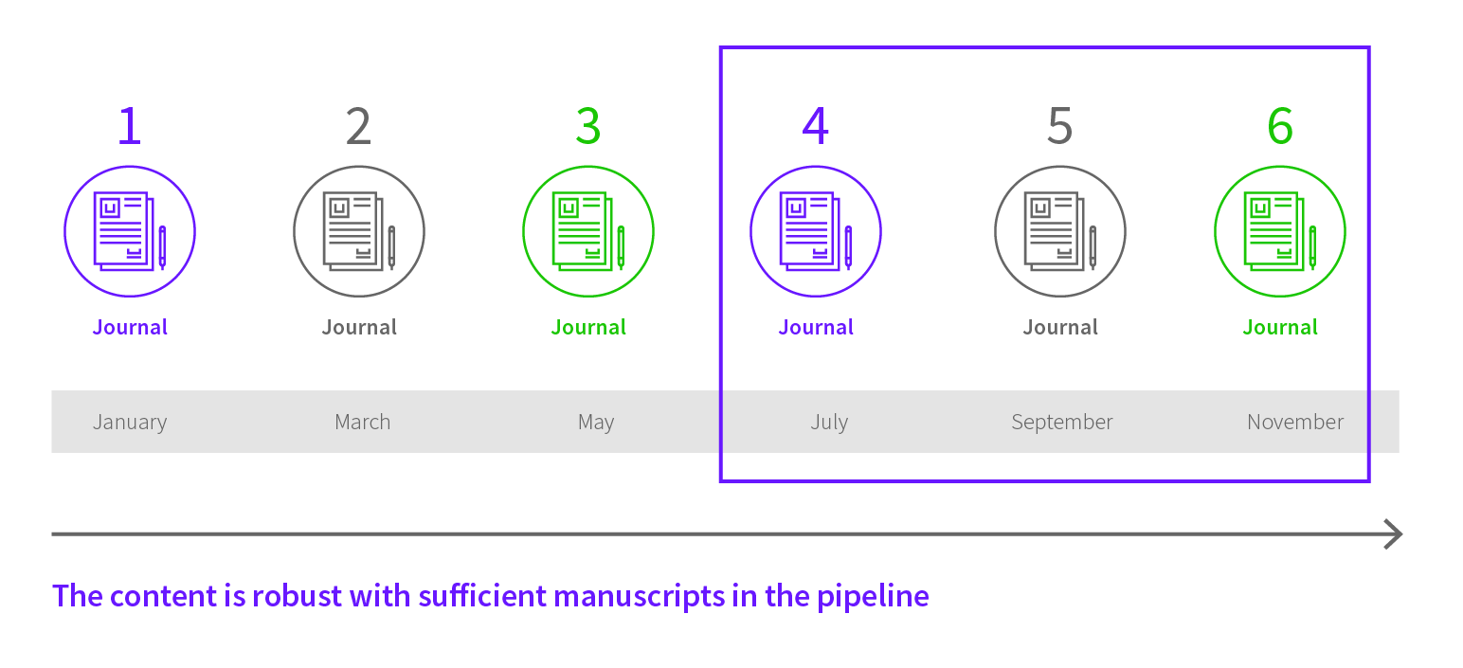
The journal should publish on time according to its publishing schedule
For electronic-only journals that publish continuously, a minimum of 20 articles per year is considered a healthy influx of contributions
We must receive three current issues on time in sequence to begin evaluation

Slide 14
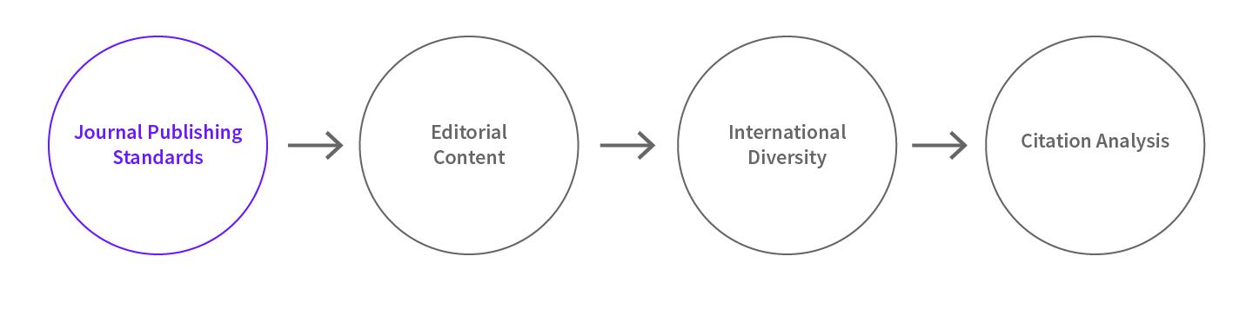
Journal Selection Criteria – international editorial conventions
Timeliness of publication
International Editorial Conventions
English language Bibliographic Information
Peer Review

Slide 15

International Editorial Conventions
Informative Journal titles
Fully descriptive Article titles and abstracts
Full address information for every author

Slide 16
Funding source is also recommended whenever possible

Slide 17
Journal Selection Criteria – English language requirements
Timeliness of publication
International Editorial Conventions
English language Bibliographic Information
Peer Review

Slide 18
Journal Selection Criteria – Peer Review
Timeliness of publication
International Editorial Conventions
English language Bibliographic Information
Peer Review

Slide 19
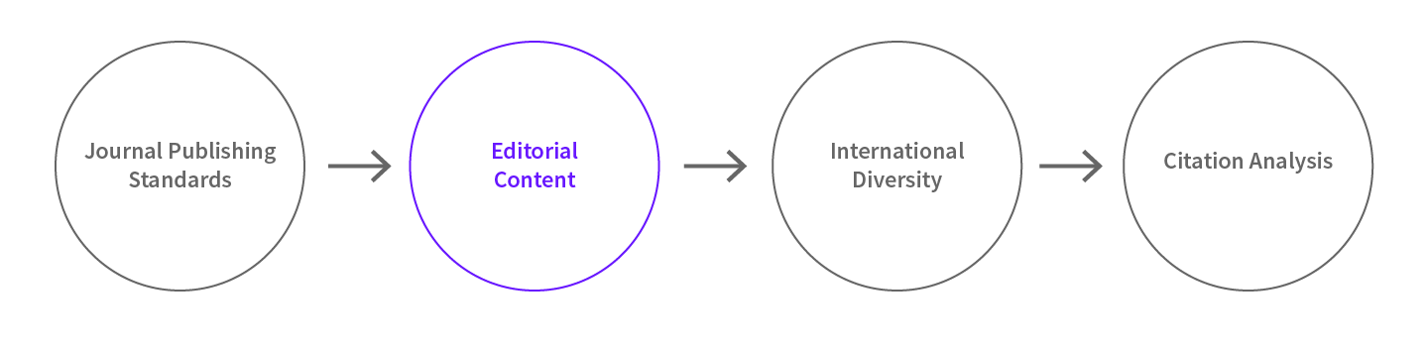
Journal Selection Criteria – Editorial assessment
How does this journal compare with covered journals of similar scope?
Is this subject already well covered?
Will this journal enrich WoS with novel content?
Subject relevance - the relationship of the journal under evaluation to journals already covered in a particular area or product.
Content relevance - the journal needs to publish scholarly content consistent with the journal’s declared aims and scope.

Slide 20
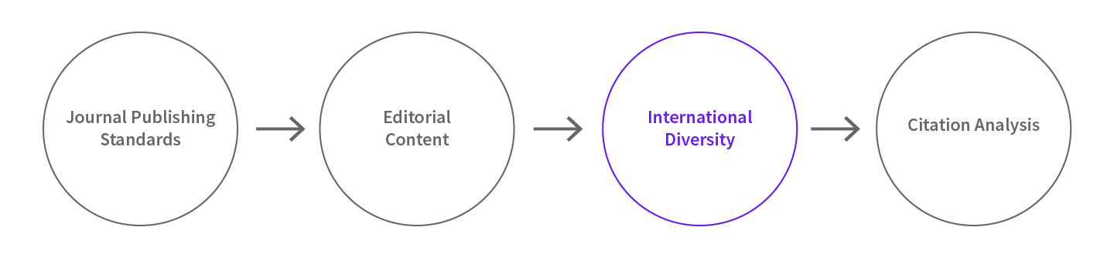
Journal Selection Criteria – diversity requirements
Does this journal target an International or Regional audience?
The geographical distribution and representation of the editorial board and authorship are considered in the context of the journal’s target audience and scope.
Citation Impact may be low to moderate – but stable

Slide 21
Journal Selection Criteria – Citation Analysis
Citation analysis is performed on the journal title, editorial board members and authors

Slide 22
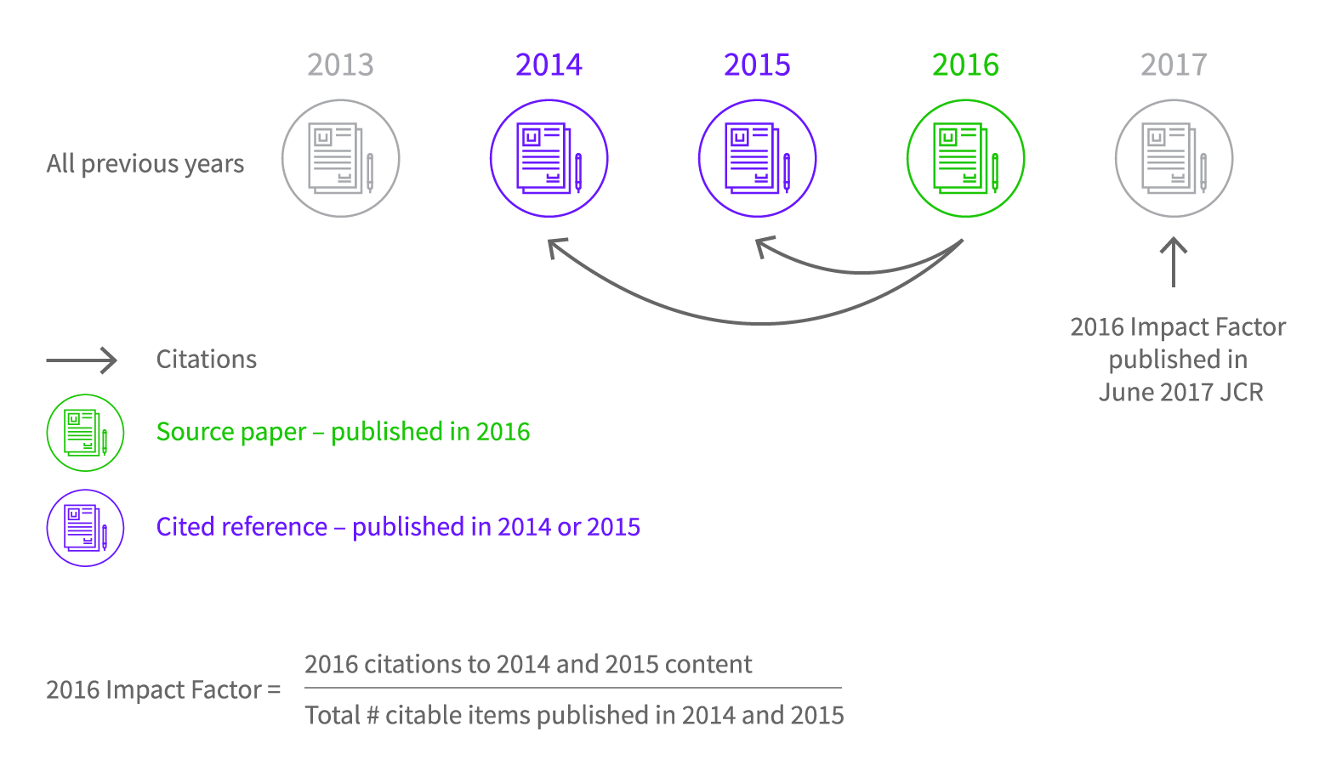
Impact Factor Calculation

Slide 23
Self-citation at all levels is acceptable if not excessive in the context of specific research areas.
85%
Most journals have self-citation rates of less than or equal to 15%
Source: JCR Science Edition (2010)
  Excessive self-citation weakens the integrity of the journal’s Impact Factor
  Journals with excessive self-citation may be suppressed from Journal Citation Reports until the problem is corrected

Slide 24
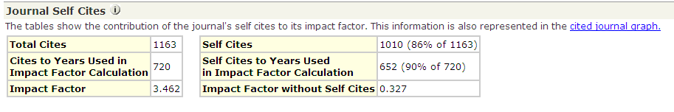
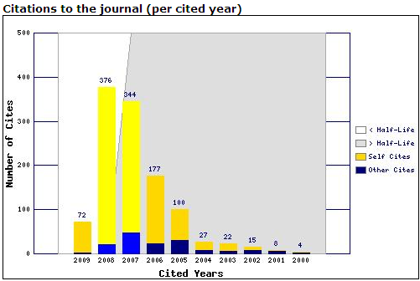
Journals can be suppressed from JCR for excessive self-citation
Suppression is not de-selection from coverage; journals can remain indexed in Web of Science while investigated for excessive self-citation
Effect of Self Citations on rank in category:
From Q1
To Q4

Slide 25

Inclusion of “How to cite this article” will minimize the probability
of losing citations
EXAMPLE:

Slide 26
Journal Publication must always be subject to improvements:
Enrollment of more internationally high impact researchers in journal editorial board
Active recruitment of high-impact articles by courting researchers
Article selection
Better services offered to authors
Boosting the journal’s media profile
M. Chew, E. V. Villanueva, and M. B. Van Der Weyden, Journal of the Royal Society of Medicine 100 (3), 142 (2007).

Slide 27
Editors, researchers, publishers and members of the Scientific/Academic Communities are invited to join our free online OPEN HOUSE SESSIONS
Better understanding of the Journal Selection Process
Answer to questions related to Journal Selection
Specify the roles of different editions
Monthly Frequency: in English and in Spanish
One hour and a quarter duration
Registration and reference required
mila.cahue@clarivate.com

Slide 28
How do I submit a journal for inclusion in the Web of Science ?
Check existing coverage
Ensure that the journal meets basic selection
criteria outlined in the selection essay
Contact Publisher Relations and fill out the
journal submission form with all required information
http://ipscience.thomsonreuters.com/info/journalsubmission-front/
Who can submit a journal for evaluation?
Editors and publishers can submit journals; we also receive recommendations from the academic community and customers

Slide 29
TURKISH JOURNALS IN WEB OF SCIENCE
FLAGSHIP IF = 64 63
ESCI = 104 137
SCIE |  | SSCI
May 2017 | Oct 2017 | May 2017 | Oct 2017
54 | 53 | 10 | 10
Q2 = 02 | Q2 = 02
Q3 = 09 | Q3 = 15 | Q3 = 02 | Q3 = 01
Q4 = 43 | Q4 = 36 | Q4 = 08 | Q4 = 09
 | May 2017 | Oct 2017
Agr., Bio&Envi | 00 | 03
ENGINE. | 05 | 08
LIFE SCI. | 06 | 09
PHYSI. | 07 | 09
A&H | 11 | 16
SS/Bh. Sc. | 15 | 31
CLIN.MED | 60 | 61

